Slide 1


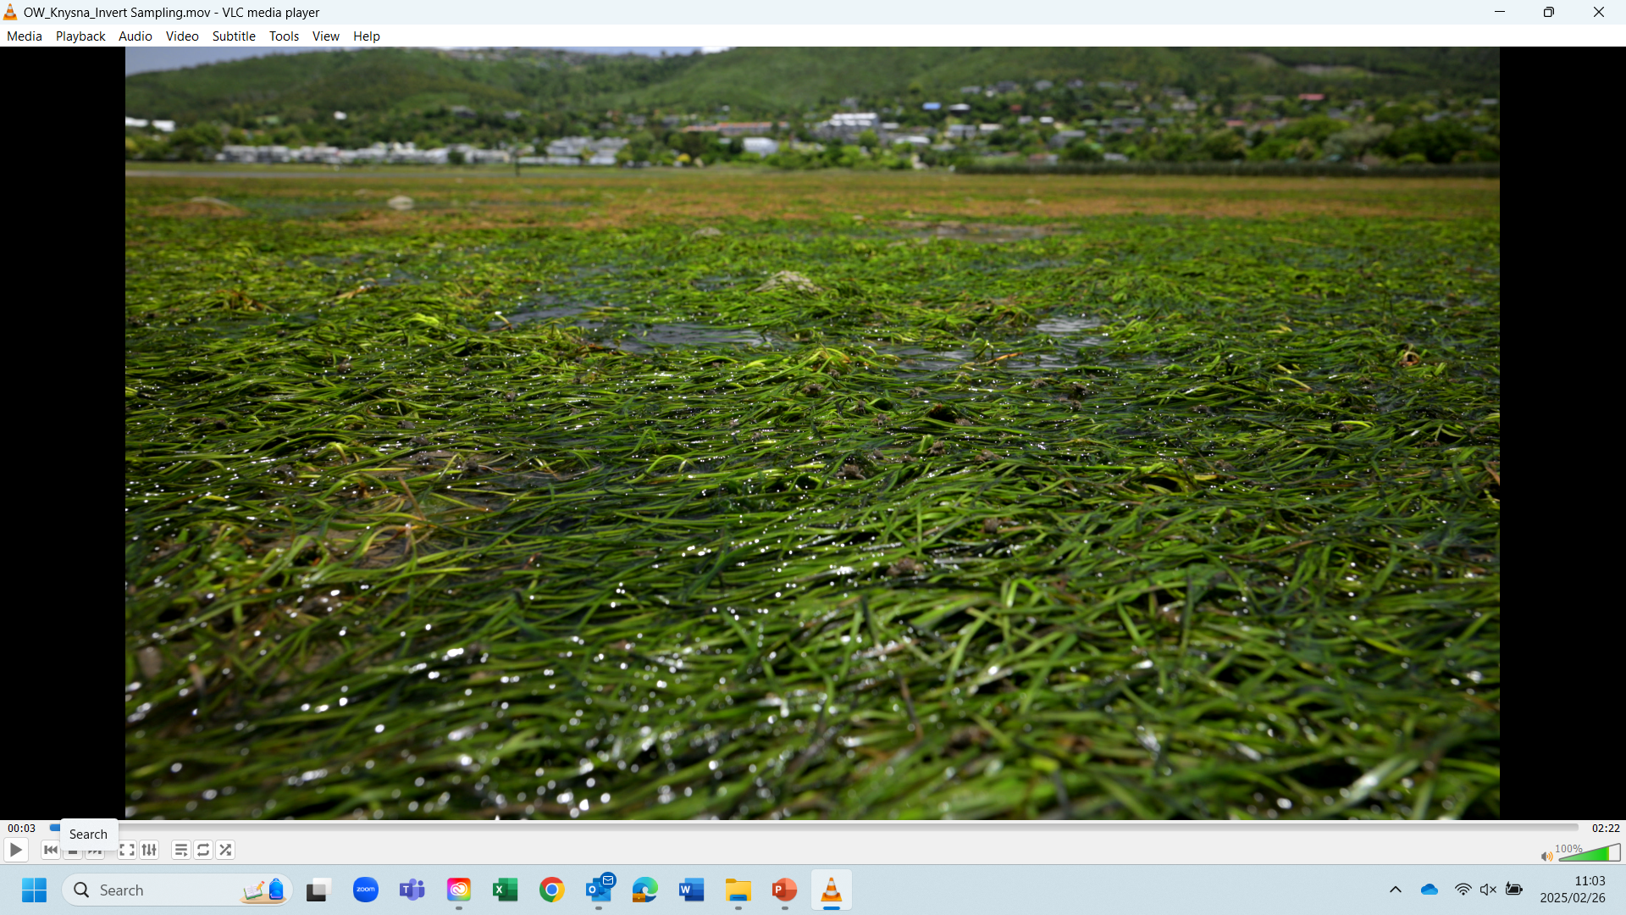

Science to action: SHALLOW WATER ECOSYSTEMS
Janine.Adams@mandela.ac.za
Transdisciplinary Ocean Sciences & Ocean Sustainability Activism Symposium
Co-hosted by Ocean Sciences, Nelson Mandela University and the Centre for Black Planetary Studies, ISHS, UNISA : 27 – 28 May 2026

Slide 2

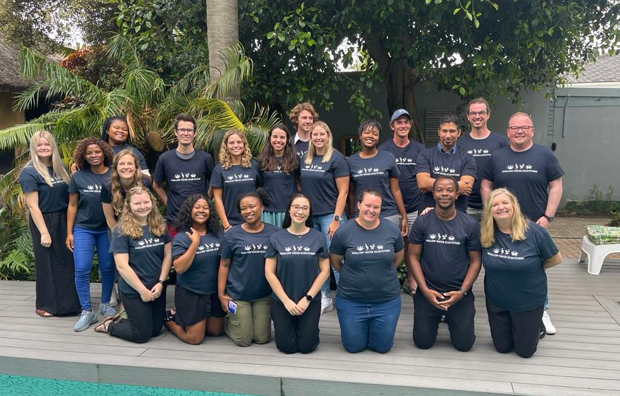



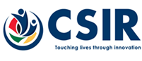
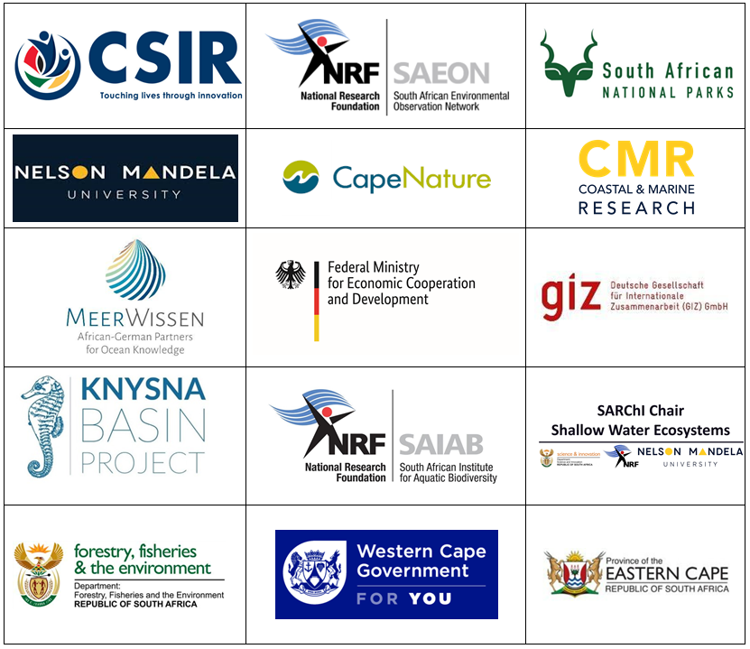


ACKNOWLEDGEMENTS
Notes:
ACKNOWLEDGEMENTS

Slide 3
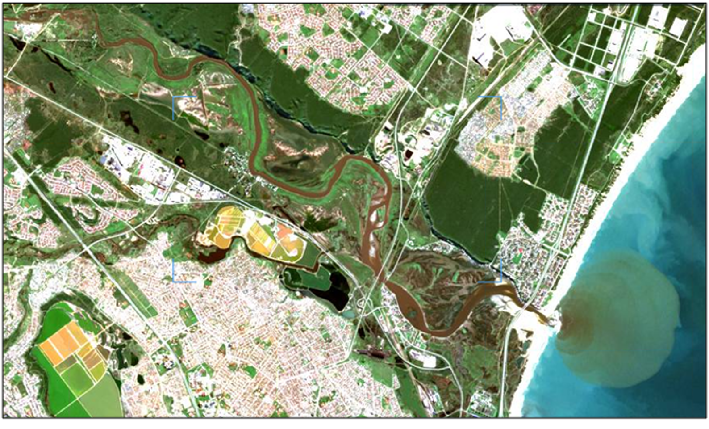

Slide 4
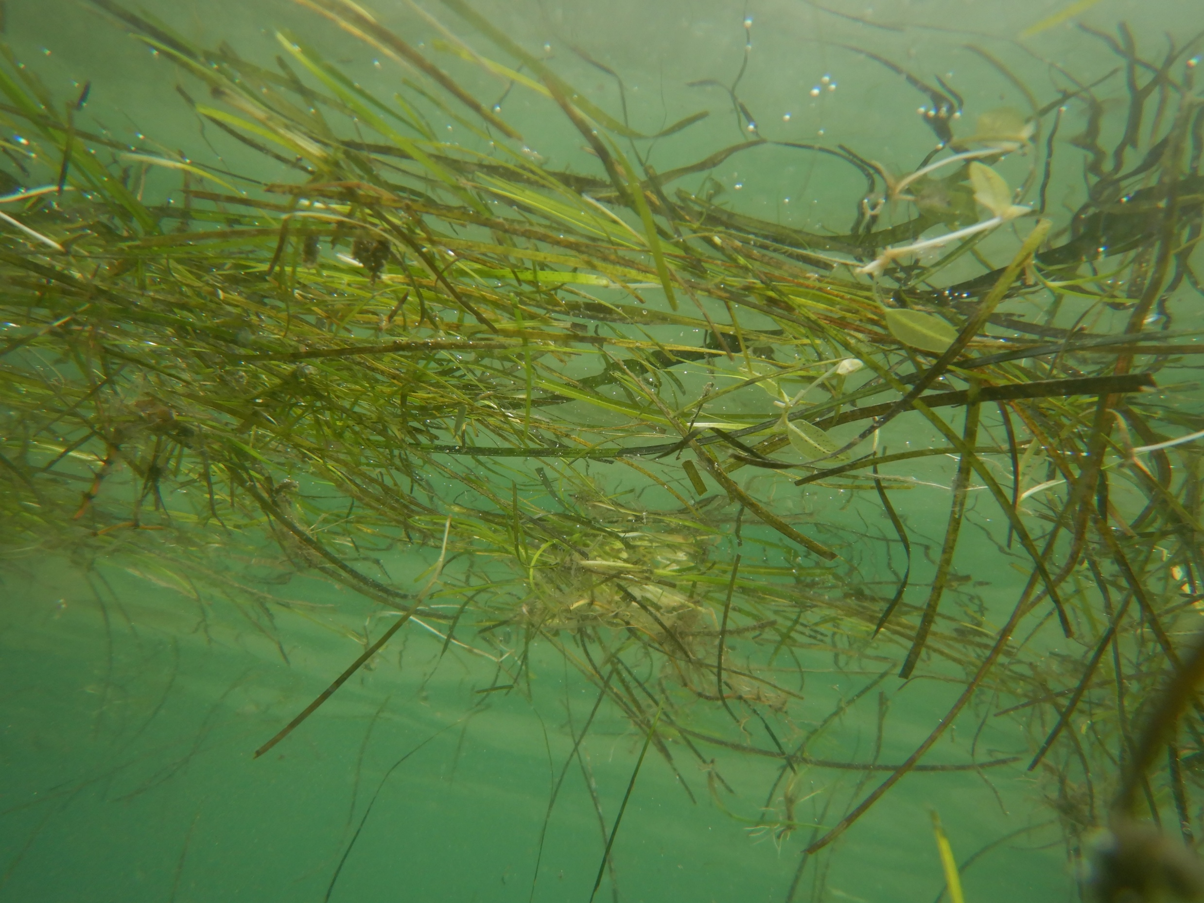
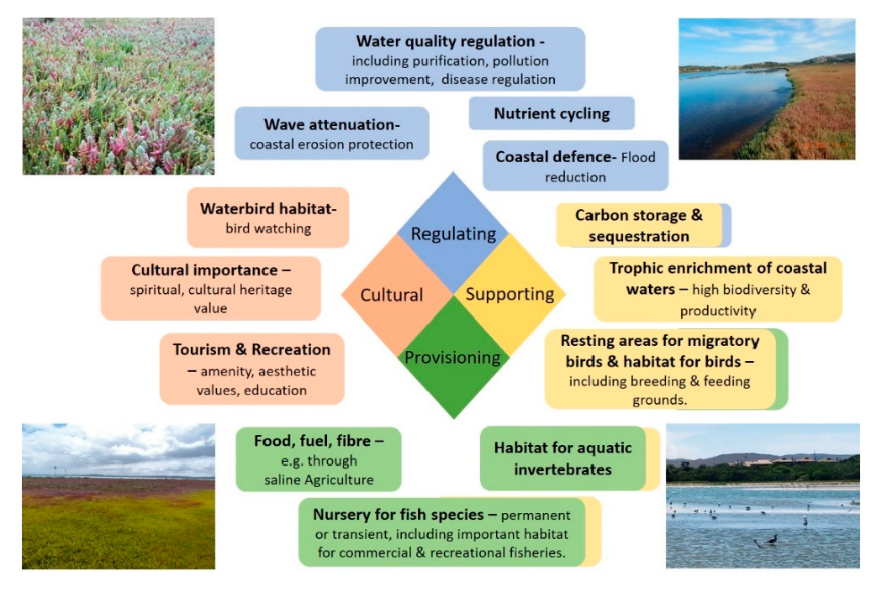
Healthy estuaries provide the ecosystem services that we are dependent on
Notes:
Foundation species….

Slide 5



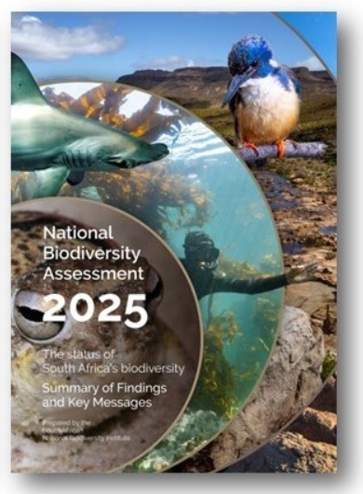
South Africa’s National
Biodiversity Assessment (NBA)

Slide 6


Estuary Management Plans
Integrated Coastal Management Act - cooperative management as set out in National Estuaries Management Protocol, using Estuarine Management Plan guidelines

Slide 7
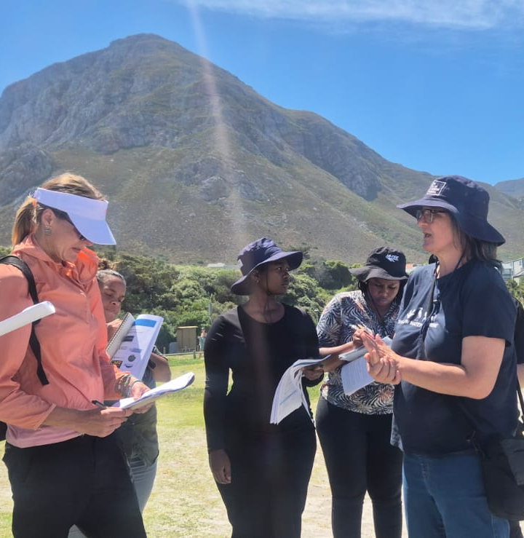
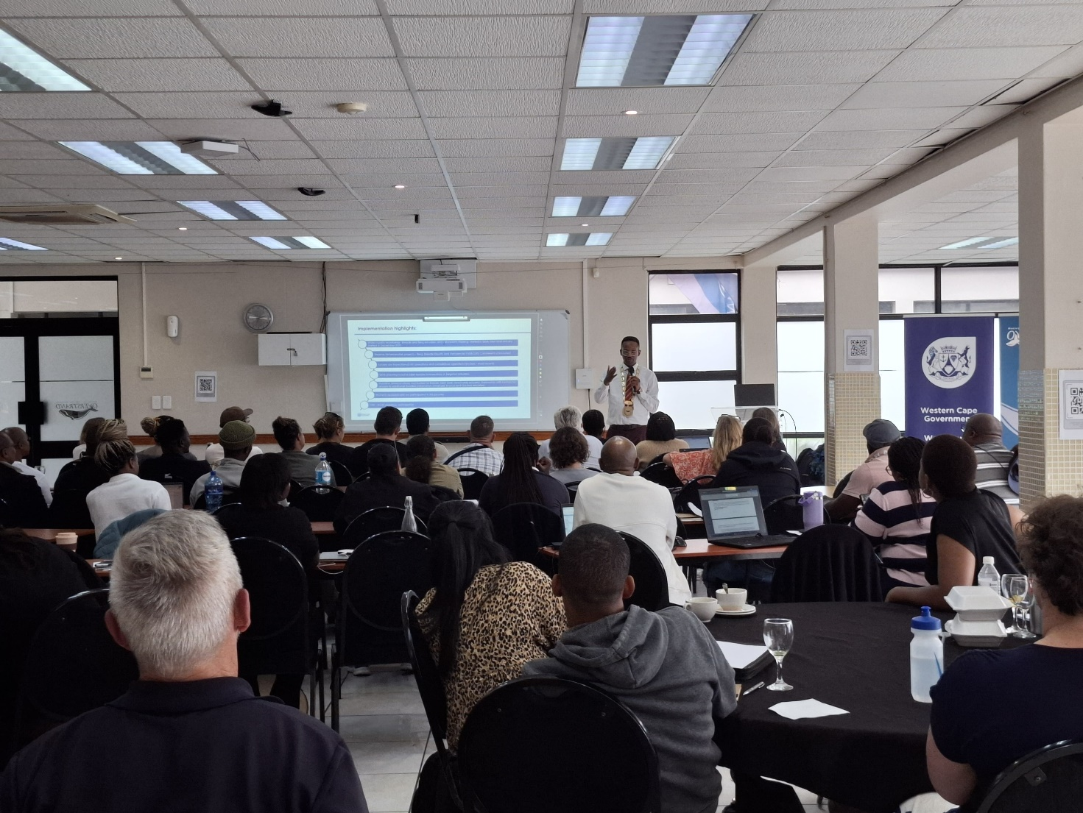
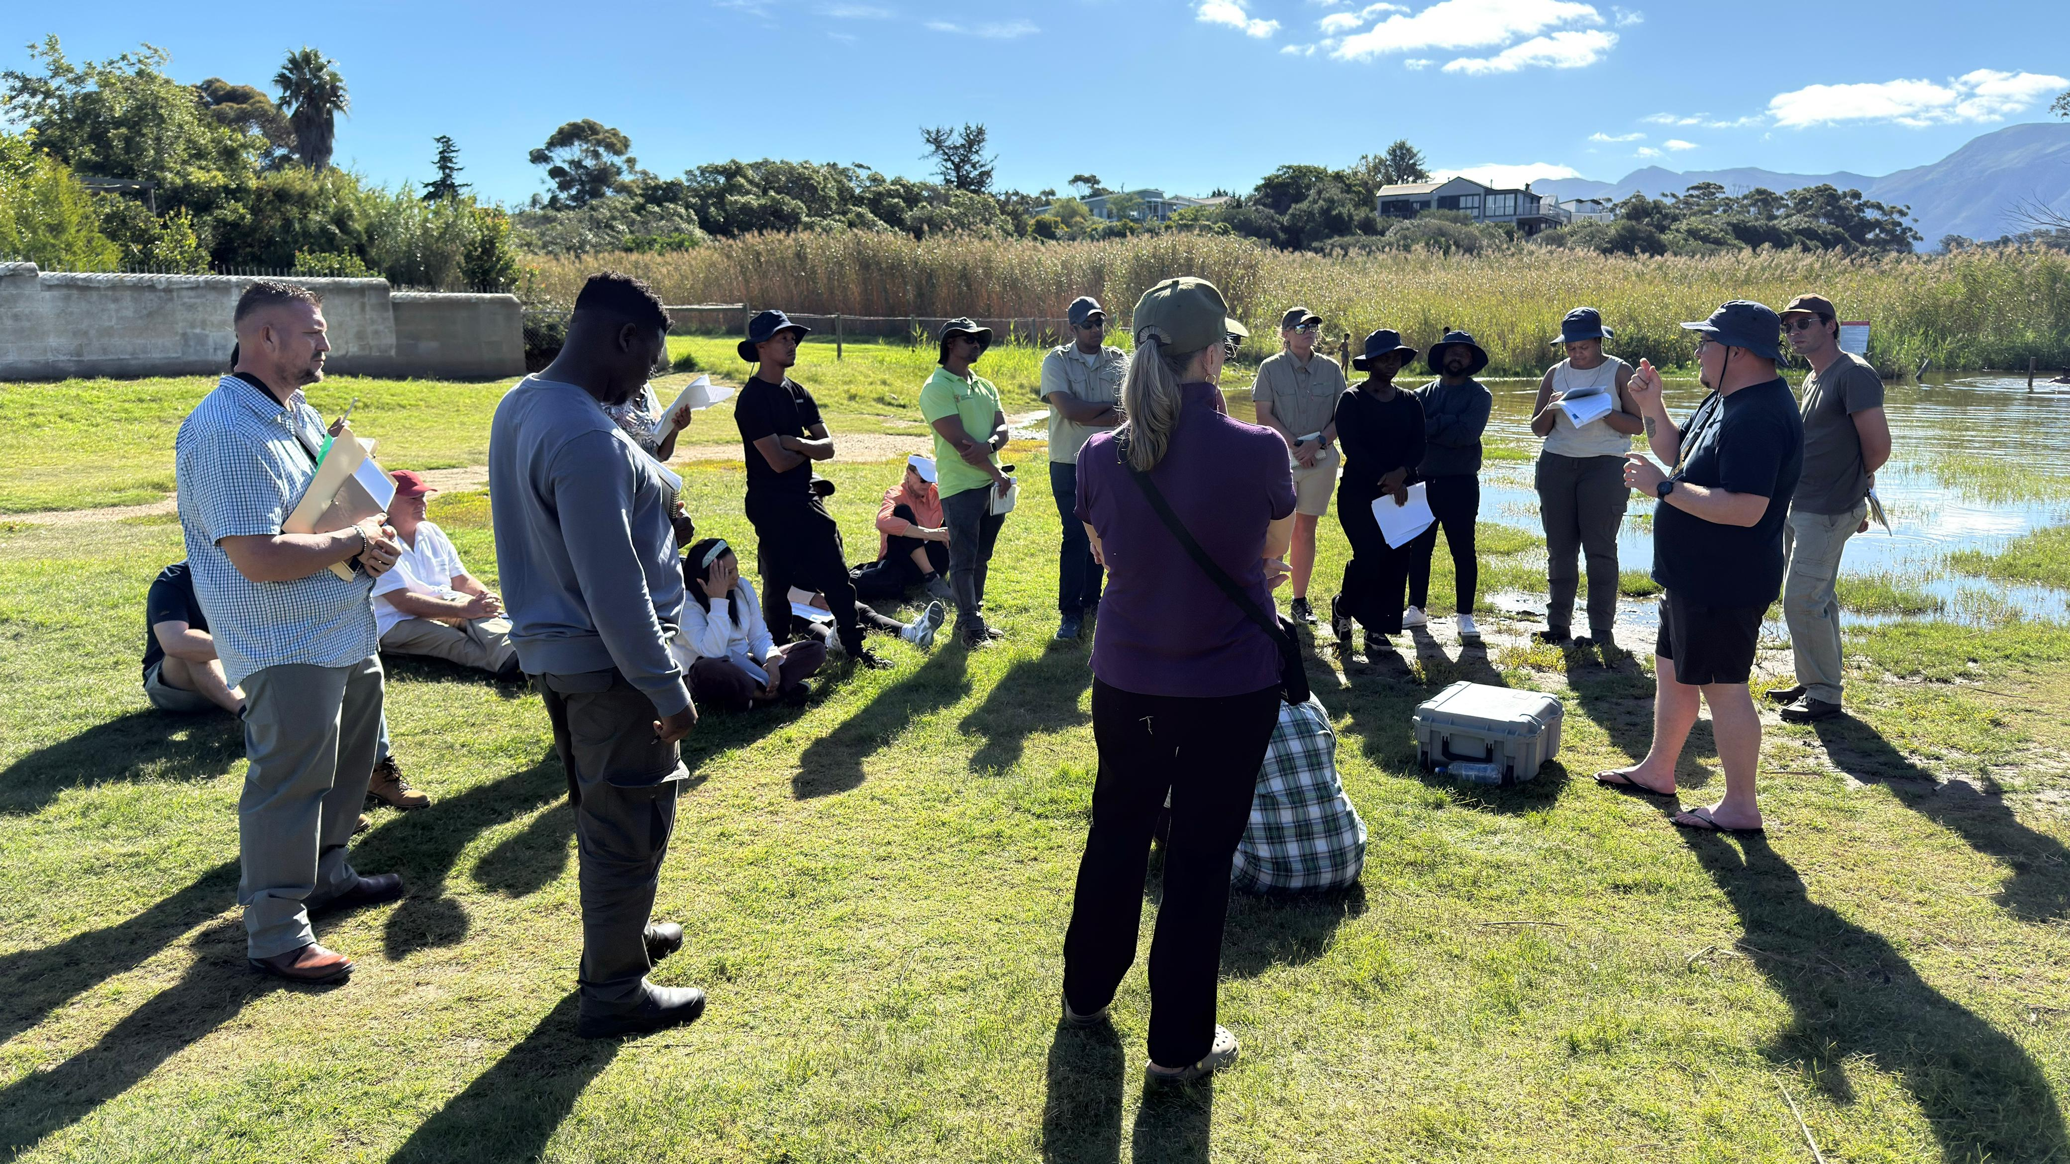
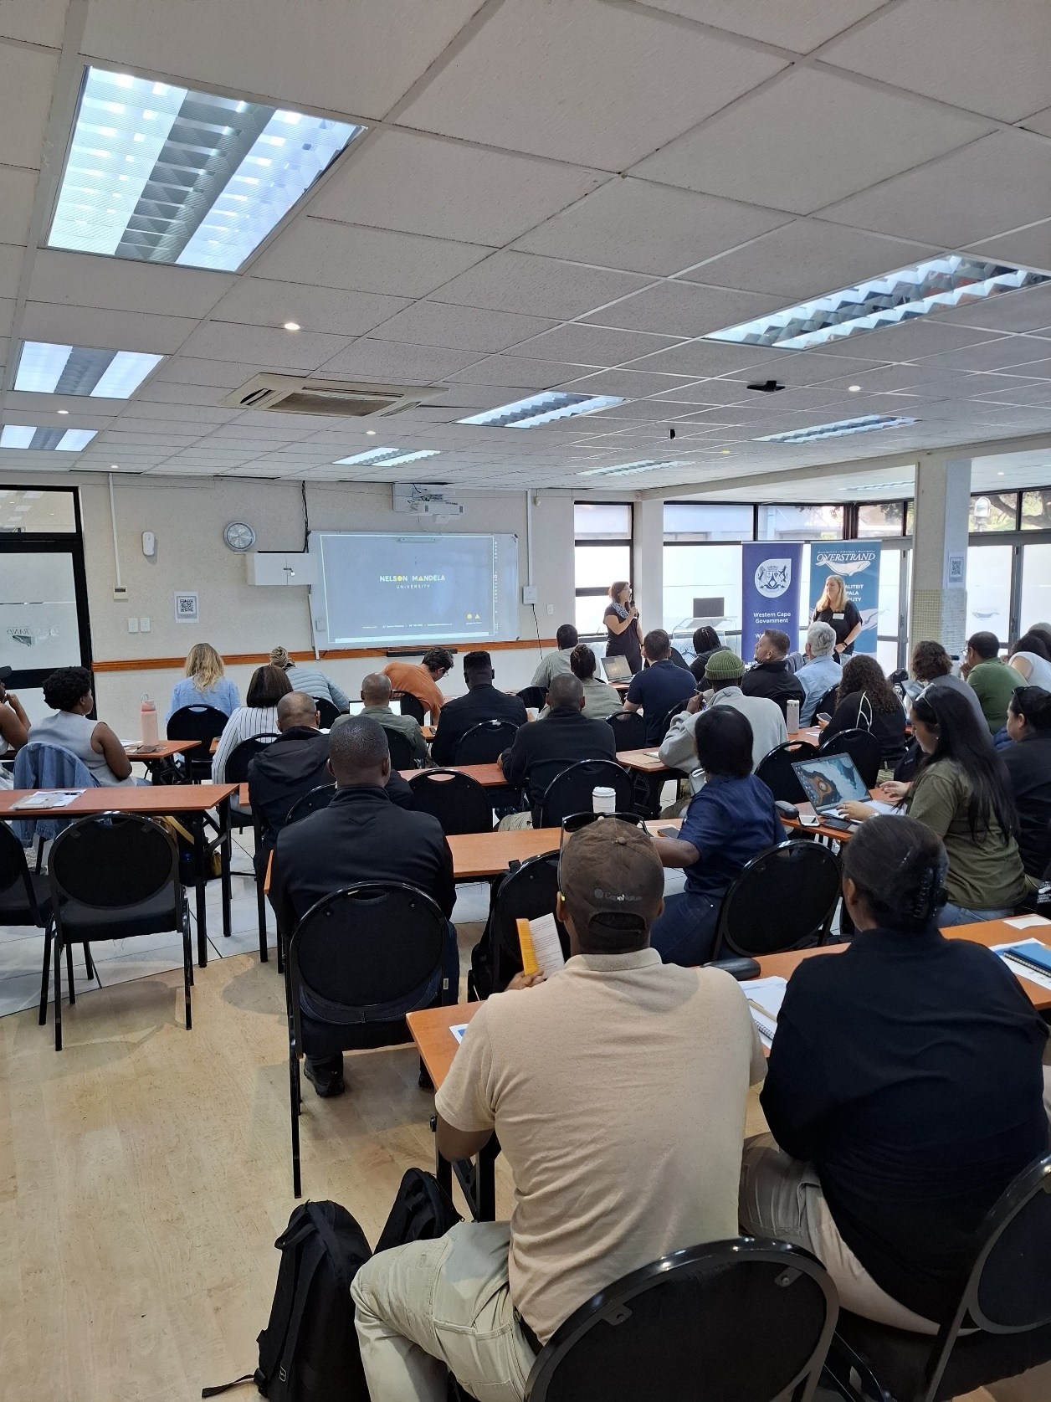
Estuary Management Course 2026 - SLP

Slide 8


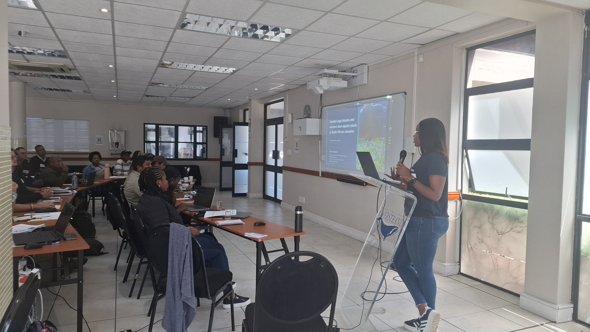





Learning from one another
in a transdisciplinary space

Slide 9
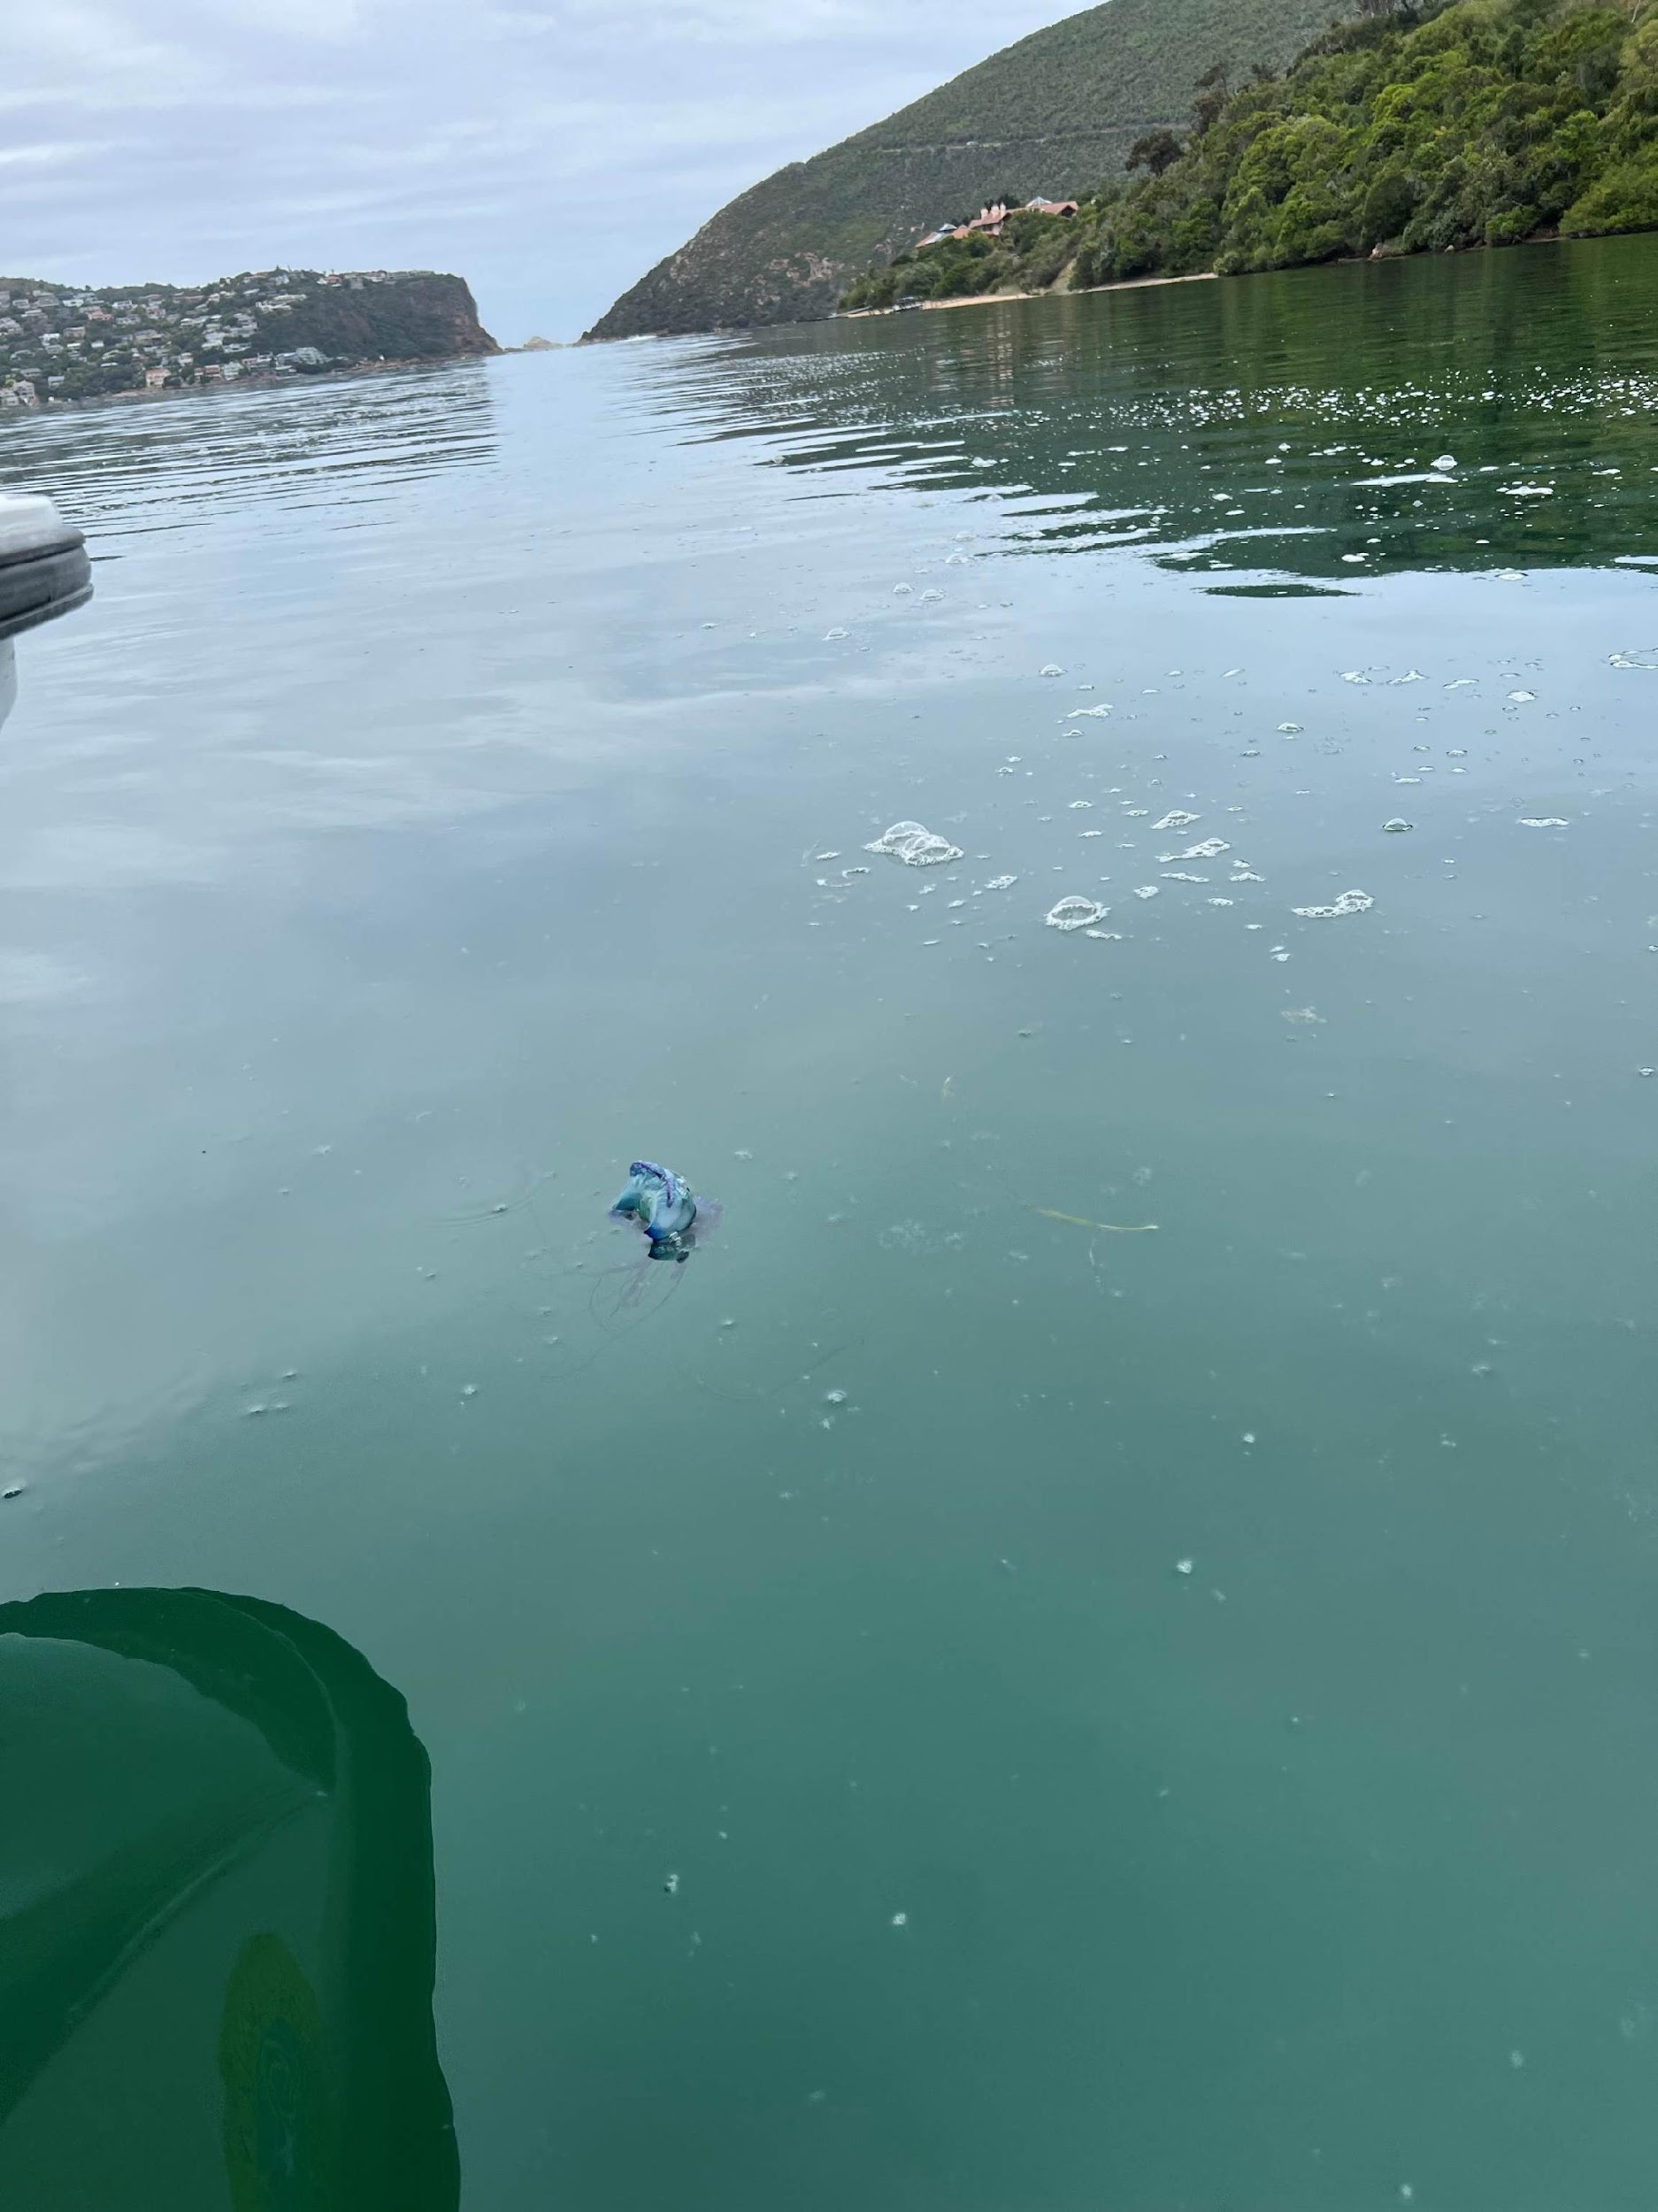

A triple planetary emergency caused by three connected crises:
(Guterres, 2020 UN Secretary General)
1) climate crisis, 2) nature crisis and 3) pollution crisis
Pollution, biodiversity loss and climate change, as three instances where planetary boundaries have been exceeded beyond a ‘safe operating space for humanity’ (Rockström et al. 2009)

Slide 10


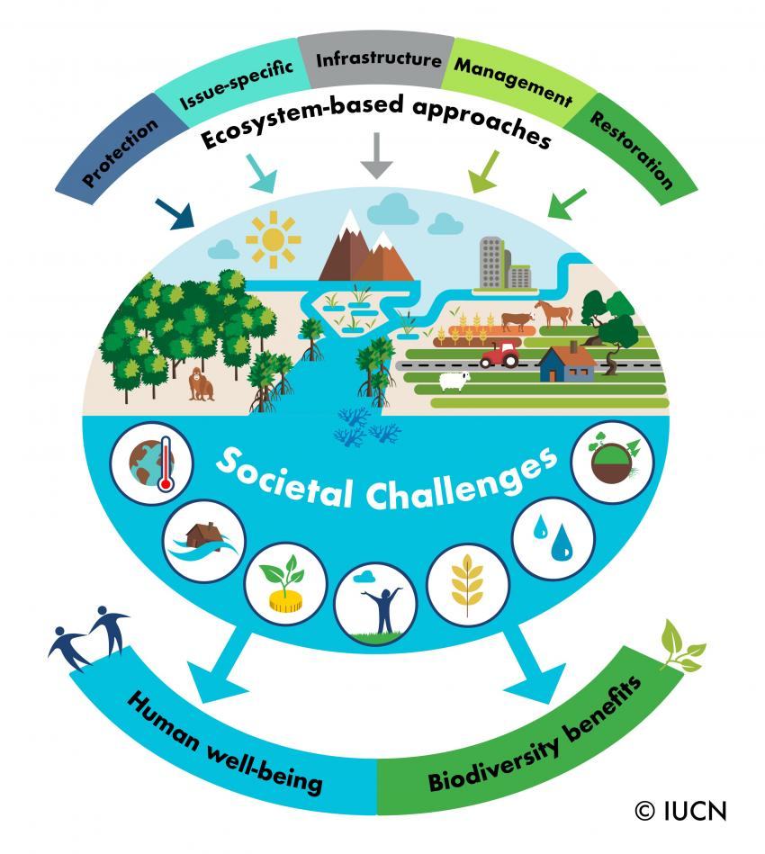

Notes:
Global, national

Slide 11
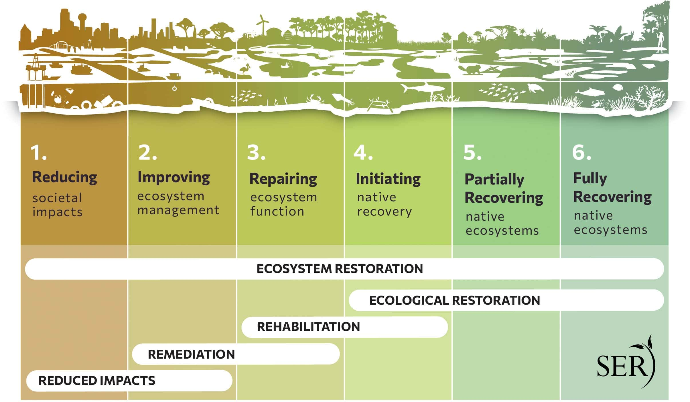

Slide 12
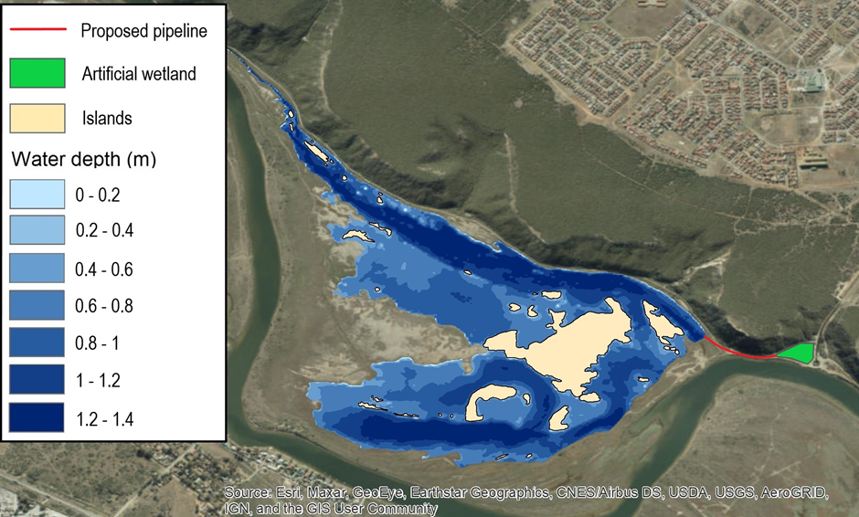
RESTORATION ACTION: DIVERT MOTHERWELL CANAL WATER TO DRY SALT PANS
Opportunity to restore waterbird habitat + improve estuary water quality
(nutrient, metals, bacteria)
Delivery of multiple ecosystem services at relatively low cost

Slide 13
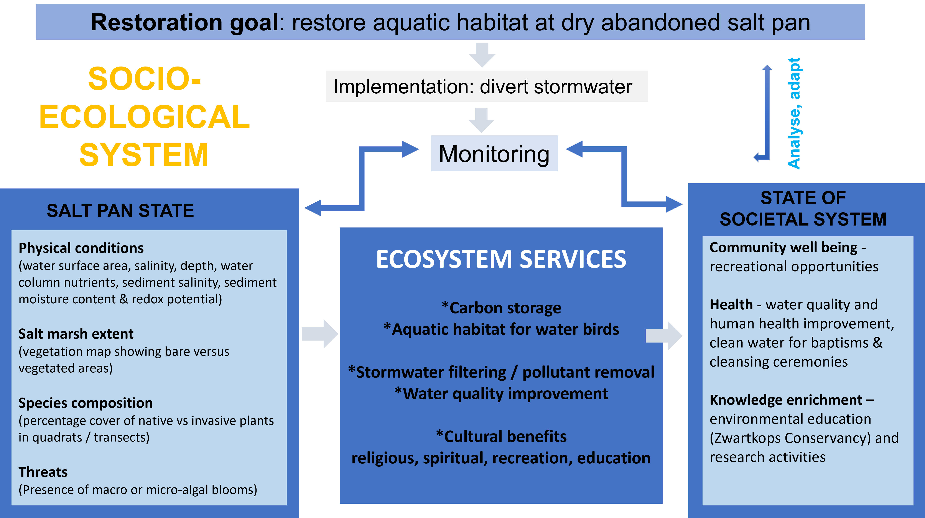

Slide 14
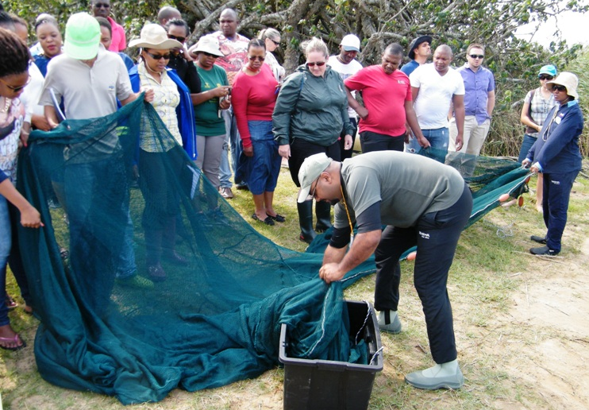
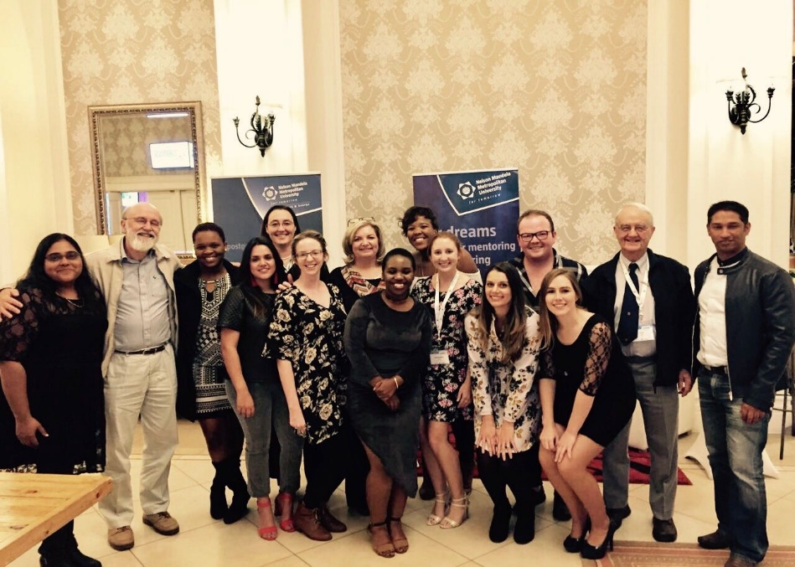
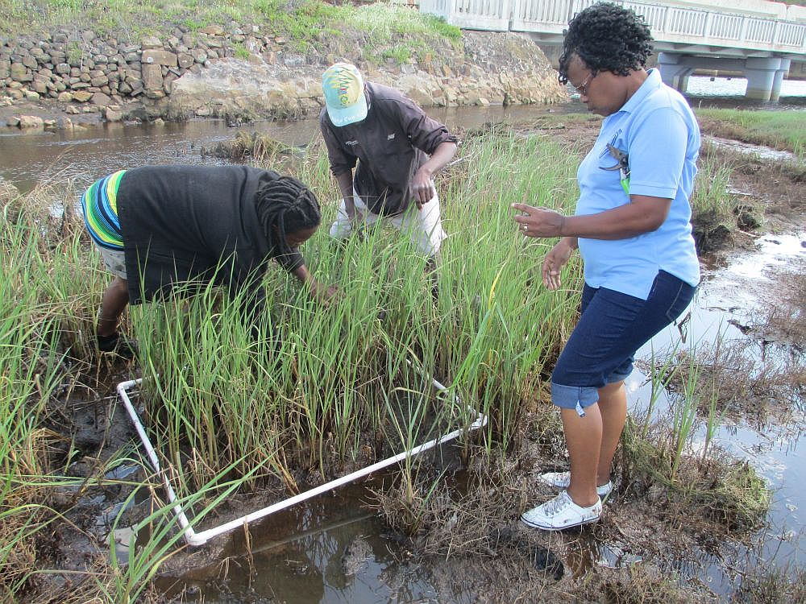
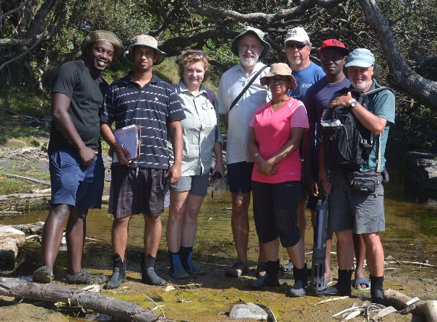
RESTORATION
INNOVATION THROUGH TRANSDISCIPLINARITY
harmonises links between disciplines in a coordinated and coherent whole that focuses on ‘real-world’ system problems
Arts & Culture, Botany, Business studies, Chemistry, Civil Engineering, Computing Sciences, Conflict Management / Politics, Development Studies, Business Management, Landscape Design, Economics, Education, Geosciences, Health Sciences, Hydrology, Ichthyology, Law, Oceanography, Statistics, Anthropology, Sociology, Zoology
Stakeholders & communities

Slide 15
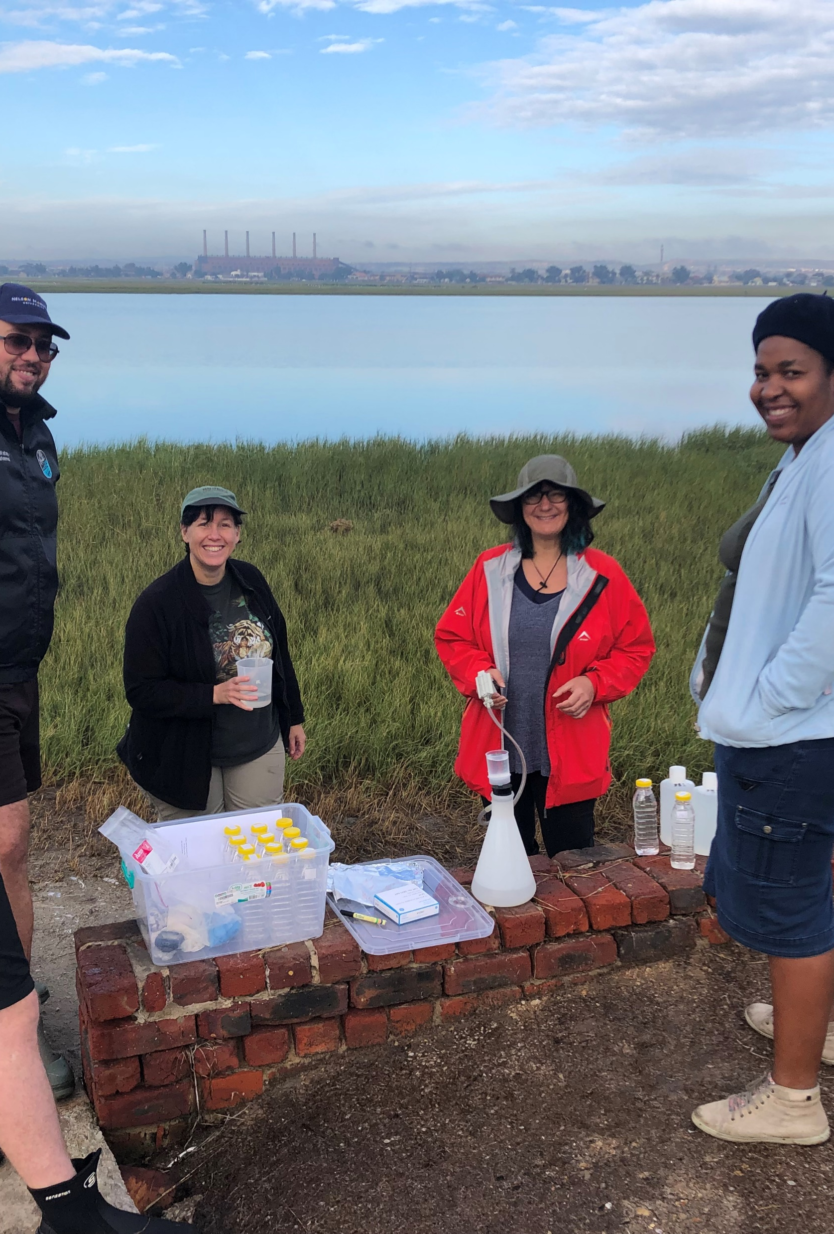
WATER RESEARCH COMMISSION – transdisciplinary research model
Scientific community, government (DFFE, DWS) e.g. input to the Swartkops Estuary Management Plan, local communities, general public and users of the Swartkops Estuary.
Provincial government on the implementation of the Swartkops Estuary Management Plan and with the Zwartkops Conservancy (NGO) on restoration of the Cerebos salt pans.
Various disciplines and non-academic knowledge merge to create new frameworks or solutions – CO DESIGN & IMPLEMENTATION

Slide 16
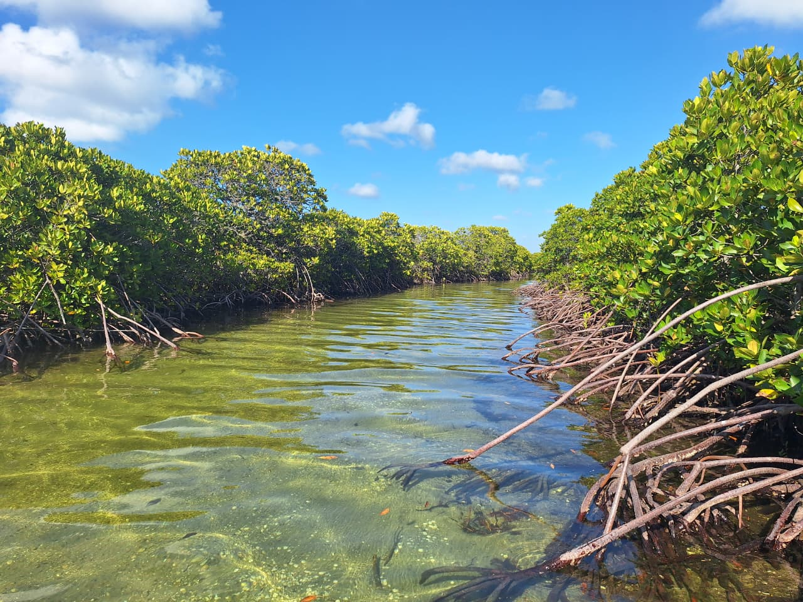
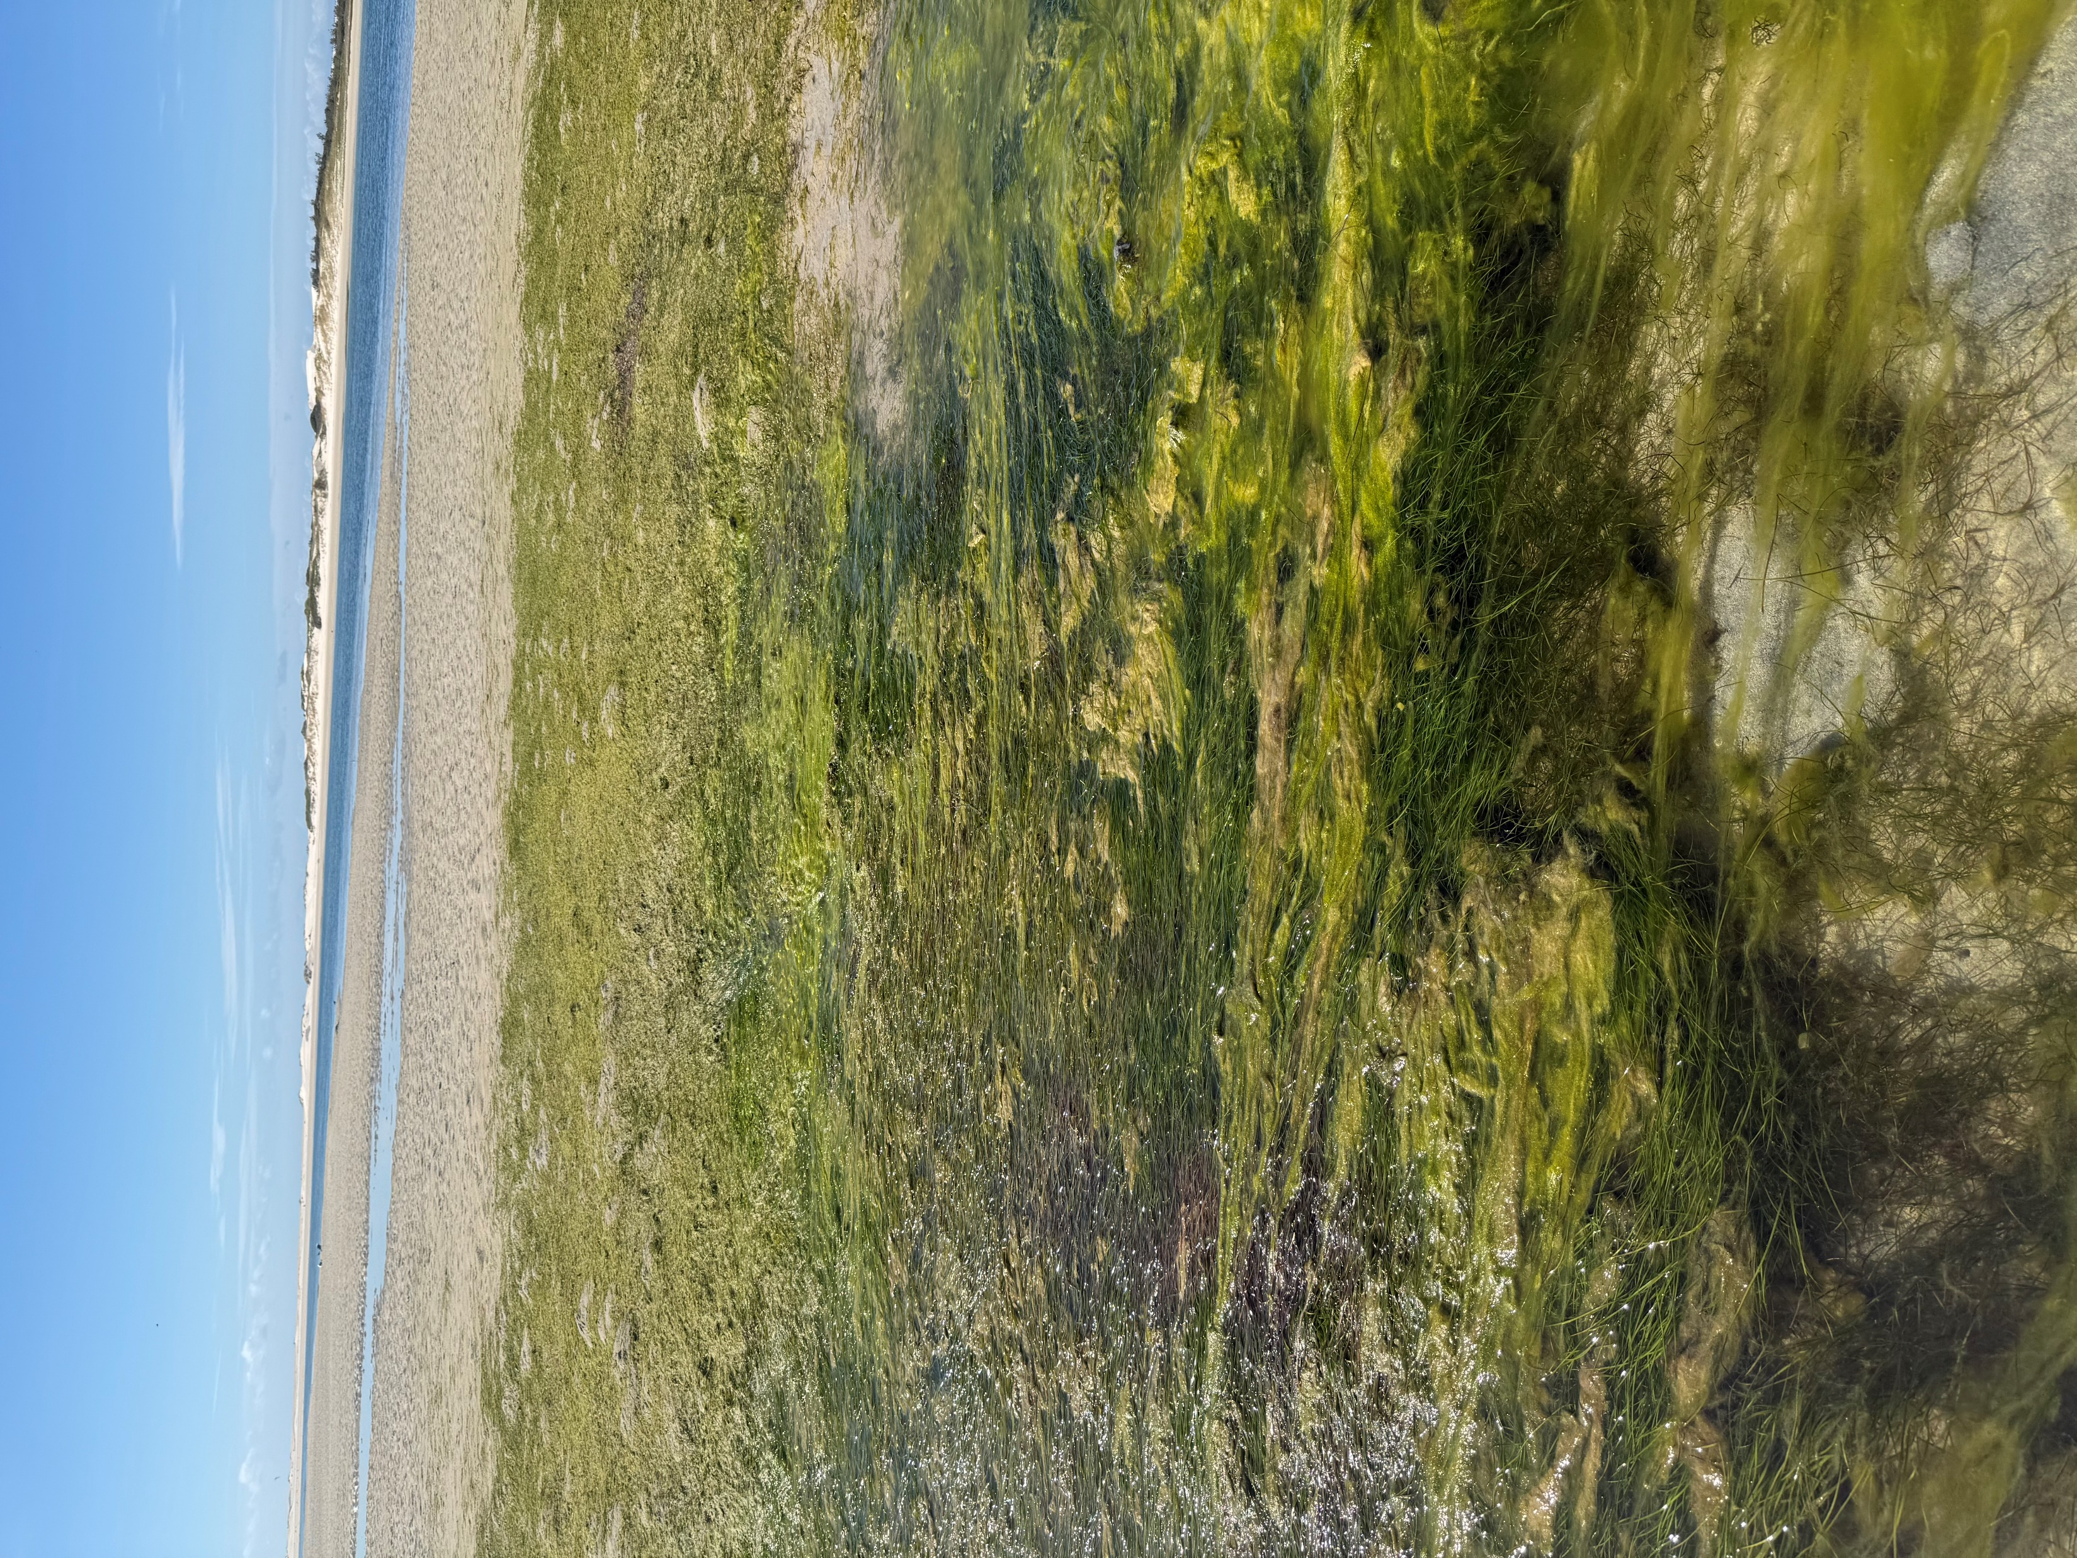
From local to global
Writing team for Chapter 3: Technologies for protecting, enhancing and monitoring the ocean carbon sink. Climate Technology Progress Report for United Nations Environment Programme, Copenhagen Climate Centre (UNEP-CCC).
Third World Ocean Assessment (WOA III) – United Nations
Presentation on Enabling and enhancing marine ecosystem restoration through international cooperation and coordination: challenges and opportunities
United Nations Open-ended Informal Consultative Process on Oceans and the Law of the Sea Twenty-sixth meeting New York, 22–26 June 2026

Slide 17




Member of the UN Ocean Decade Programme for Blue Carbon (GO-BC) science technical working group
International Blue Carbon Scientific Working Group member (Conservation International & IUCN)
Appointed by the South African Ministry for Electricity & Energy as the South African co-ordinator for the IAEA RAF7020 (African) project “Establishing regional capacities to assess the importance of carbon sequestration in aquatic systems
for climate change mitigation, environmental conservation and
economic purposes”

Slide 18
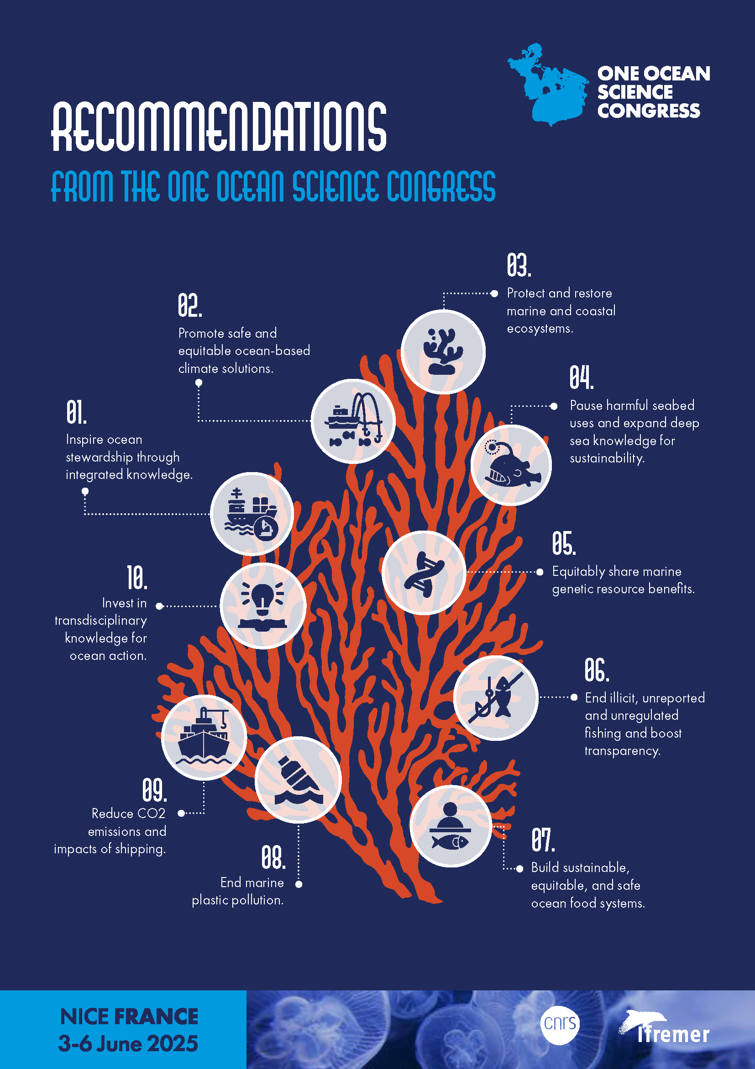
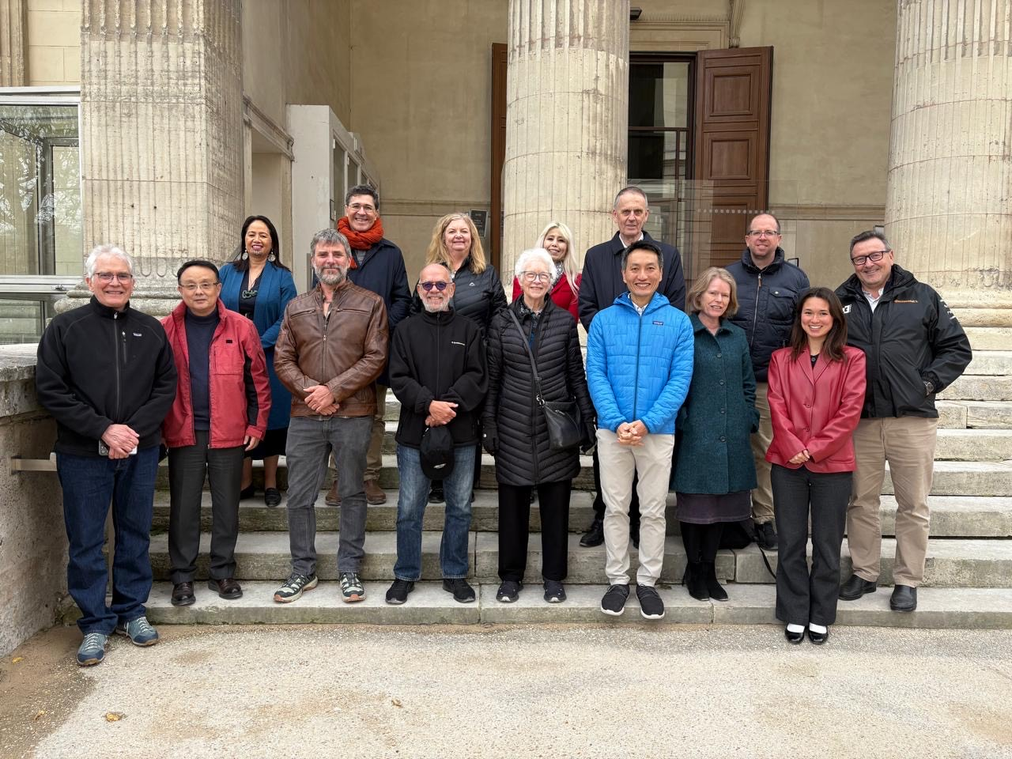
UNOC3 – Nice declaration

Slide 19
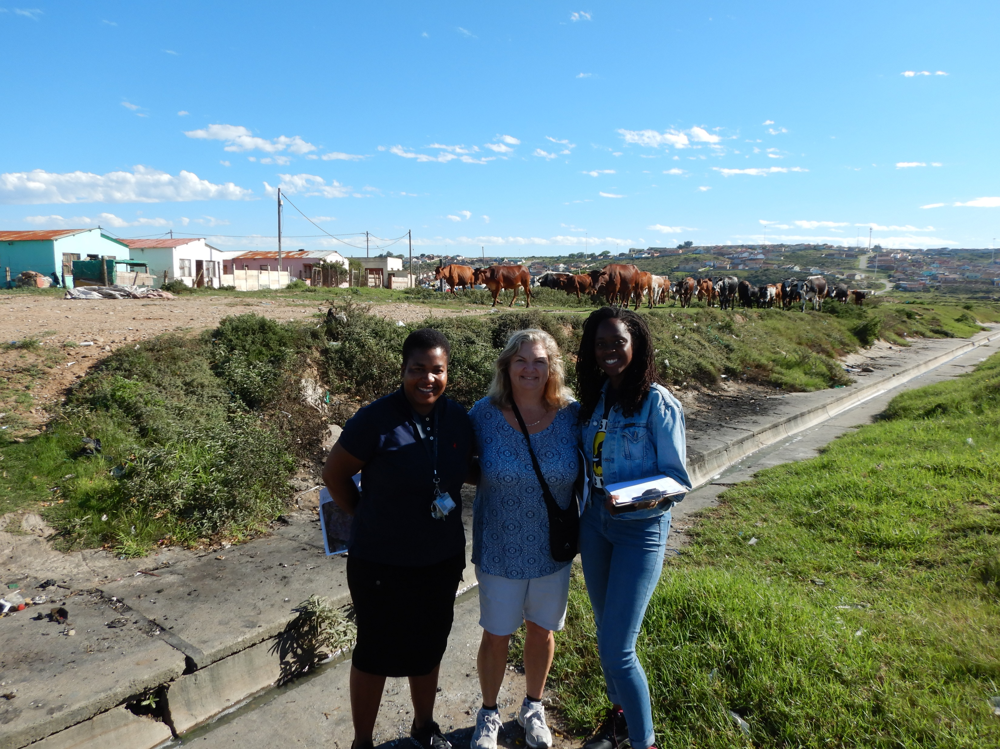
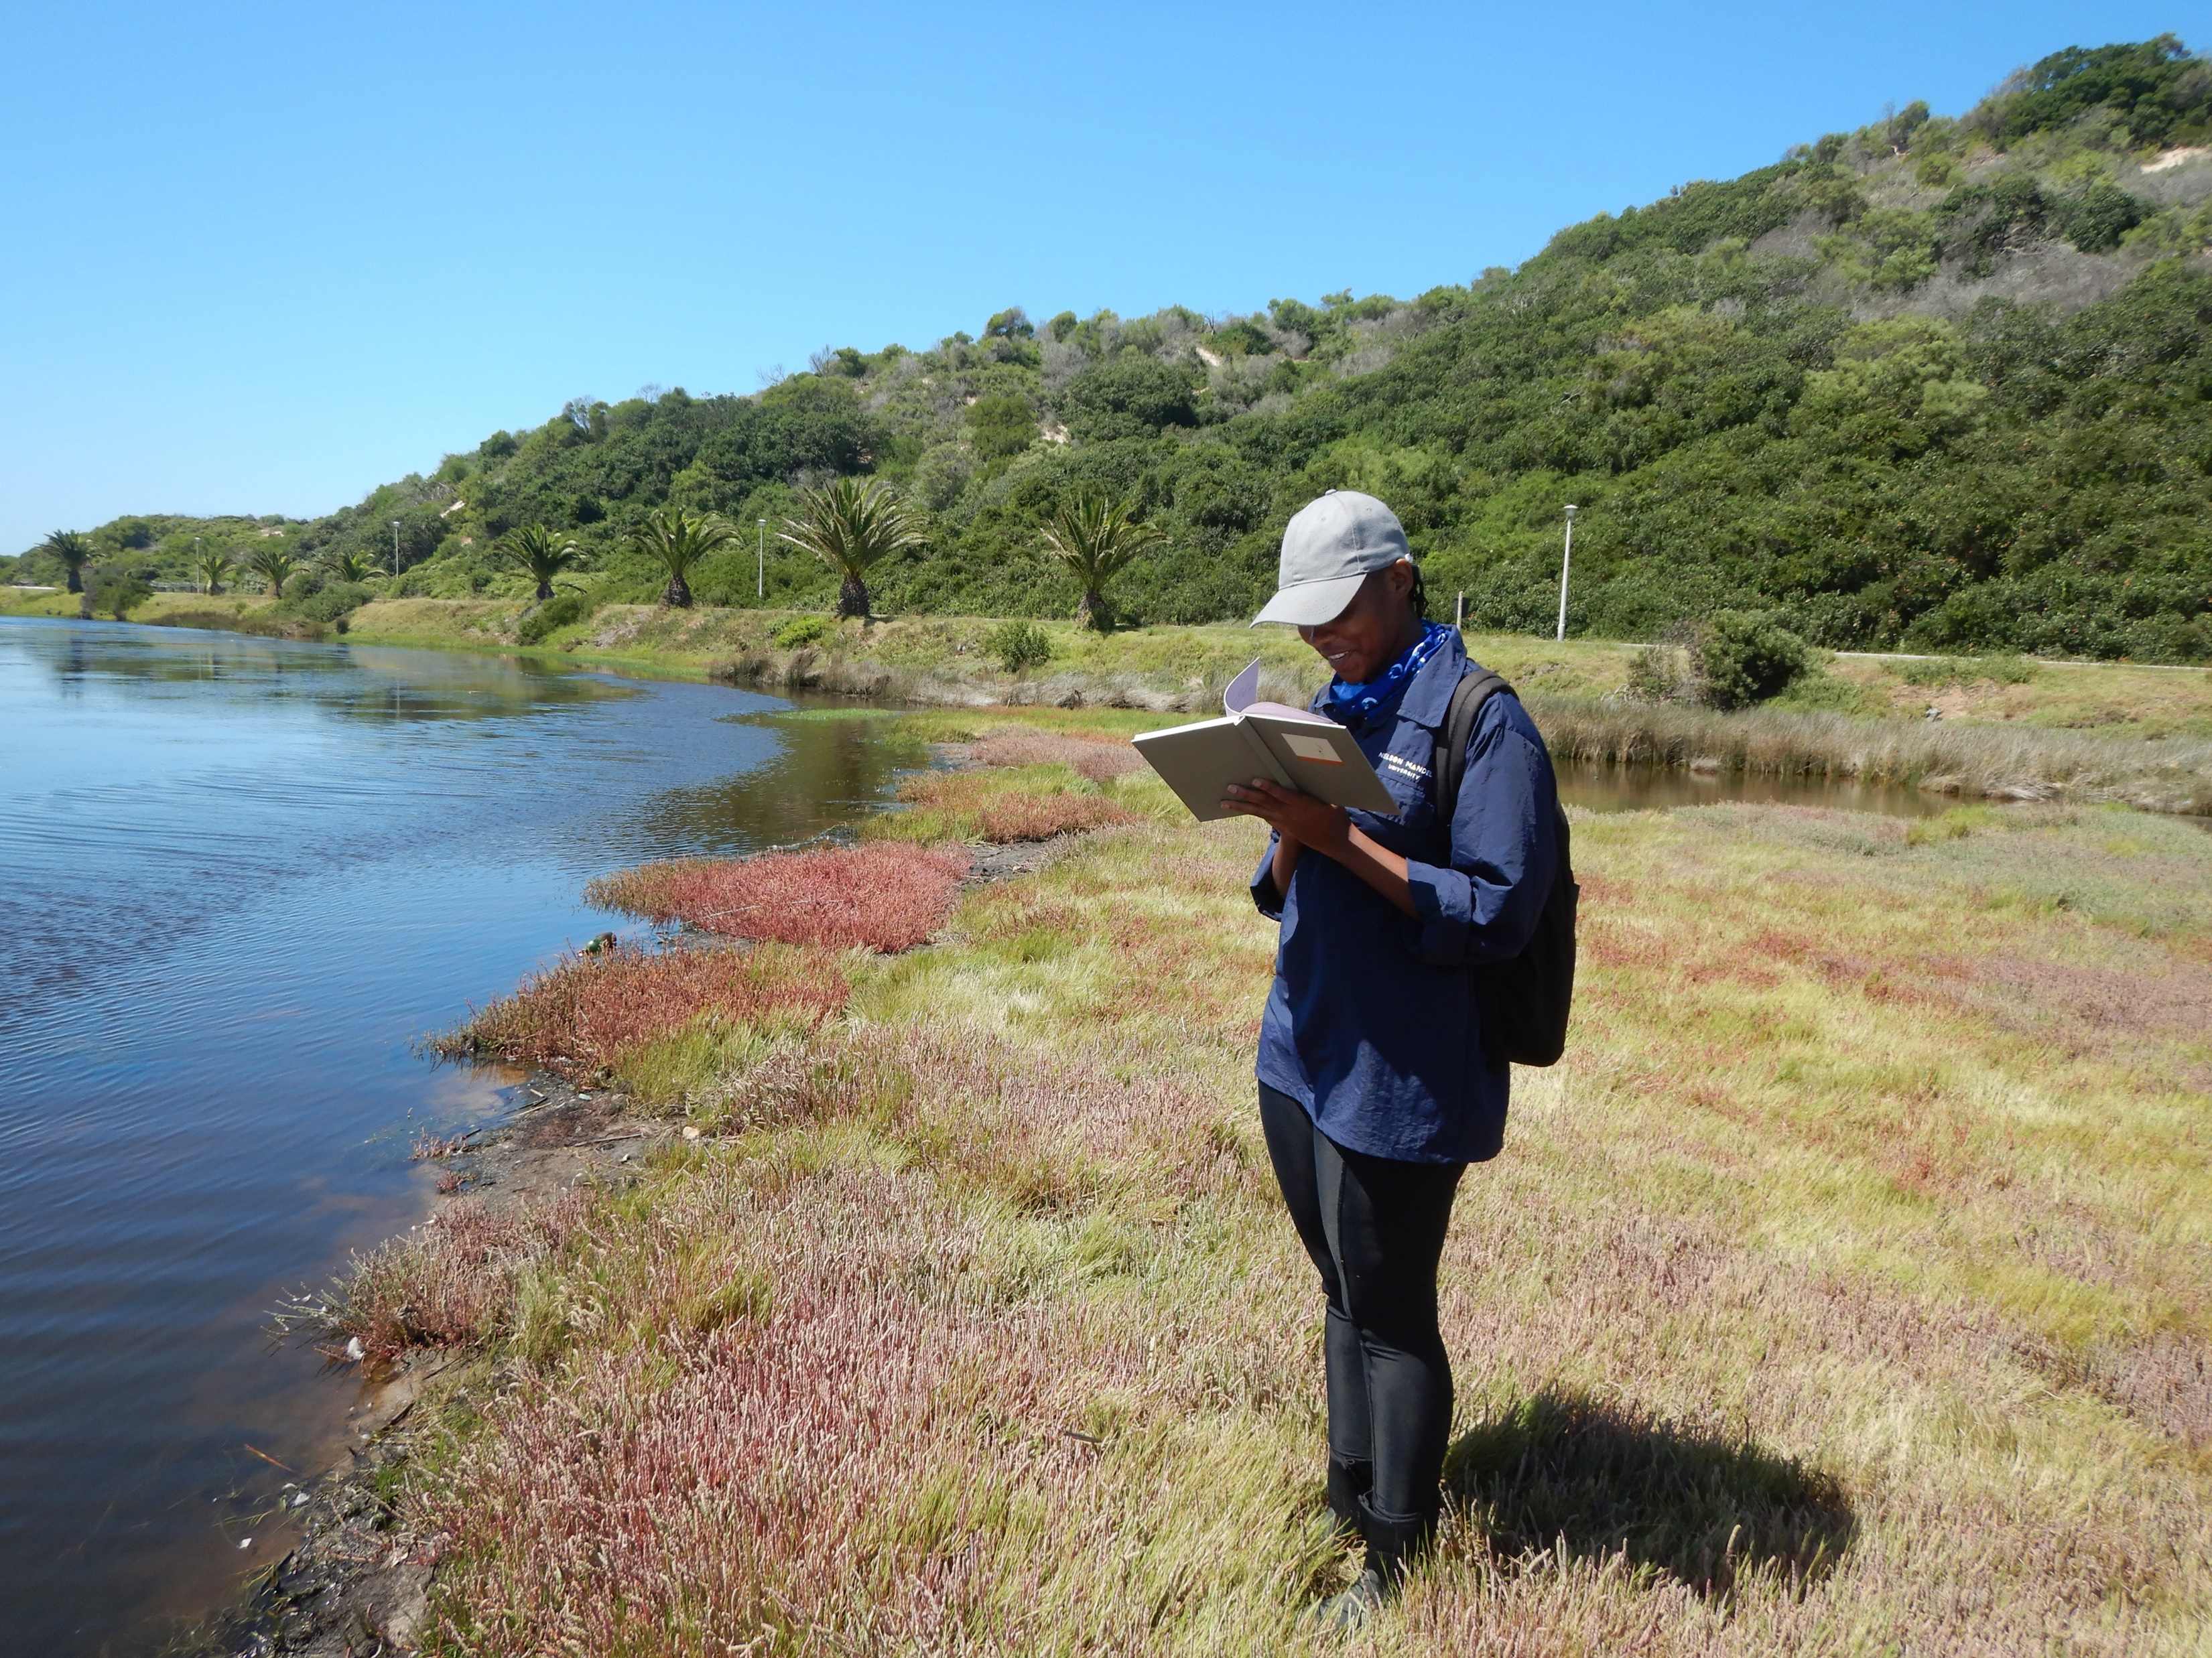
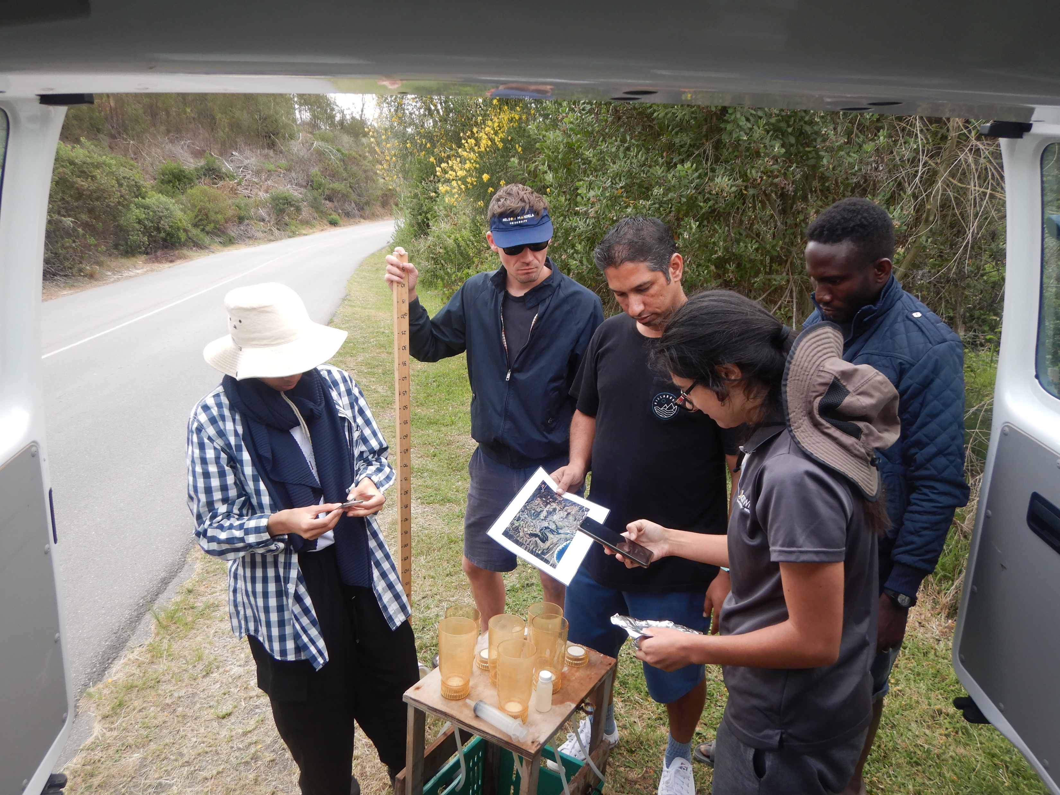
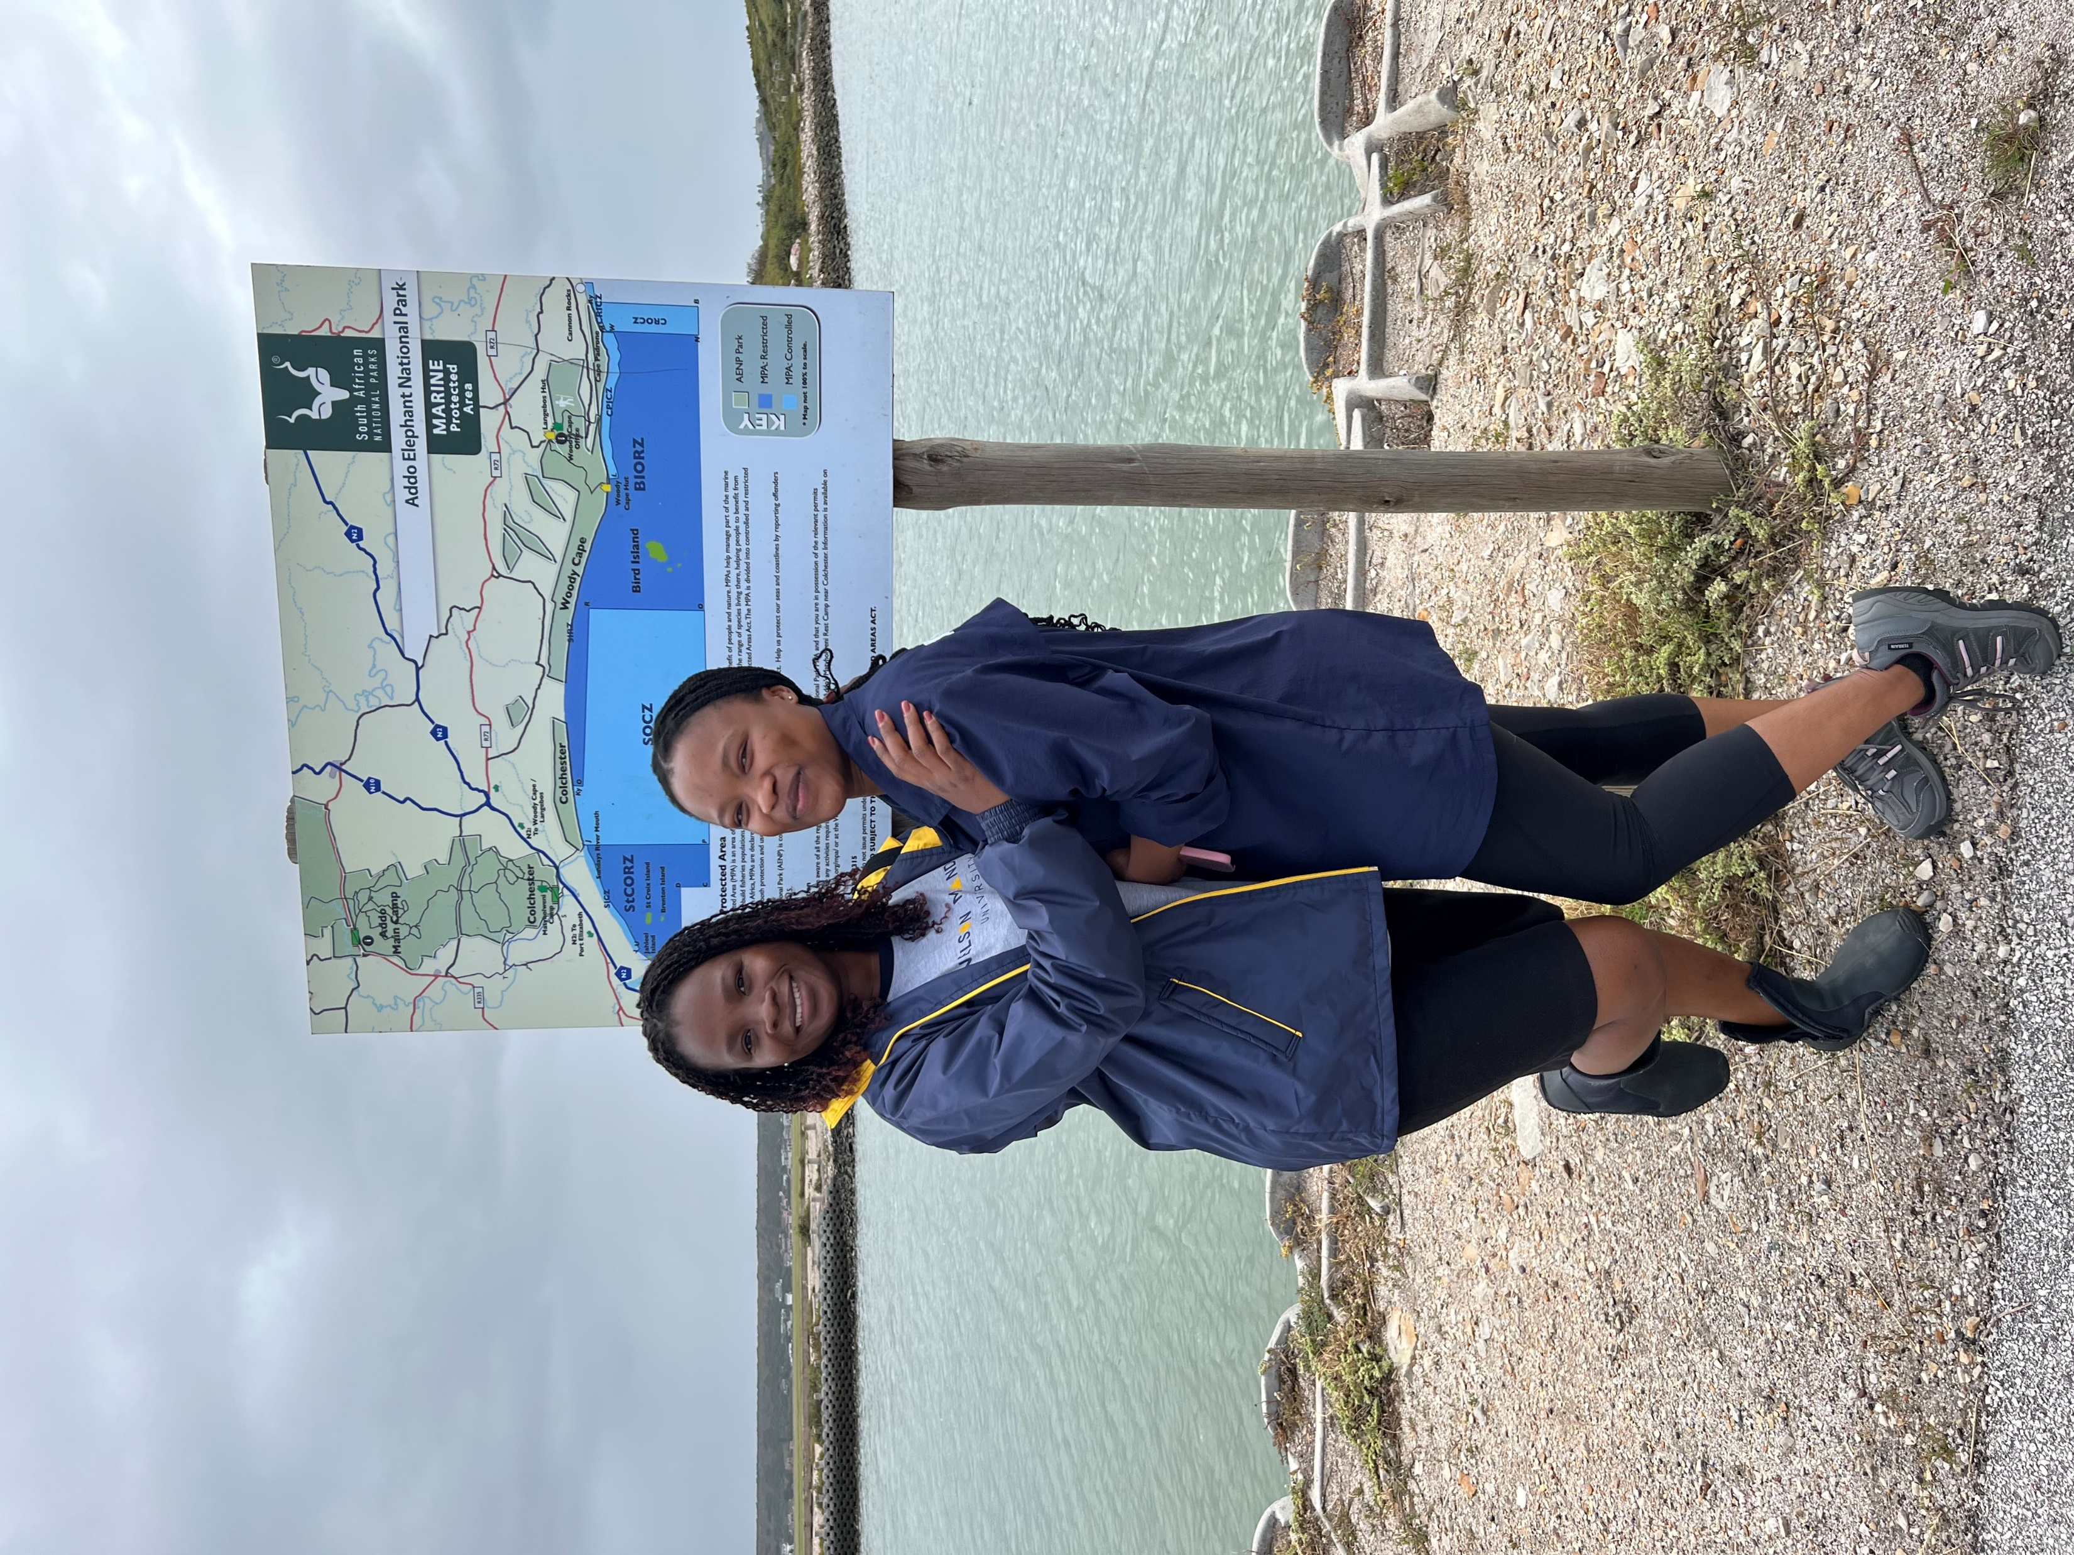
Advancing ocean science through research and student training

Slide 20
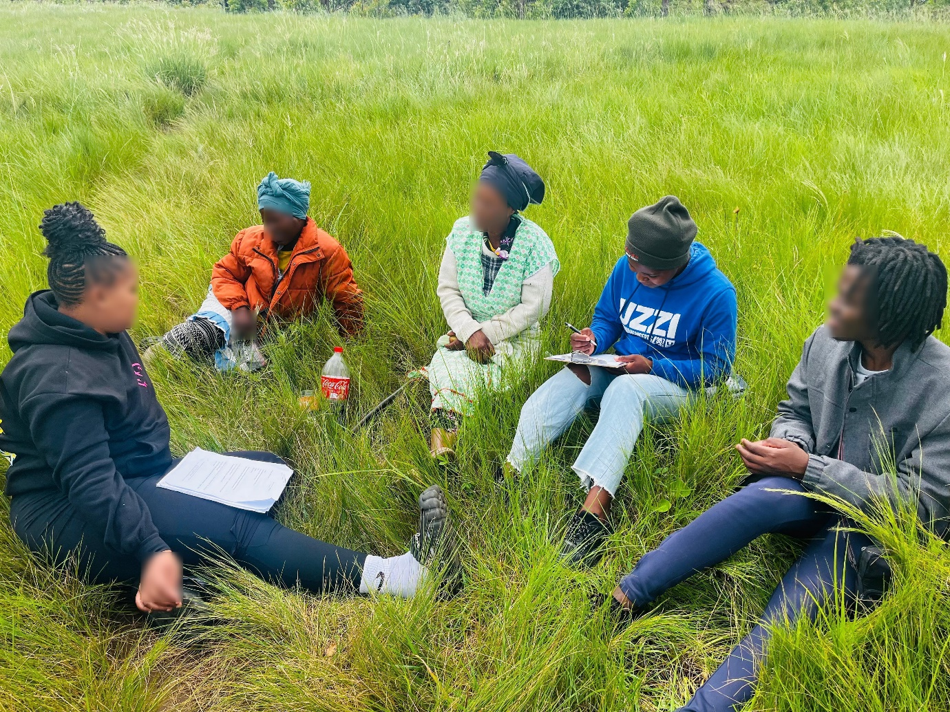


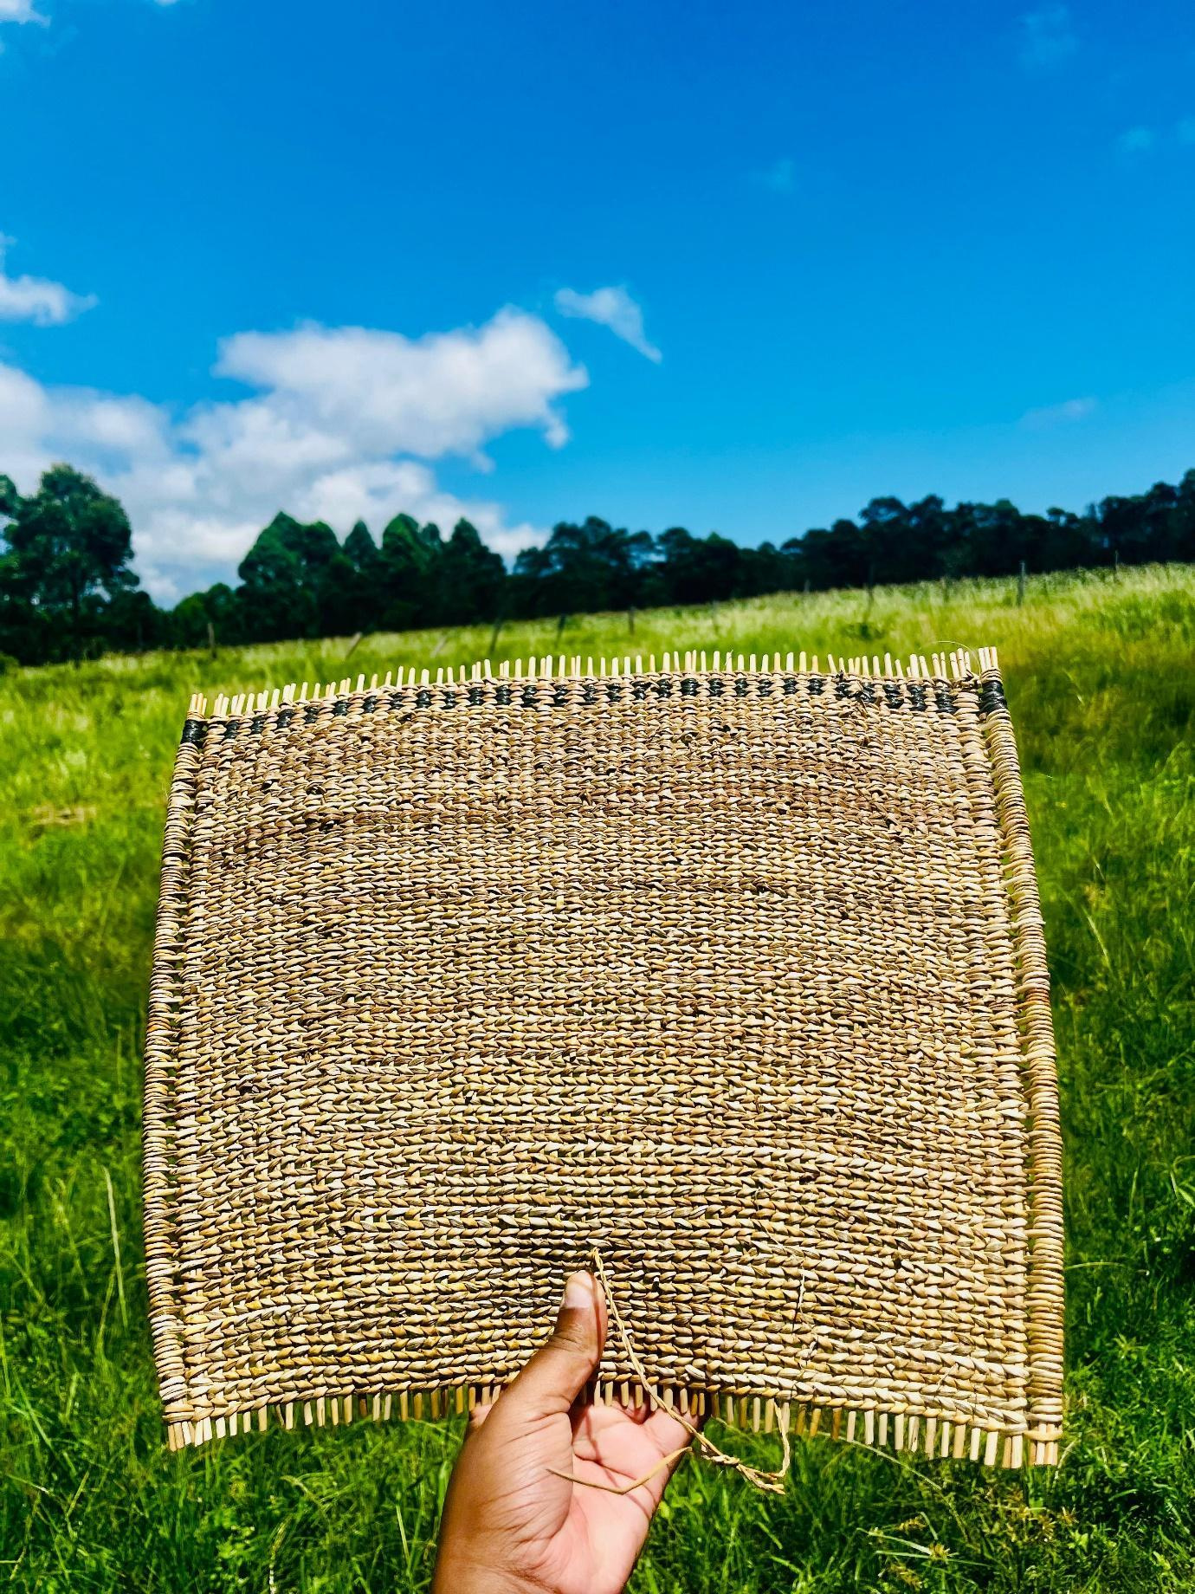
DR VUYO MXO
Potential for domesticating the sedge Cyperus textilis for applications in ecological engineering of coastal urban systems
Amadiba community – established partnerships
Transdisciplinary through collaboration

Slide 21
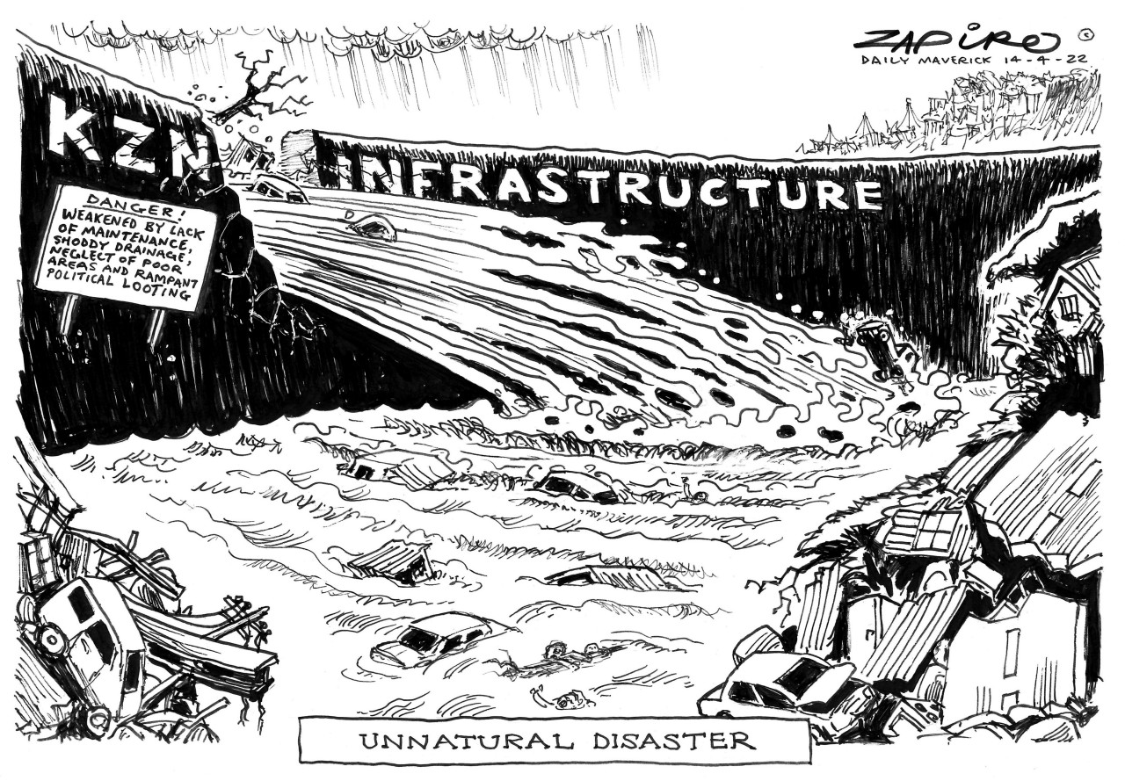
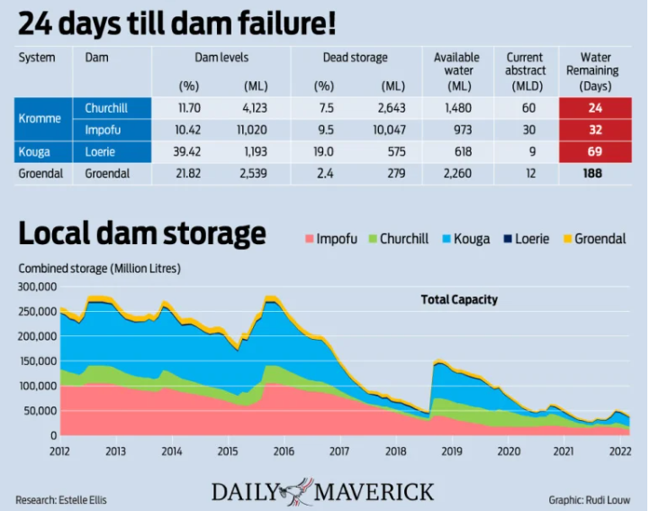
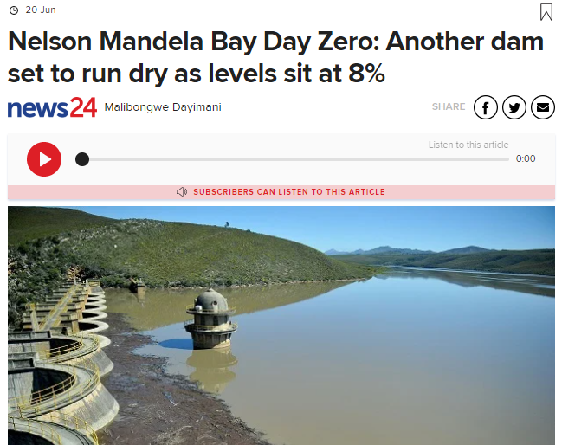
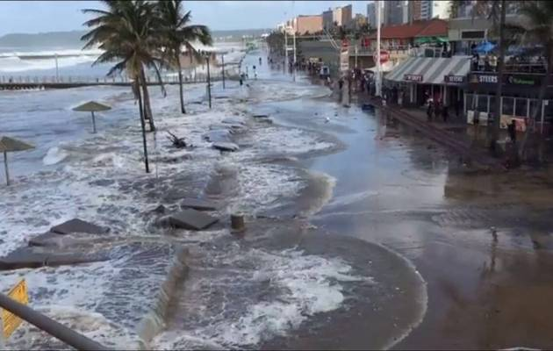
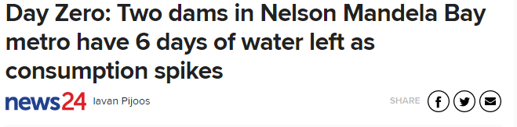

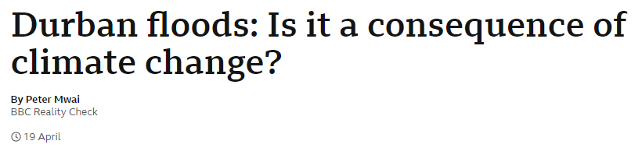
CONSERVATION & MANAGEMENT CHALLENGES
Climate change - shifting baselines

Slide 22


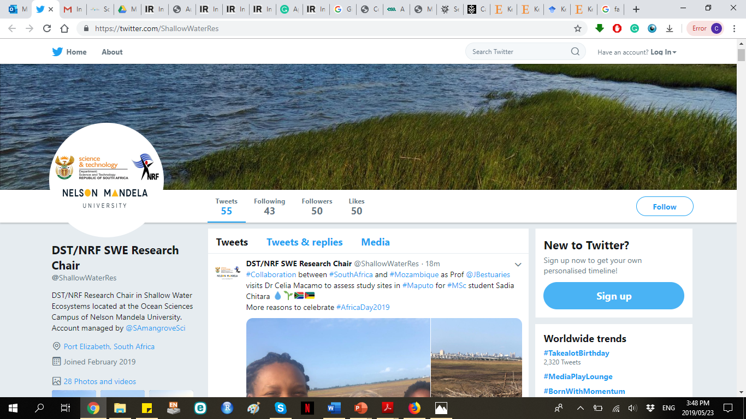
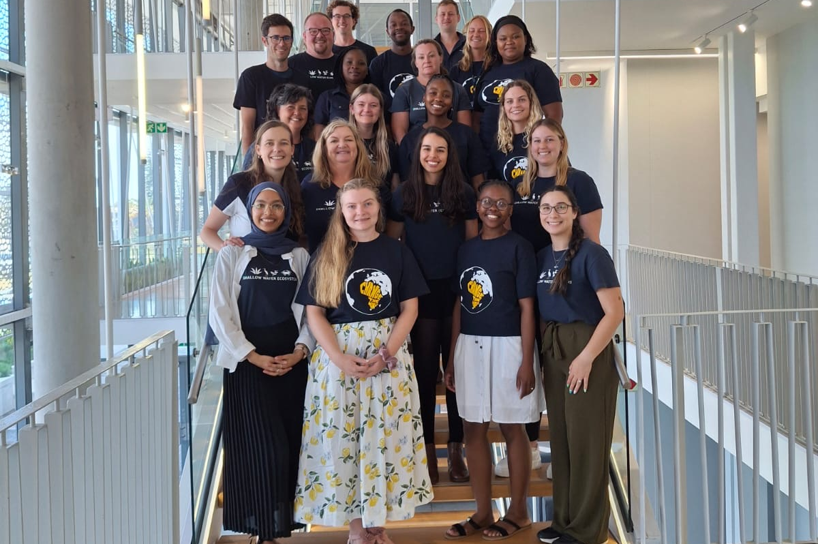
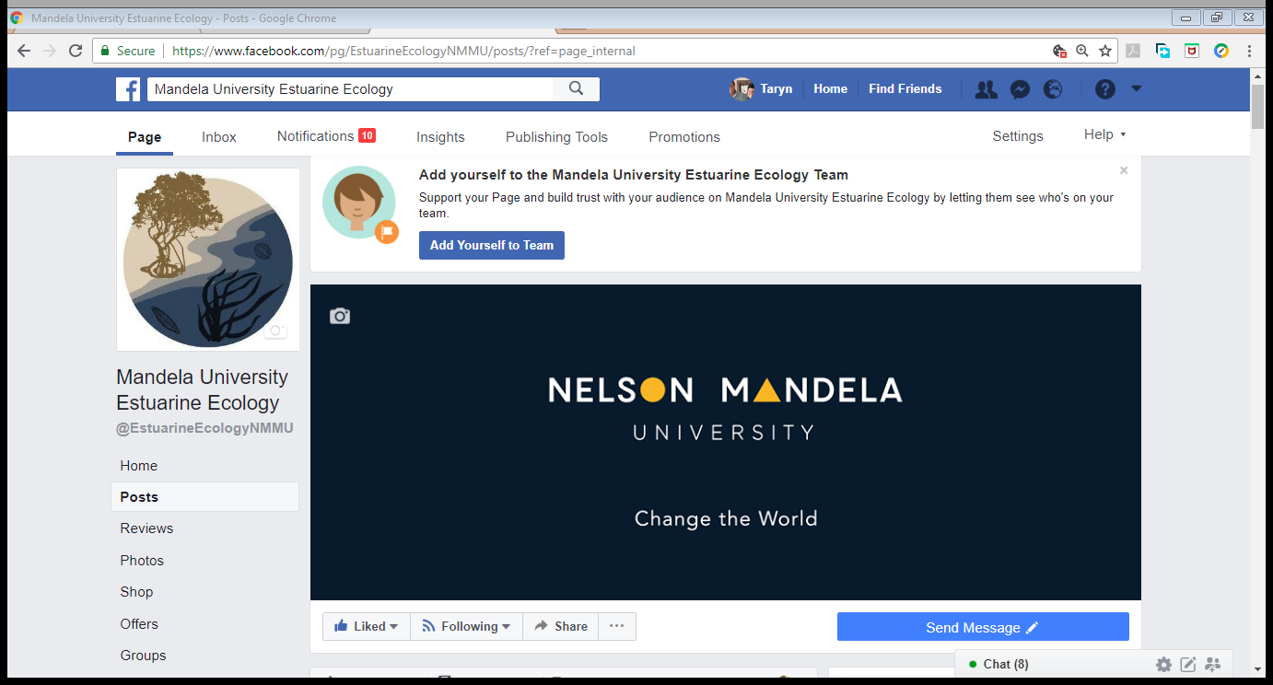

Follow us on social media
Notes:
Please follow us on social media platforms

Slide 24
