Slide 1
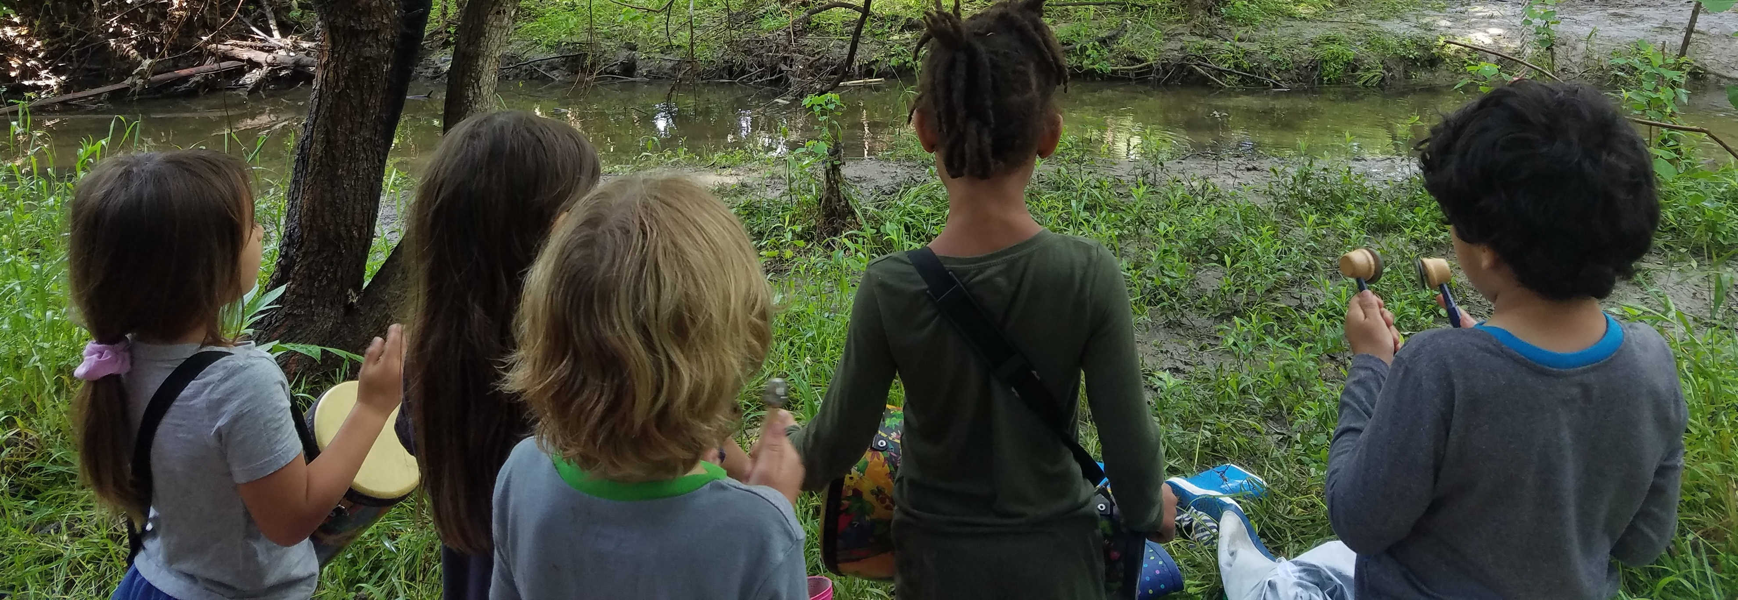
Child-Creek Pedagogical/Research Encounters
2 years with Kindergarten children and teacher in outdoor ‘creek’ encounters
Children’s creative engagements with climate change-related impacts within their local contexts.
Working closely with educators to support their pedagogy
Inquiry-informed curriculum-making – responsive to children’s curiosities and planned place-attuned pedagogies eg water testing, water-story literacies
SSHRC PDG Funding; Climate Action Network: Exploring Climate Change Pedagogies with Children

Slide 2
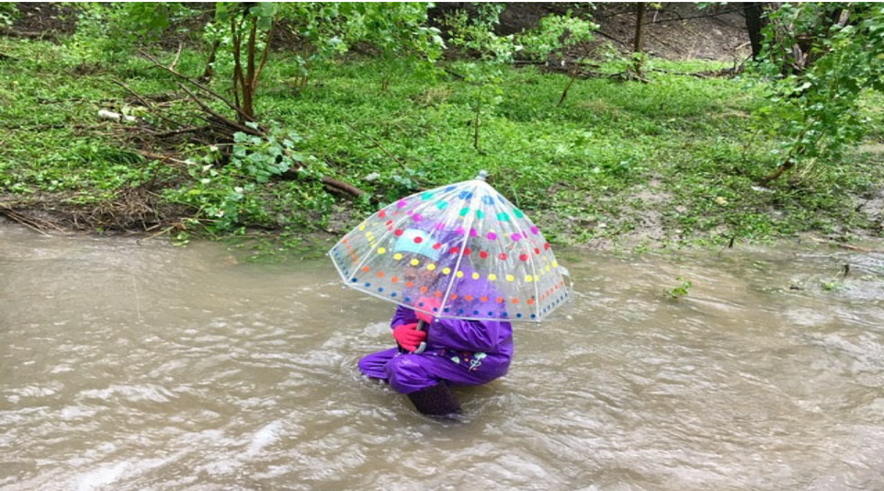

Slide 3
