Slide 1

Black Planetary Studies
Hugo ka Canham

Slide 2
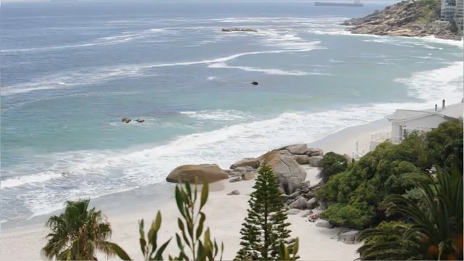
My name is February

