Slide 1


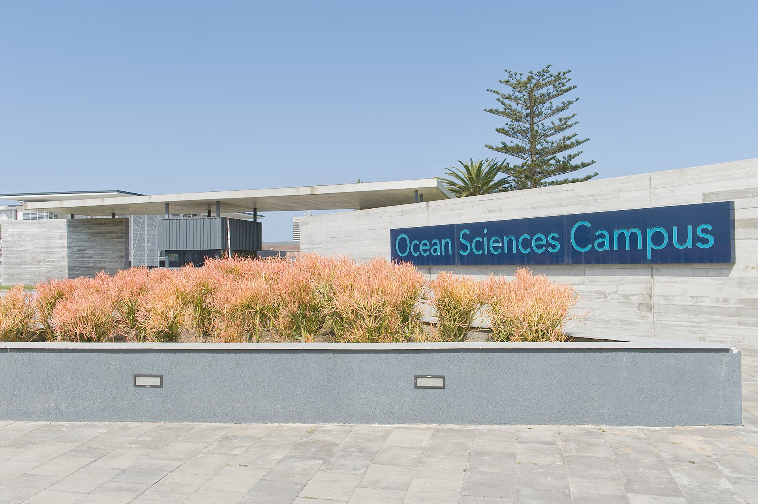
OCEAN SCIENCES TRANSDISCIPLINARY STRATEGY
Professor Heather Nel
Transdisciplinary Ocean Sciences and Ocean Sustainability Activism Symposium
27 May 2026

Slide 2
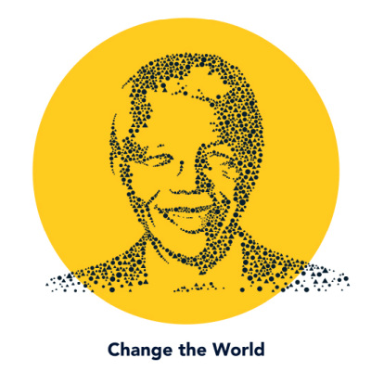
NELSON MANDELA UNIVERSITY OCEAN SCIENCES STRATEGY IN CONTEXT

Slide 3
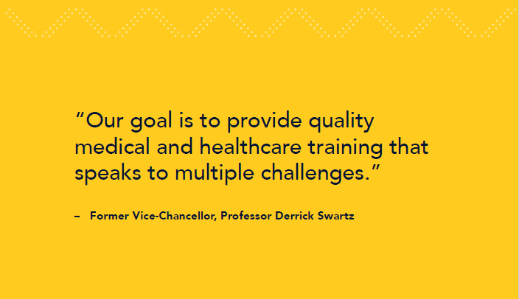



Global, continental and national context
Nelson Mandela University’s Vision 2030 strategic aspirations were developed against the backdrop of the development goals articulated in the United Nations 2030 Sustainable Development Goals (SDGs), the African Union Agenda 2063, and the South African 2030 National Development Plan (NDP).

Slide 4
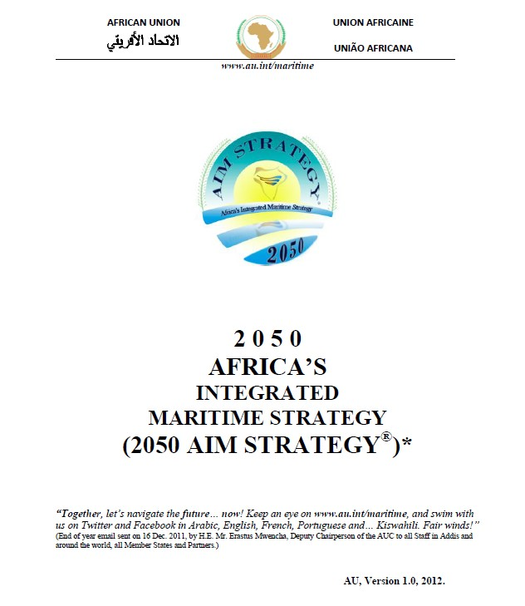


Africa’s Integrated Maritime Strategy 2050
54 African states: 38 have a coastline and 6 are islands
2050 AIM Strategy provides a broad framework for the protection and sustainable use of the Integrated African Maritime Sector Domain for wealth creation

Slide 5
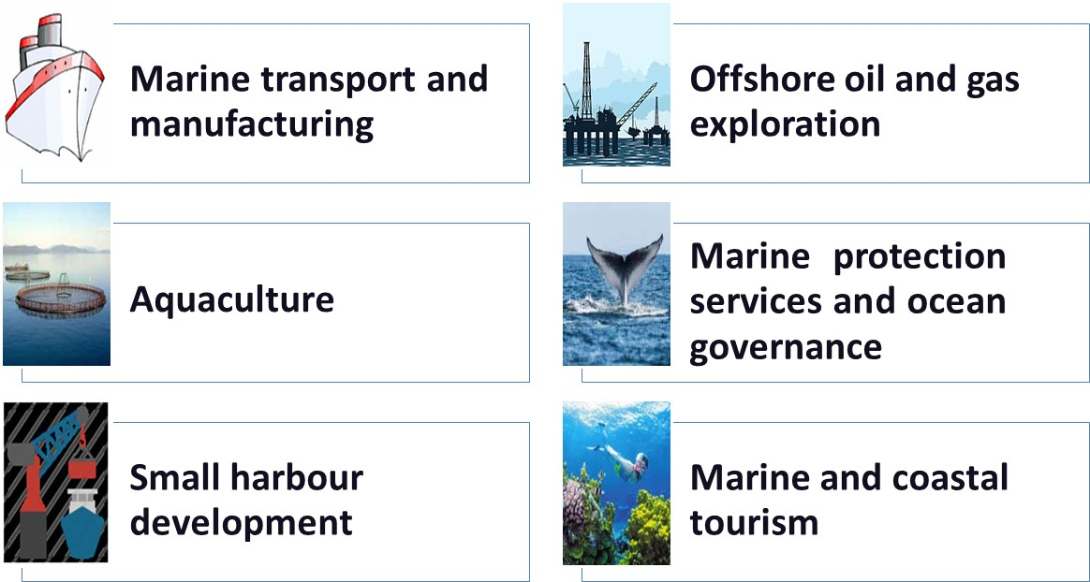
Operation Phakisa Oceans Economy
4

Slide 6
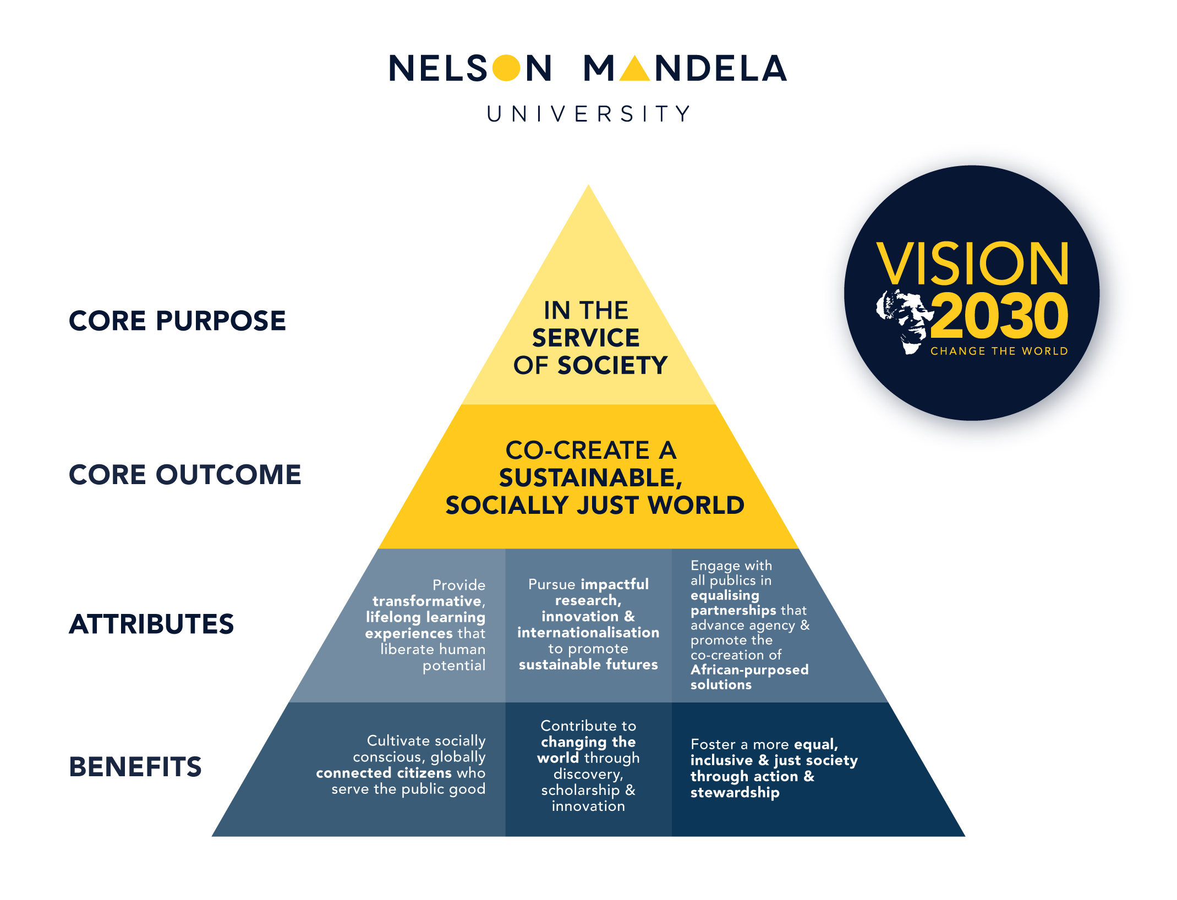
University in the service of society
As the only university in the world to be named after the late President Nelson Mandela, the University is mindful of its responsibility to honour the legacy of its iconic namesake.
The University positions itself in the service of society through humanising pedagogies, impactful research and innovation, and repositioning equalising forms of engagement to enhance social responsiveness.
https://www.mandela.ac.za/Leadership-and-Governance/Strategy-Vision-2030
5

Slide 7

Transversal strategic priority areas
Transversal strategic priority areas
Repositioning equalising forms of engagement
Research and innovation excellence (incl. international partnerships)
Sustainability and transdisciplinarity
Ocean sciences
Virtual Academy and digitalisation
Student access and success
Revitalising the humanities
Transformation, decolonisation and institutional culture
Medical school
Food sovereignty and security
Student entrepreneurship and youth employability

Slide 8
Institutional research themes
Social justice and Democracy
Environmental Stewardship and Sustainable Livelihoods
Ocean and Coastal Sciences
Humanising Pedagogies
Innovation and the Digital Economy
Origins, Culture, Heritage and Memory

Slide 9
TRANSDISCIPLINARY OCEAN SCIENCES STRATEGY

Slide 10
Pillars of ocean sciences strategy
Transdisciplinary under- and postgraduate learning, teaching, research, innovation, and engagement – “where art meets science”
Sustainable coastal livelihoods, economic development & marine protection
Quintuple helix partnerships
Leading post-school destination for transdisciplinary ocean sciences

Slide 11
Principles underpinning ocean sciences strategy
Holistically promote environmental, social and economic sustainability.
African identity and rootedness - African-purposed curricula, research and partnerships.
Harness pioneering, boundary-spanning inter- and transdisciplinary synergies
across all faculties while preserving disciplinary depth and integrity.
Sustain a network of quintuple-helix partnerships at local, regional, national, continental, and global levels.
Create an ecosystem for convergence or dedicated physical and intellectual spaces to co-create knowledge that addresses global sustainability challenges.
Embrace a hub and spoke model - Ocean Sciences Campus serves as a “hub” for transdisciplinary ocean sciences postgraduate studies, research and innovation.
Design multi-purpose spatial precincts that facilitate the co-location of scholars, students and partners in alignment with outward-facing transdisciplinary ocean sciences themes.

Slide 12
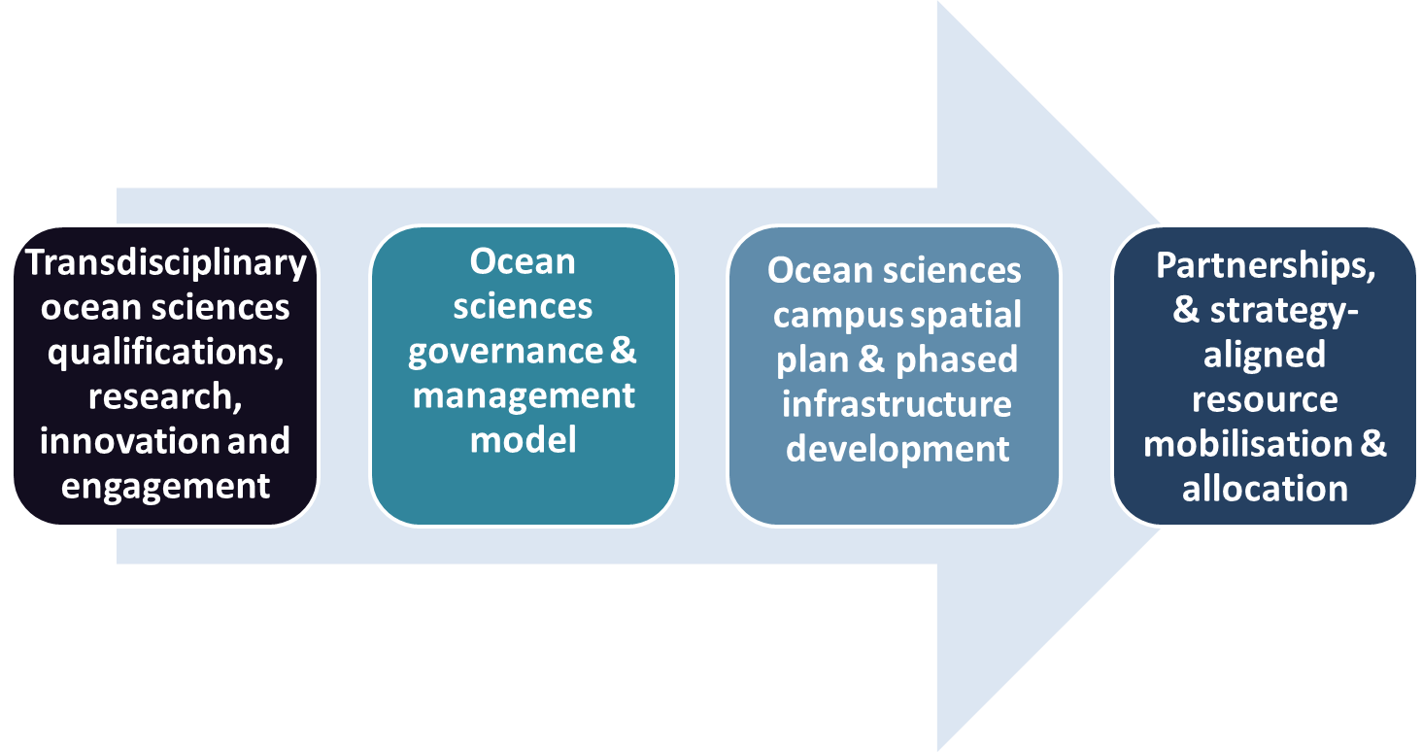
Key focus areas of ocean sciences strategy

Slide 13
Ocean sciences transdisciplinary strategy

Slide 14
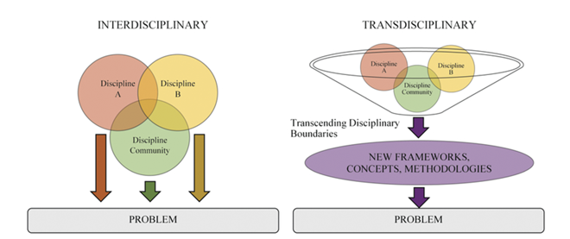
Ocean sciences transdisciplinary strategy
https://www.cambridge.org/core/journals/quantitative-plant-biology/article/convergence-and-transdisciplinary-teaching-in-quantitative-biology

Slide 15
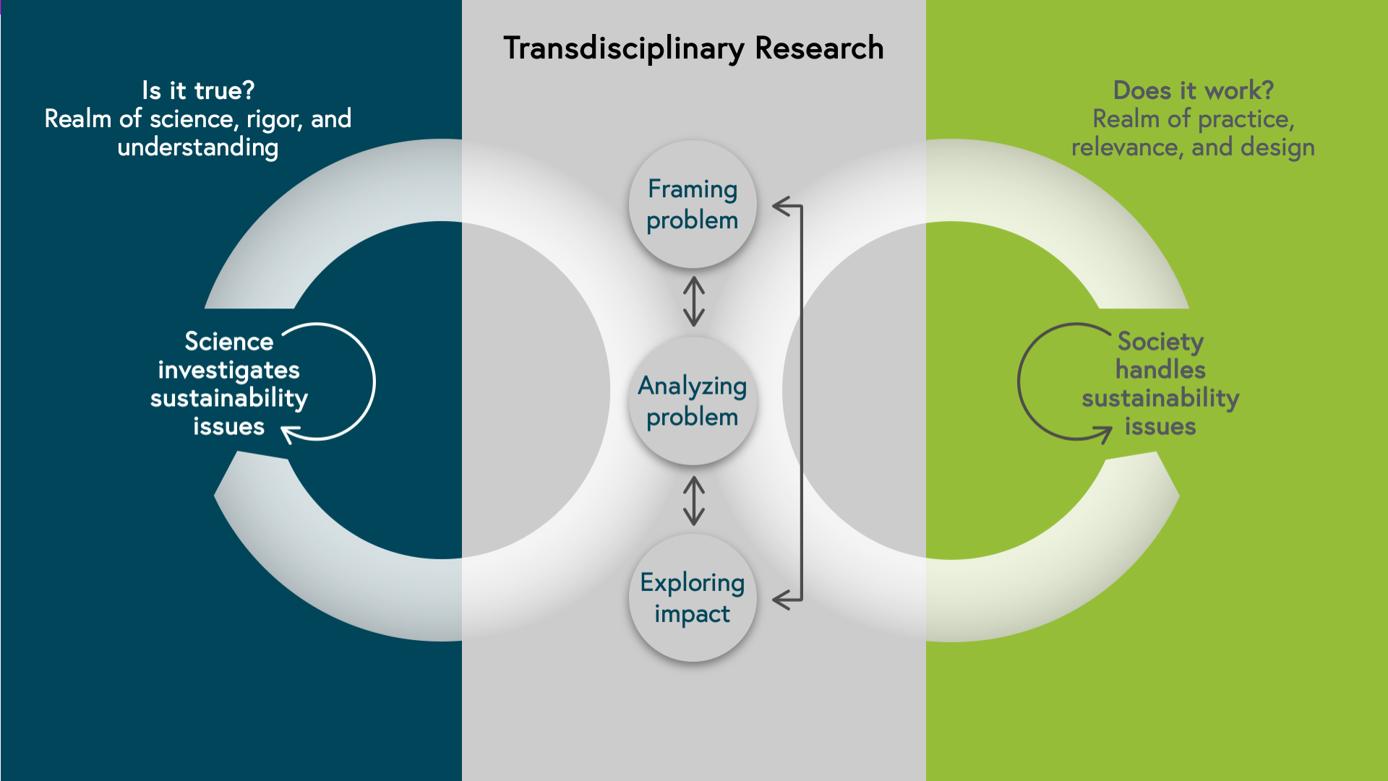
Ocean sciences as an ecosystem of convergence
https://www.futurelearn.com/info/courses/partnering-for-change/0/steps/91244

Slide 16
Ocean sciences transdisciplinary capabilities
Ocean cultures, heritage & coastal paleontology
Ocean governance and law of the seas
Marine engineering & robotics
Shallow water ecosystems & estuaries
Oceanography
Marine biodiversity
Marine spatial planning
Climate and global change
Oceans economy
Maritime management & logistics
Marine food security
Marine & coastal tourism

Slide 17
Ocean sciences research chairs
Chair in Ocean Cultures and Heritage
Chair in Law of the Sea and Development in Africa
Chair in Ocean Science and Food Security
Chair in Marine Spatial Planning
Chair in Shallow Water Ecosystems

Slide 18








Ocean sciences transdisciplinary capabilities

Slide 19
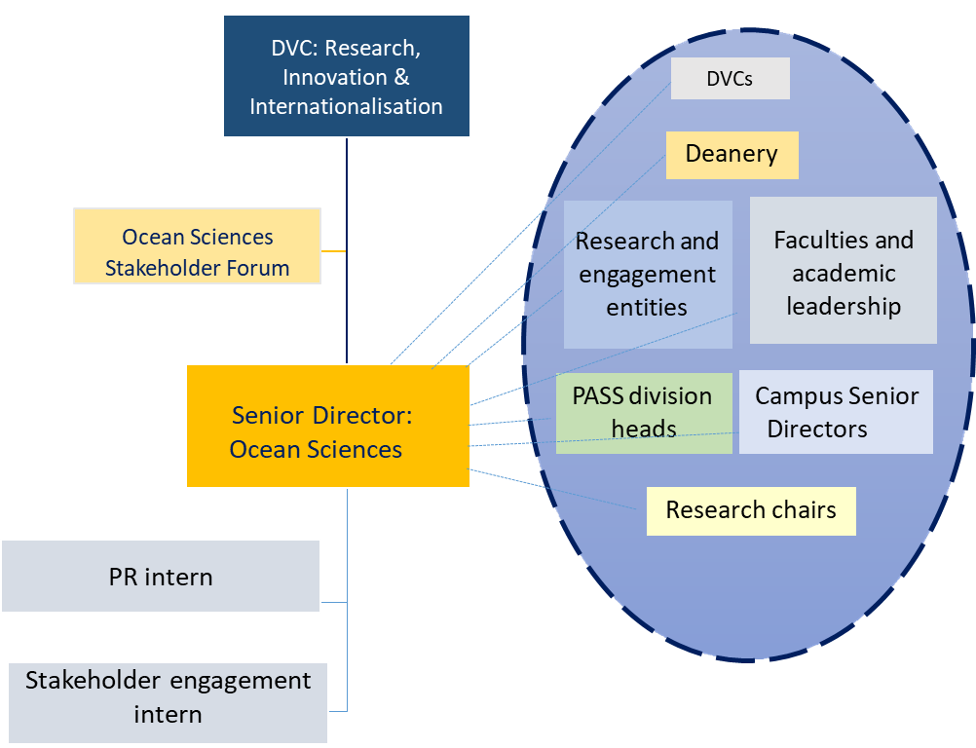
Ocean sciences governance: Networked model
The Senior Director of Ocean Sciences will fulfil the role of leveraging existing and emerging institutional capabilities to foster innovative, transdisciplinary collaboration, positioning the University as a premier destination of choice for ocean sciences. This will be brokered and facilitated through a networked model in close liaison with all faculties, as well as relevant research and engagement entities, research chairs, and support service divisions.

Slide 20
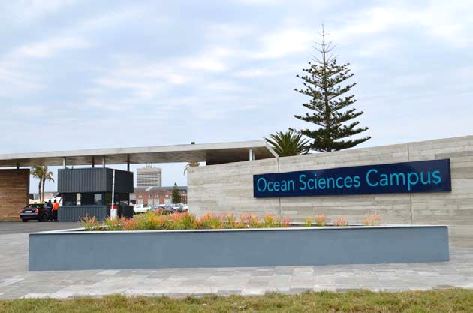
Modernised infrastructure and facilities
Only dedicated Ocean Sciences campus in South Africa

Slide 21
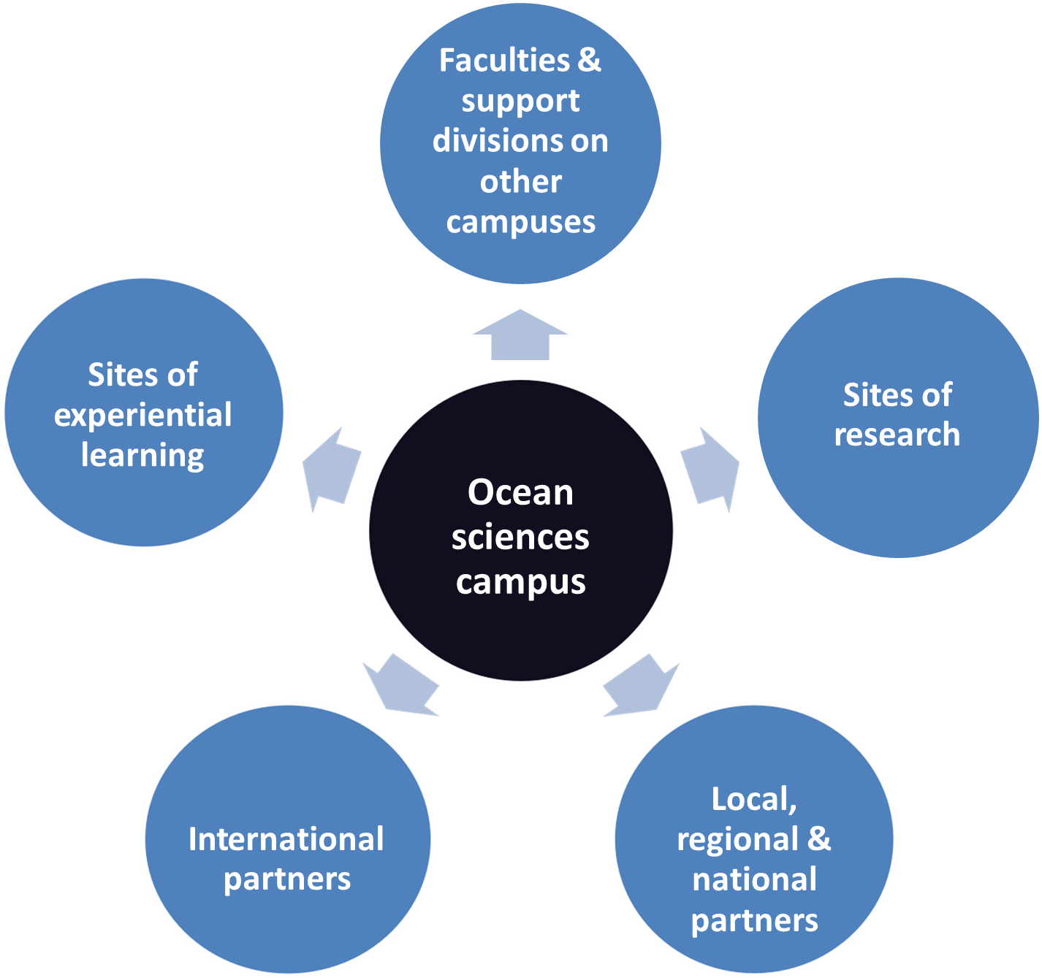
Ocean sciences governance: Hub and spokes model

Slide 22
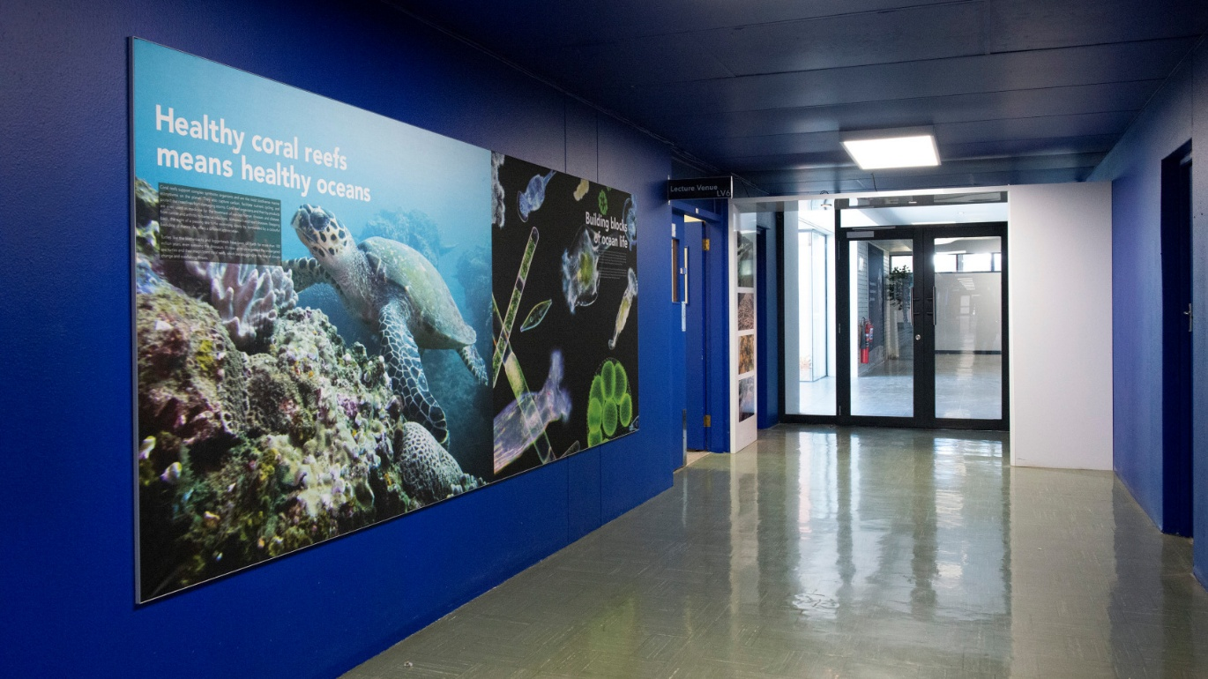
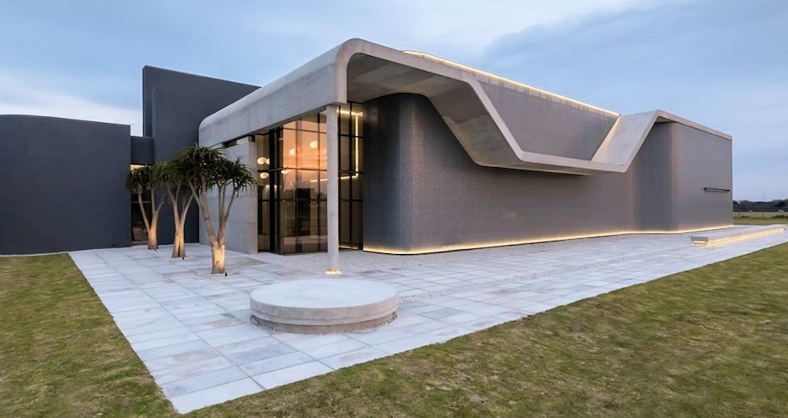
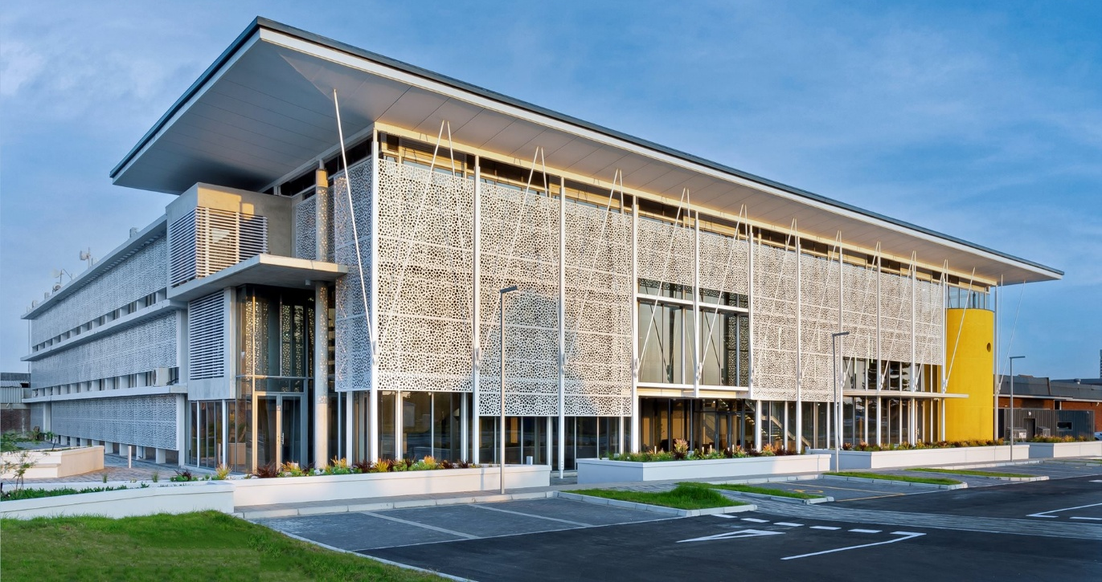
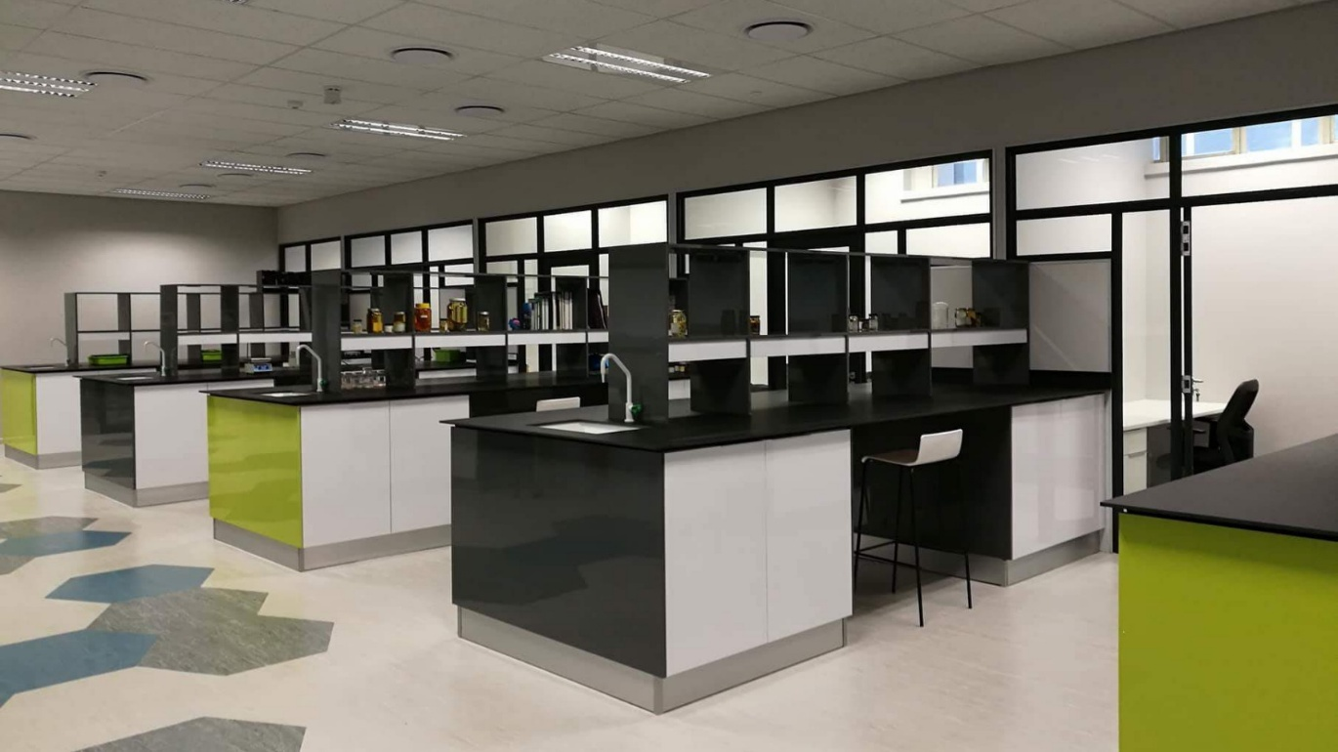
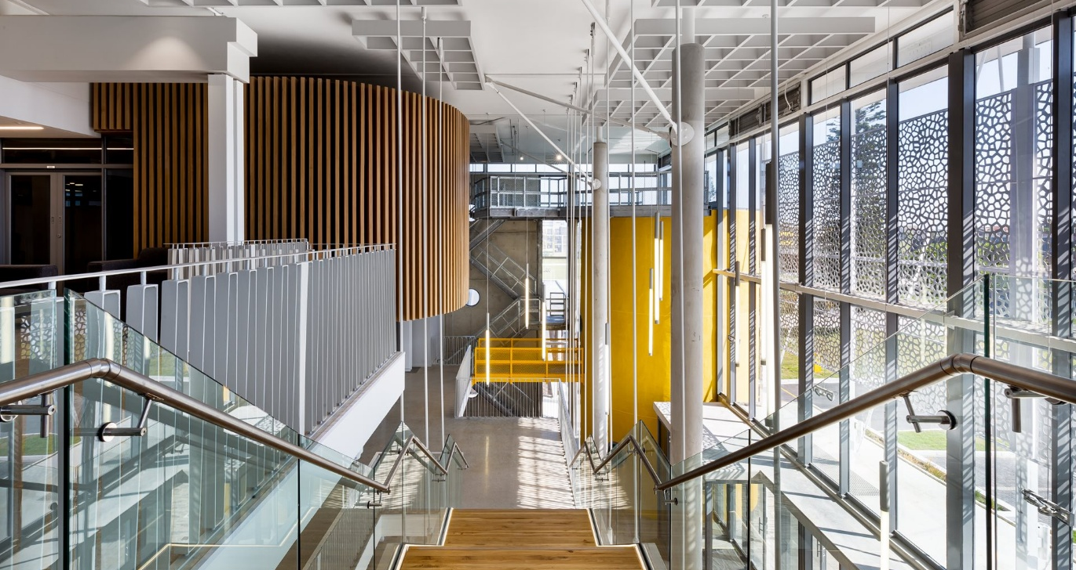
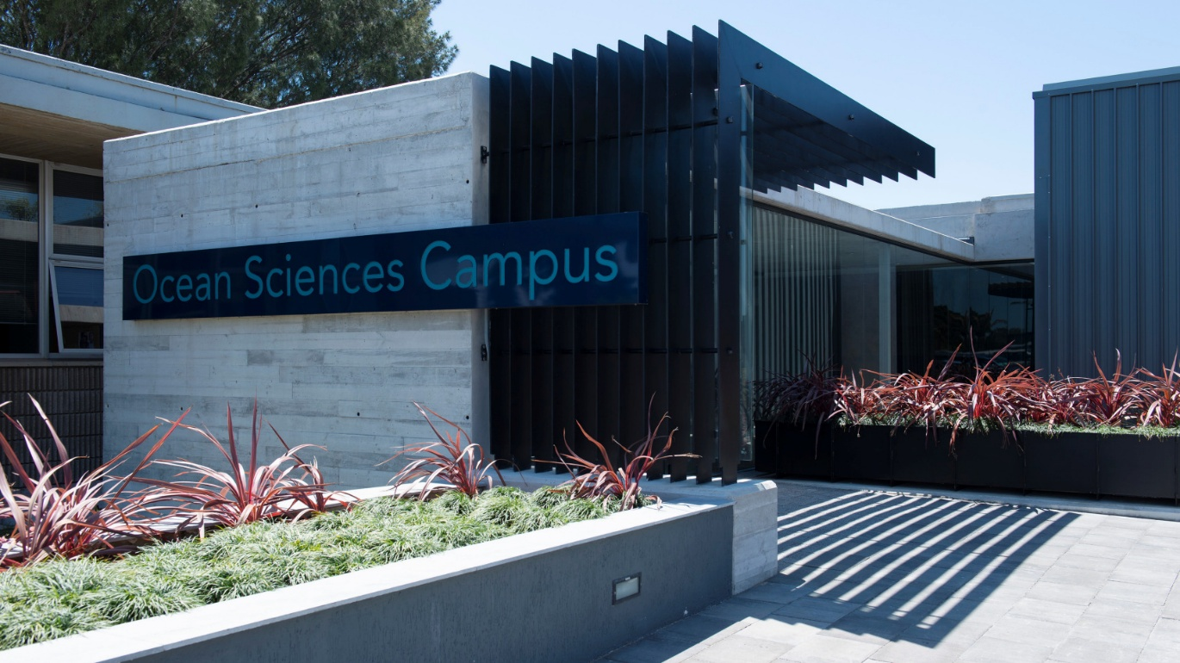
Ocean sciences infrastructure & facilities

Slide 23
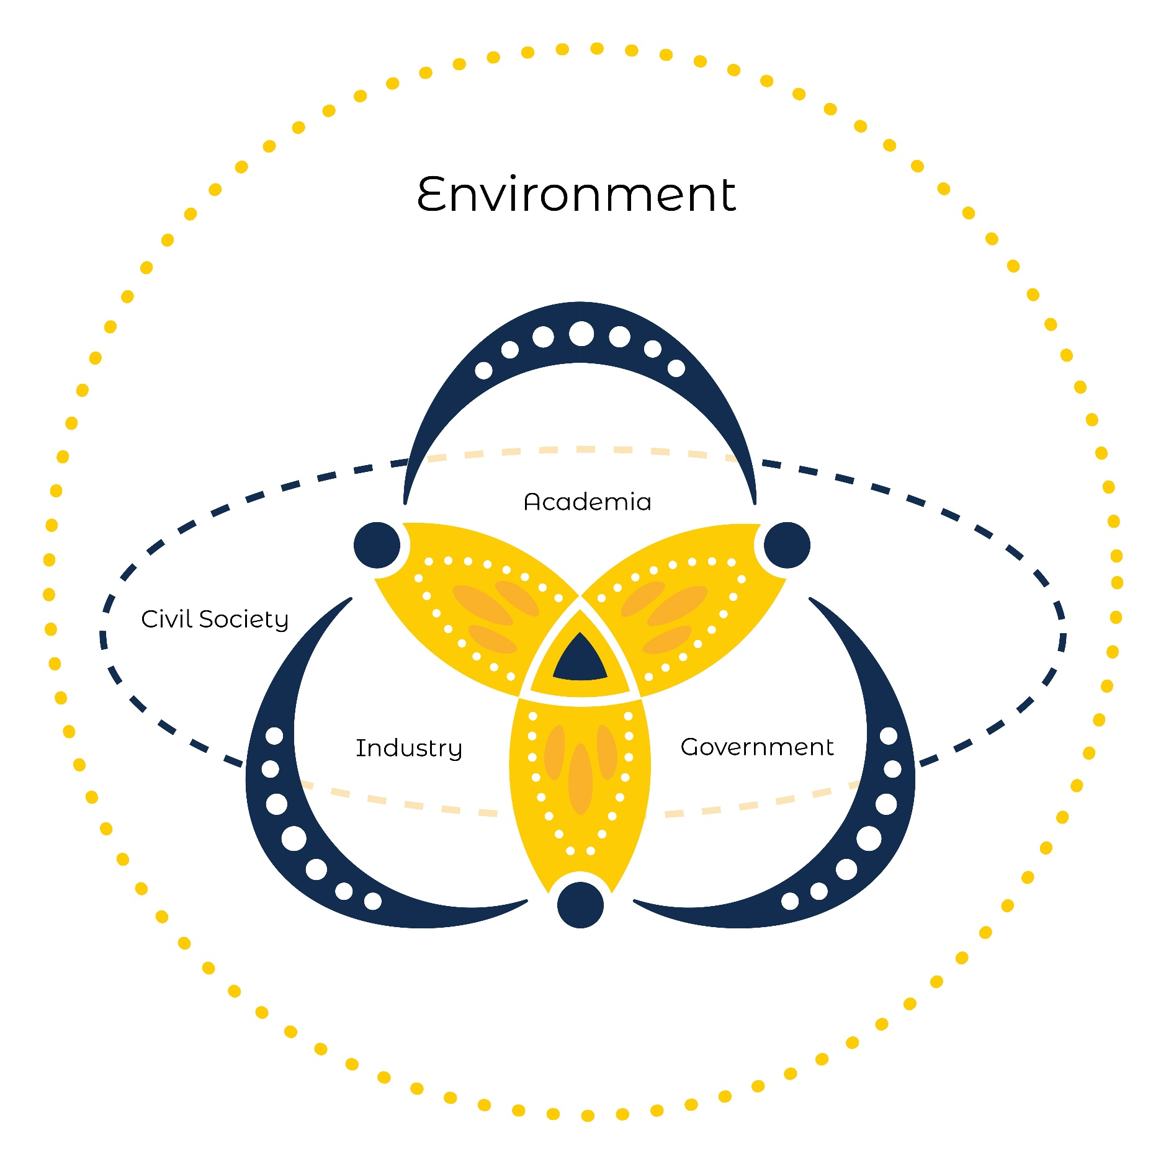
Ocean sciences quintuple helix partnerships
A pillar of the Ocean Sciences Strategy is to forge mutually beneficial quintuple helix partnerships with civil society, industry, government, and other post-school educational institutions nationally, on the African continent, and internationally.
The University is progressively building towards creating a conducive ecosystem for convergence where university staff and students can come together with external stakeholders to address multi-faceted sustainability challenges.
The relationships between the actors are the context for achieving value-creating outcomes that none of the parties could have achieved alone (Hasche, Höglund & Linton, 2019: 3-5).
The quintuple helix has emerged as a transdisciplinary perspective that strives to achieve a sustainable balance between the development paths of society and the economy, with their natural environments (Carayannis & Campbell, 2011; Mineiro, de Souza & de Castro, 2021).
This aligns well with the intentions of Mandela University to position itself as a socially embedded university where engagement is conceptualised as convergence or the coming together of university and community to co-create knowledge through impactful, real-life programmes that promote sustainability (Muthwa, 2018).

Slide 24
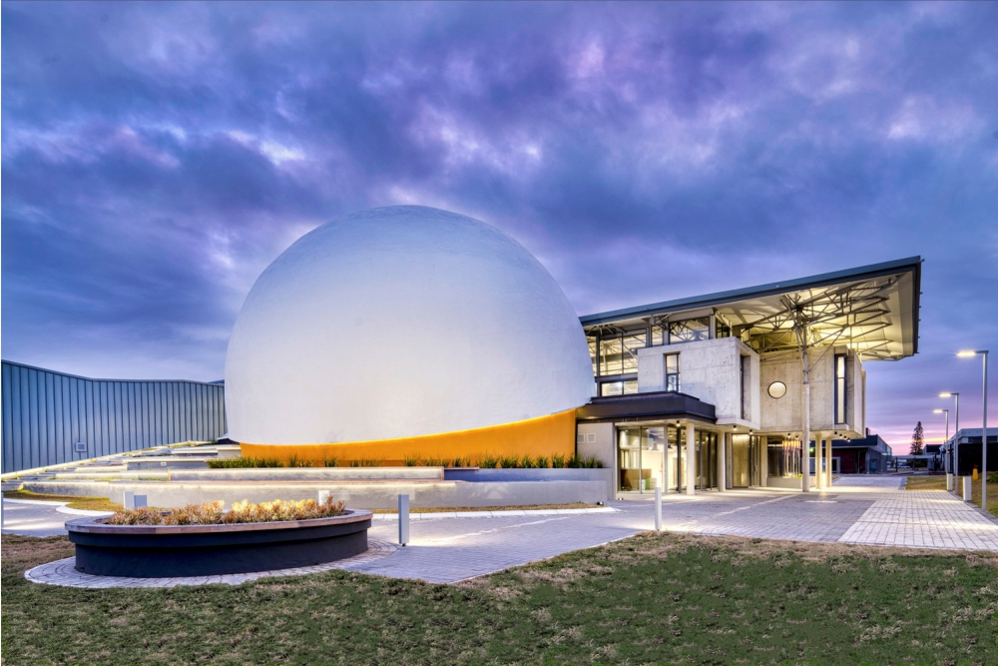
Infrastructure advancing science for society
The Science Centre was established as an expression of the University's commitment to being an engaged, socially responsive institution, dedicated to inspiring young people to become the next generation of scientists and innovators through a transdisciplinary approach to Science, Technology, Engineering, Arts, and Mathematics (STEAM) education.

Slide 25
CONCLUDING REMARKS
45

Slide 26

Concluding remarks
Nelson Mandela University seeks to advance inter- and transdisciplinary scholarship to respond to the grand challenges confronting our communities, planet, and oceans.
The ocean sciences strategy promotes an ecosystem of convergence by leveraging equalising partnerships between academia, government, industry, and civil society in novel, mutually respectful ways to change the world.

Slide 27


