Slide 1
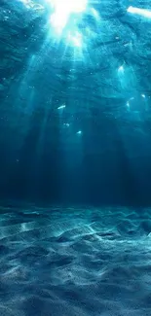



Deep waters, shared space: Transdisciplinary insights into marine mammal-fisheries interactions.
Lindiwe Makapela
Stellenbosch University &
Sea Search Research and Conservation
Transdisciplinary Ocean Sciences and Ocean Sustainability Activism symposium
Paul Tixier
Simon Elwen
Charlene da Silva
Stewart Norman

Slide 2
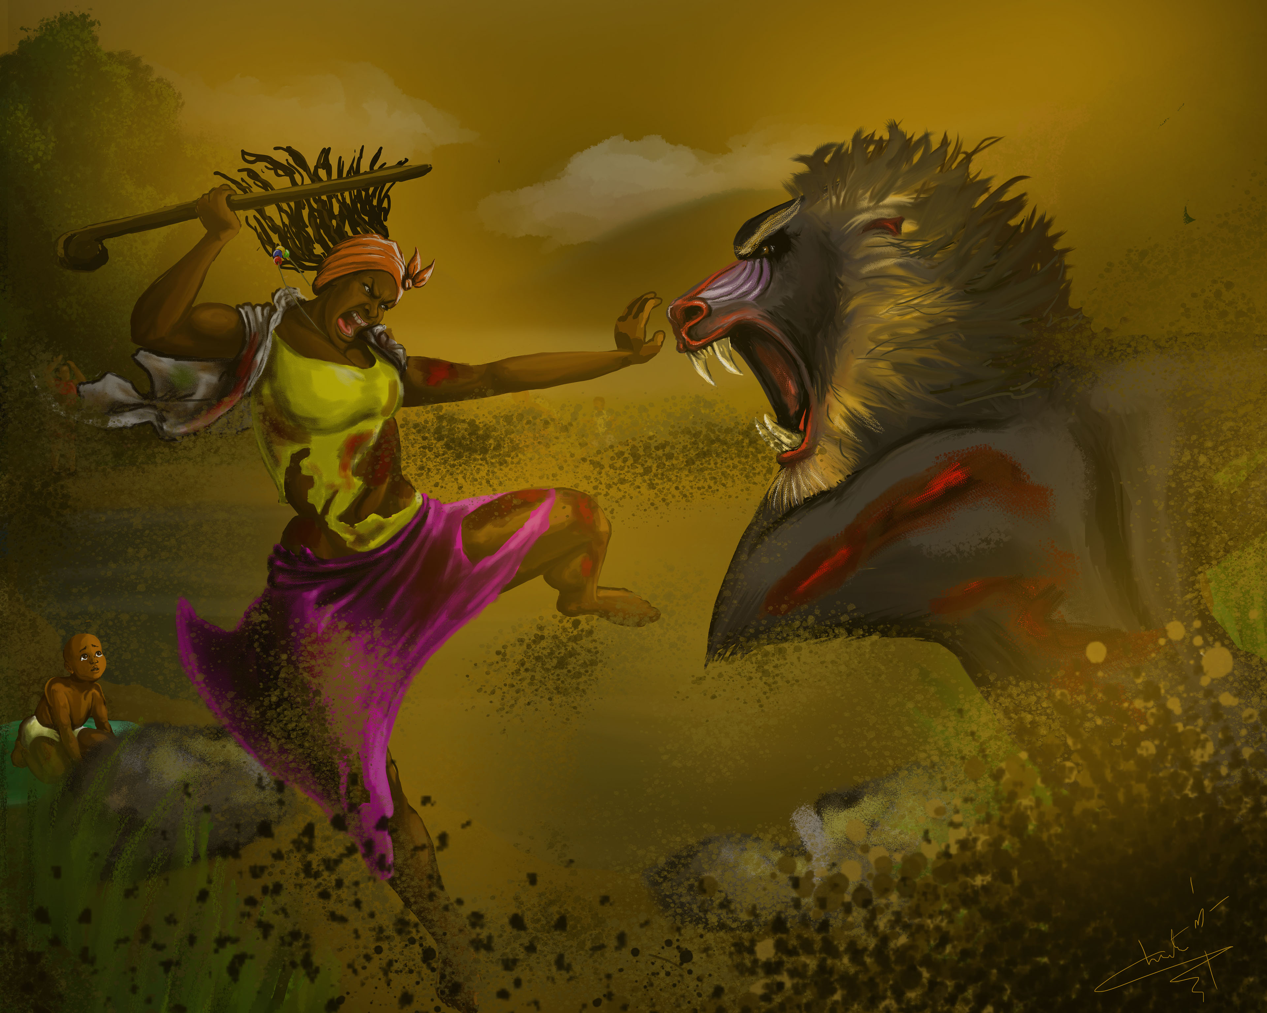
HUMAN - WILDLIFE CONFLICTS
The expansion of human populations-> interactions with wildlife -> conflict (Woodroffe et al. 2005)
Drivers of human - wildlife conflicts
1) Adverse effects of humans on wildlife
2) Threat to property, economy, security, recreation and safety
Socio-economic, ecological, conservation and management implications
Notes:
Relevance of human wildlife conflicts e.g. depredation to transdisciplinary ocean research:
Interactions between humans and wildlife involve
A. Natural systems (Marine ecology) – conservation and ecological aspect
predator behaviour in response to human activity, conflict with humans
Human system (Fisheries operations) – socio economic aspect
Fishermen behaviour
Knowledge system (science + governance) – management aspect
Data limitations
reporting bias
Interpretation of management
And the interaction between these systems is where transdisciplinary science becomes essential

Slide 3
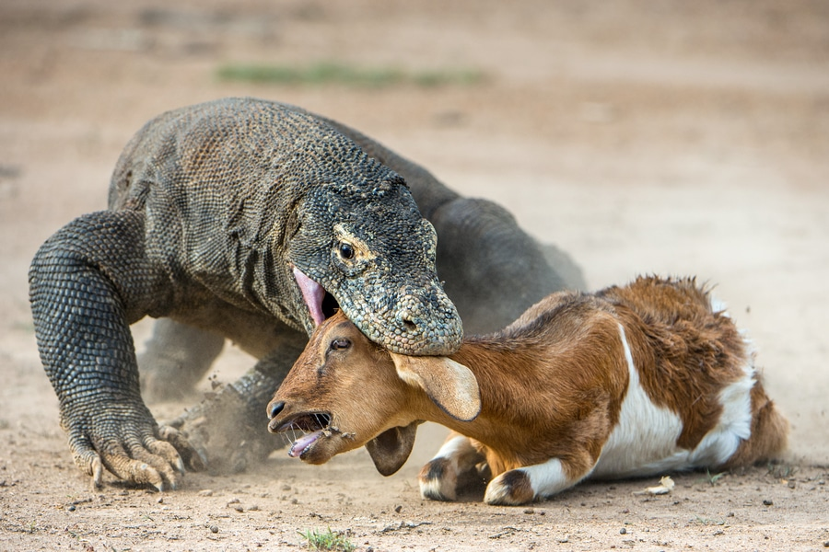
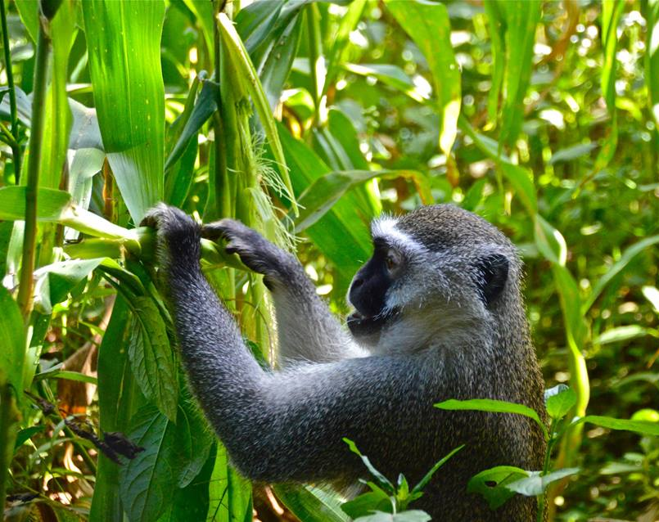
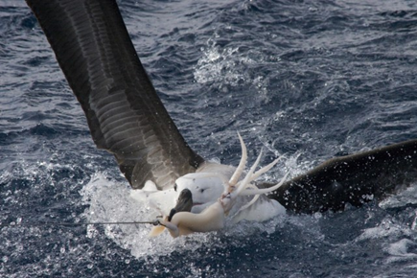
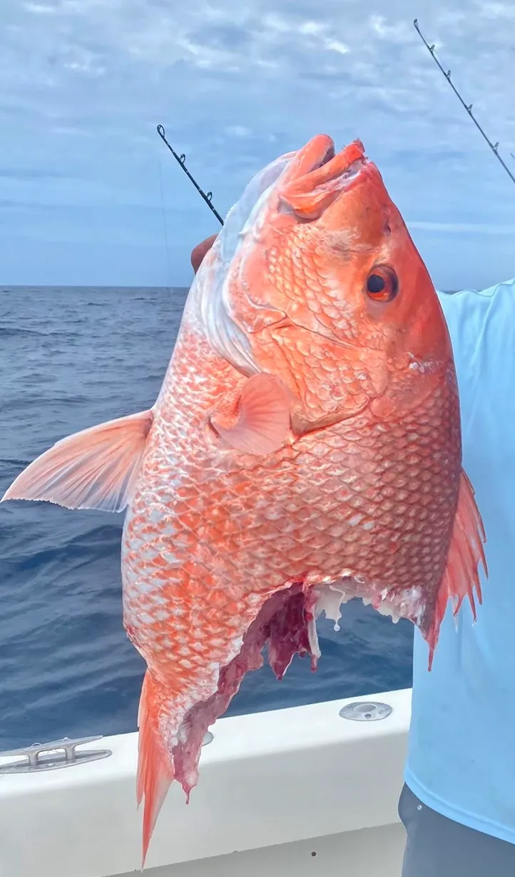
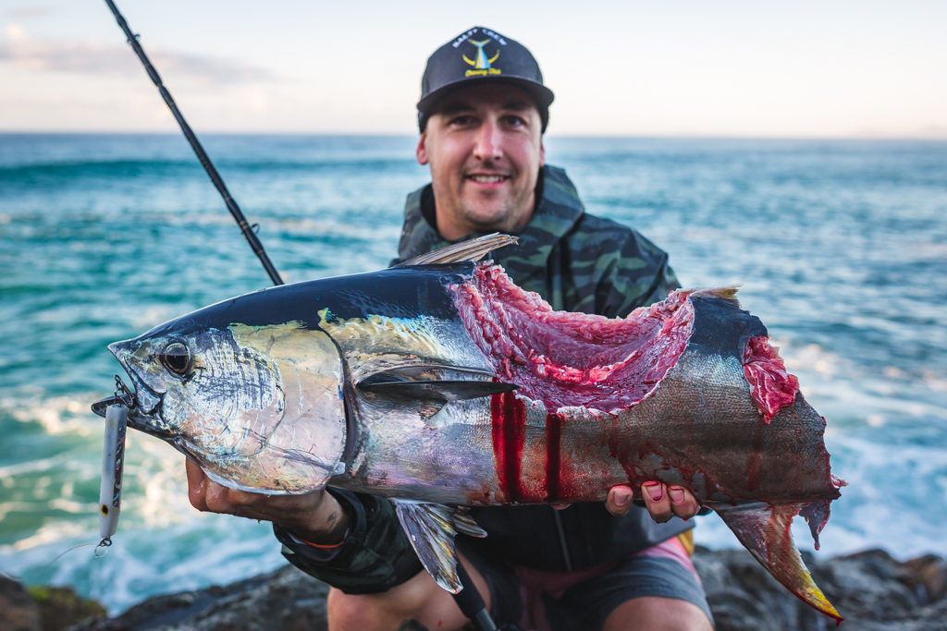
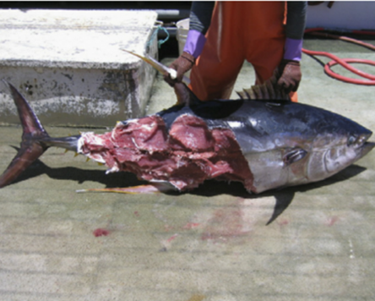
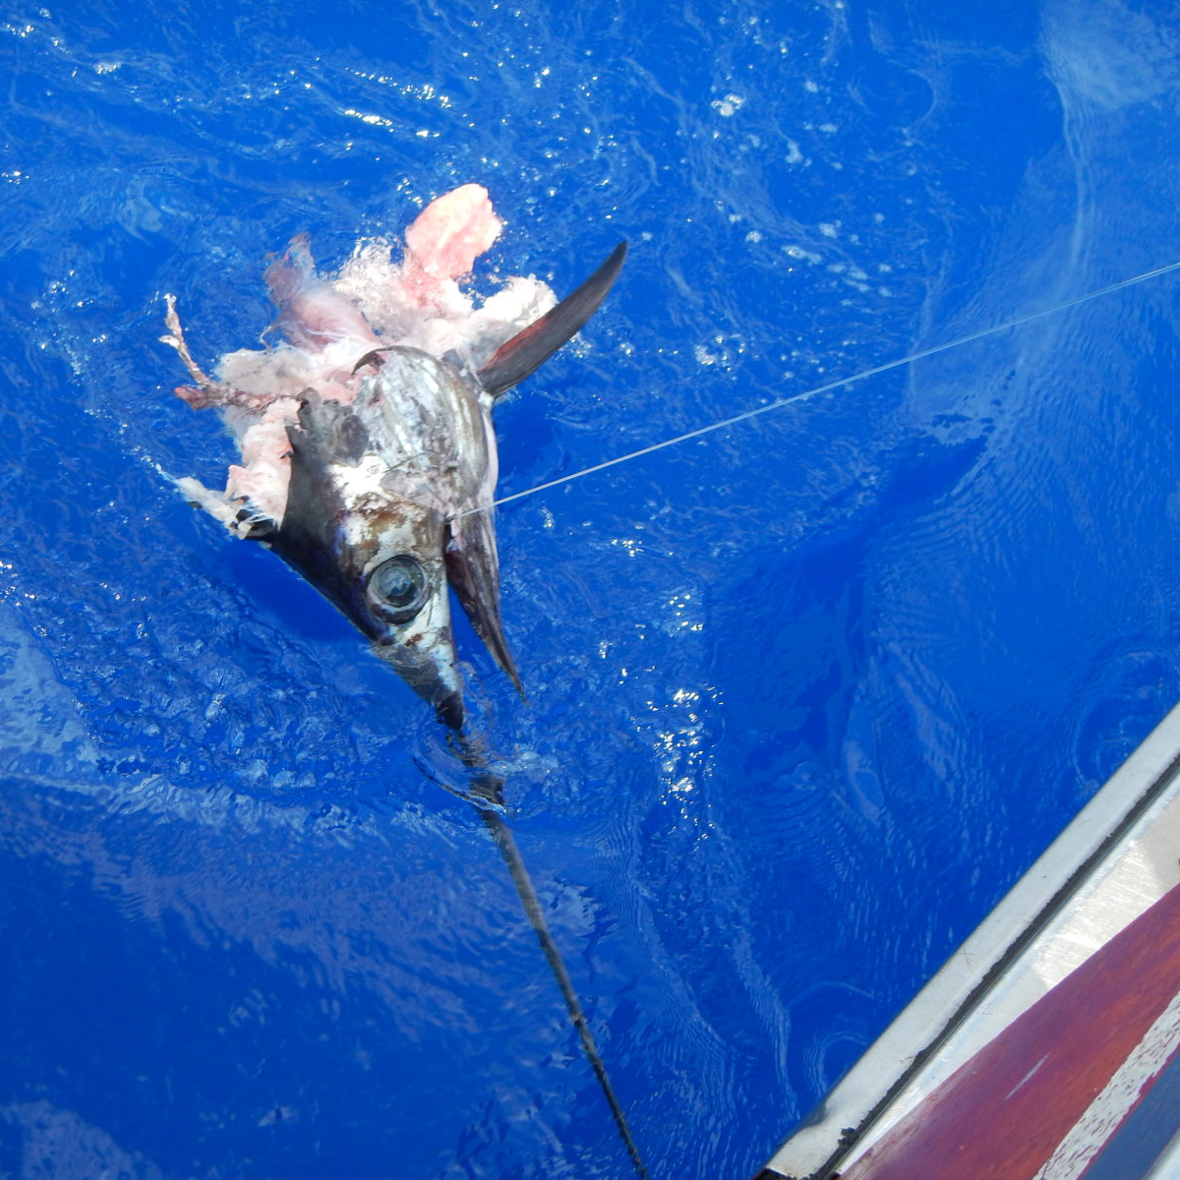
DEPREDATION
Species feeding on plants or animals that are cultivated, raised or caught by humans (Woodroffe et al. 2005)
Notes:
A major source of human-wildlife conflicts -> Depredation

Slide 4
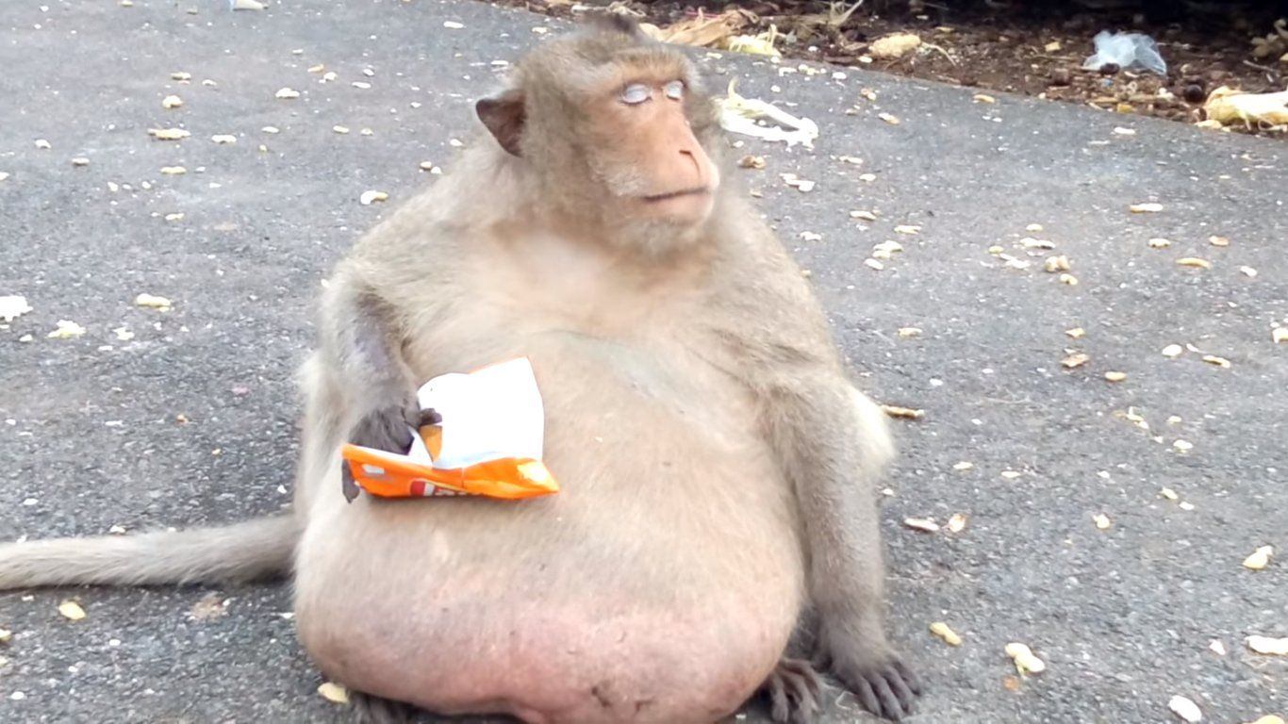

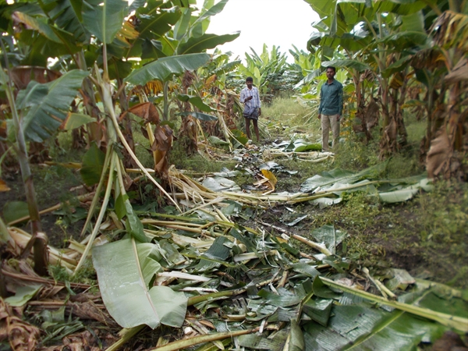
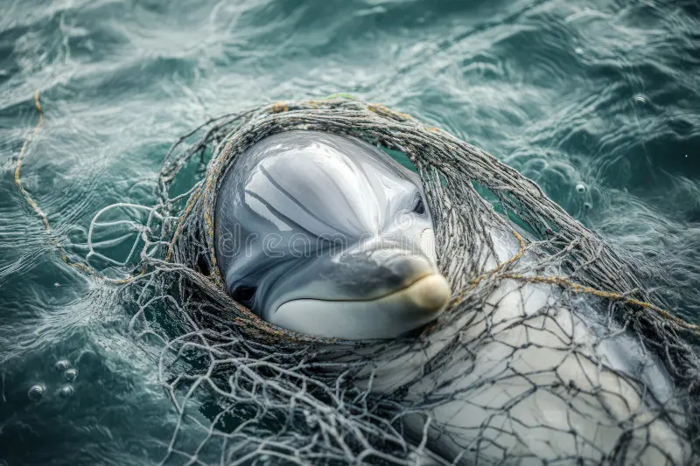
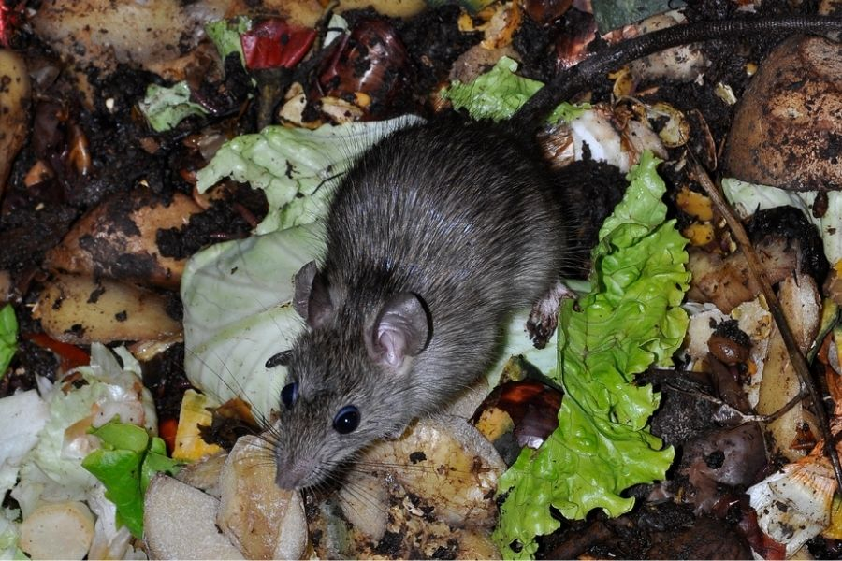
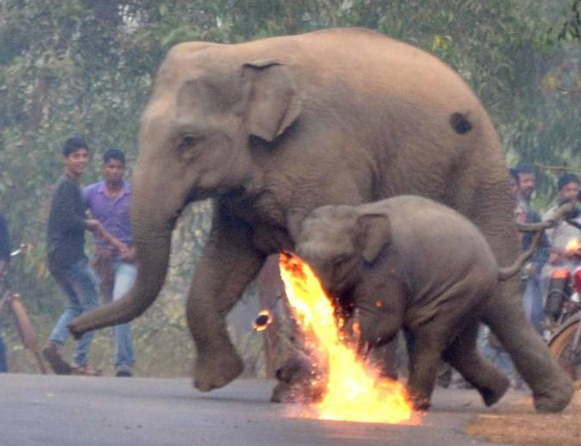
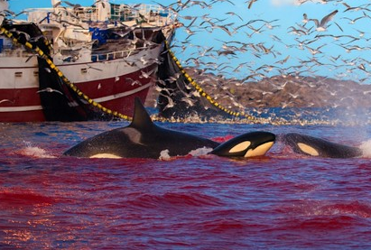
IMPACTS OF ARTIFICIAL FOOD SUBSIDIES ON WILDLIFE
ECOLOGICAL
SOCIO-ECONOMIC
CONSERVATION
Notes:
Ecological impacts
Positive = improved body condition I animals, increased resting time relative to foraging time ( more energy available for reproduction)
Negative = Explosion of populations e.g. rats and mice which are disease vectors , injury and possibly death due to retaliation by humans
Socio-economic = farmers and fishermen lose lots of money due to loss of resources as a result of depredating individuals
Conservation = Animals can get injured, entangled in fishing gear or killed by fishermen and this poses a problem for species which are endangered or threatened and are likely to face extinction

Slide 5
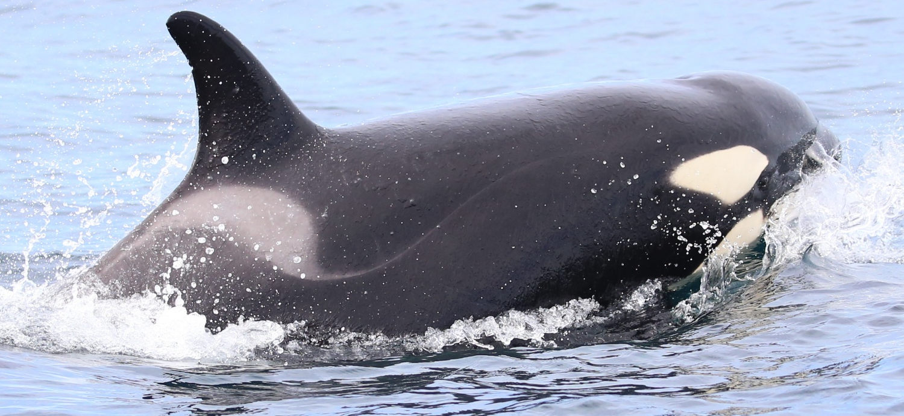
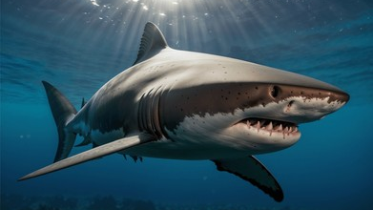
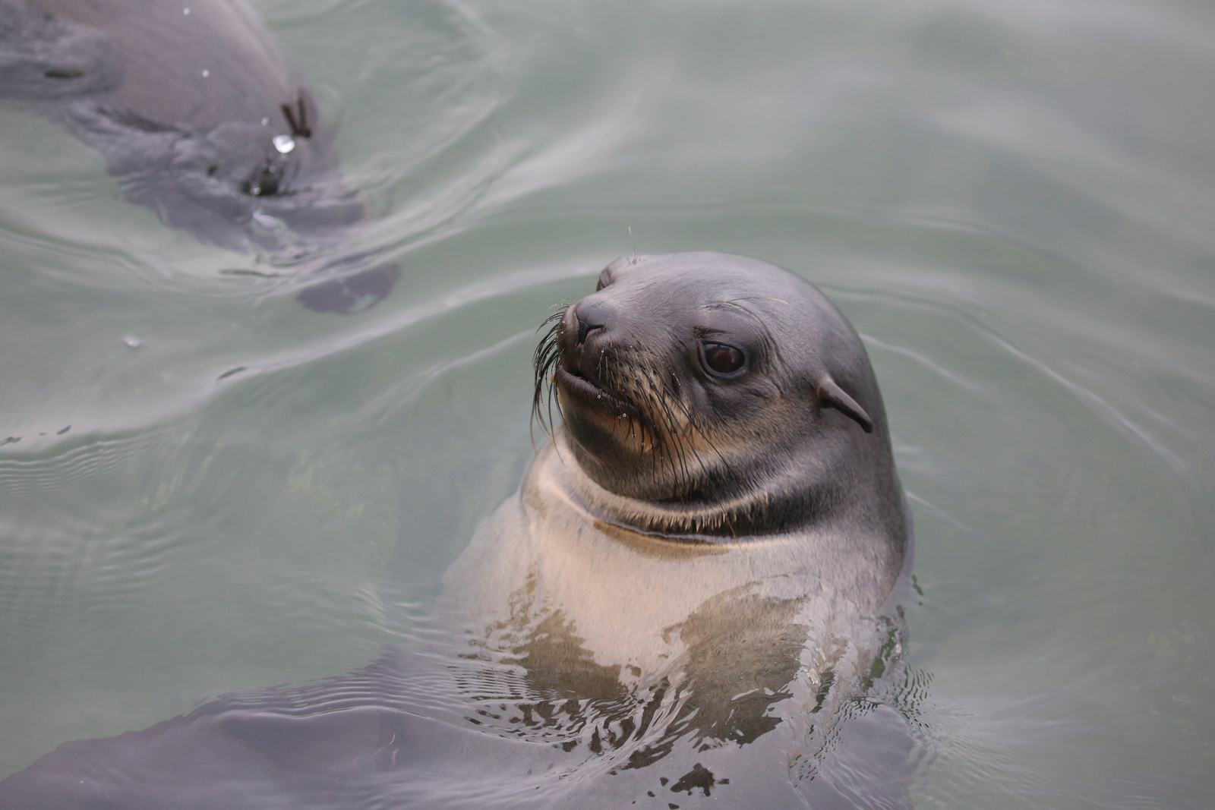
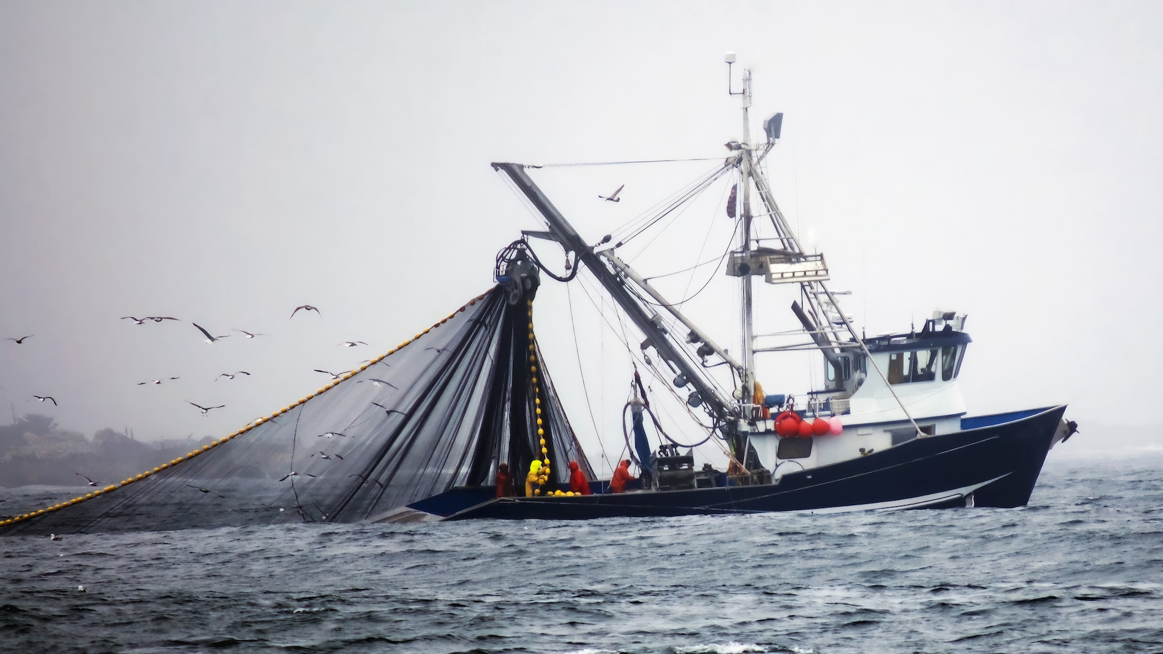
DEPREDATION IN THE MARINE ENVIRONMENT
Notes:
Depredation records date back to 1904
Large marine top predators (e.g. odontocetes, sharks, pinnipeds)
Depredation has increased ~ 50 years
Studies of top predators feeding on fishery catches is limited in SA
Behaviour has ecological,economic and conservation impacts

Slide 6
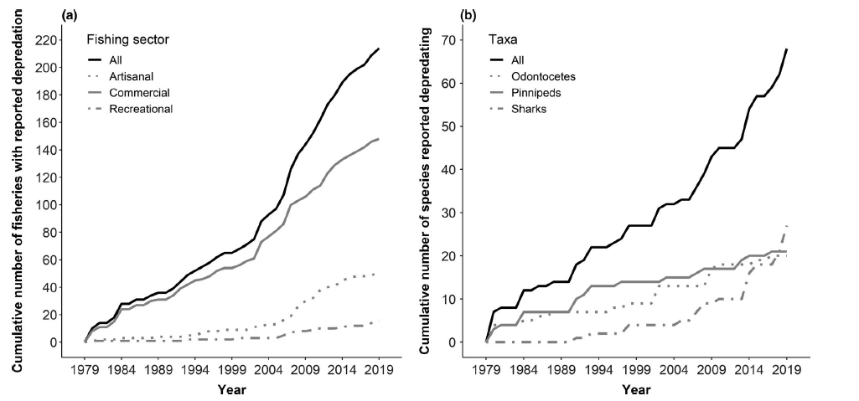
GLOBAL CONTEXT OF DEPREDATION
The number of fisheries depredated, and the species involved, are increasing (Tixier et al. 2020)
Notes:
Depredation has emerged as a global issue -> 214 fisheries affected
Patagonian tooth fish fishery off Crozet Islands (Tixier et al 2010) :
Economic impacts
2003 – 2008 :
- € 8.40 per kilo
571 tonnes of toothfish lost = € 4, 800, 000
2025 :
571 tonnes = € 8, 222, 400 – 25, 243, 910
Ecological impacts
Injury
Bycatch
Retaliatory killing

Slide 7

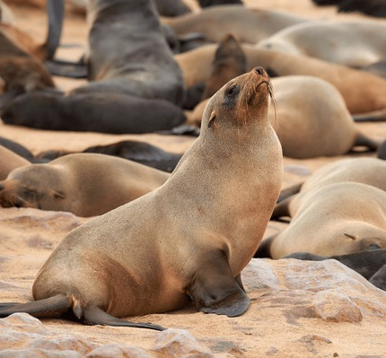
LOCAL CONTEXT OF DEPREDATION : SOUTHERN AFRICA
Notes:
Poorly investigated
Species have been documented feeding from fishery catches for the past 20 years
Two mains cases of depredation in commercial longlines in Southern Africa
Killer whales – Tuna/Swordfish longline fishery ( since 1970)
Cape Fur seals – Hake longline ( data limited)

Slide 8
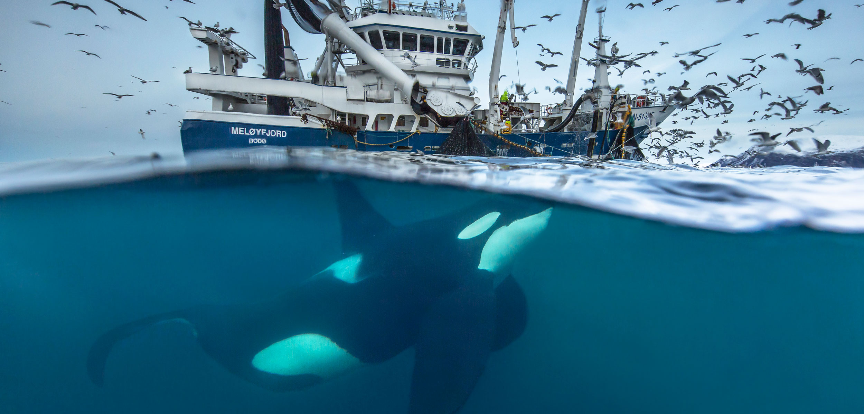
ORCINUS ORCA –FISHERIES INTERACTIONS IN SA

Slide 9
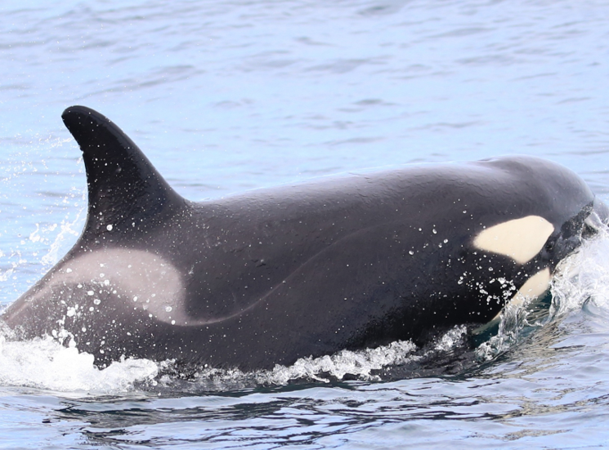
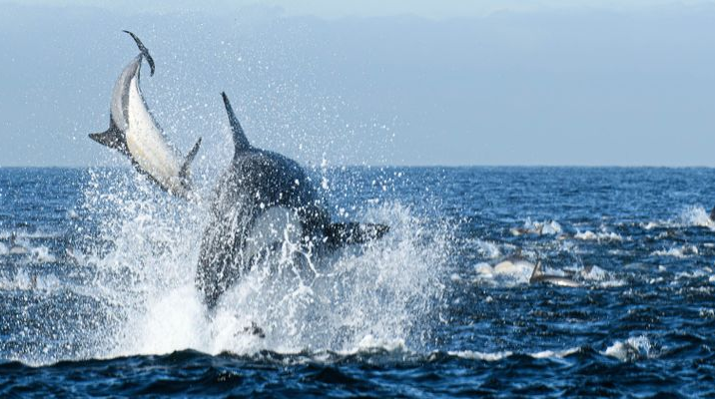
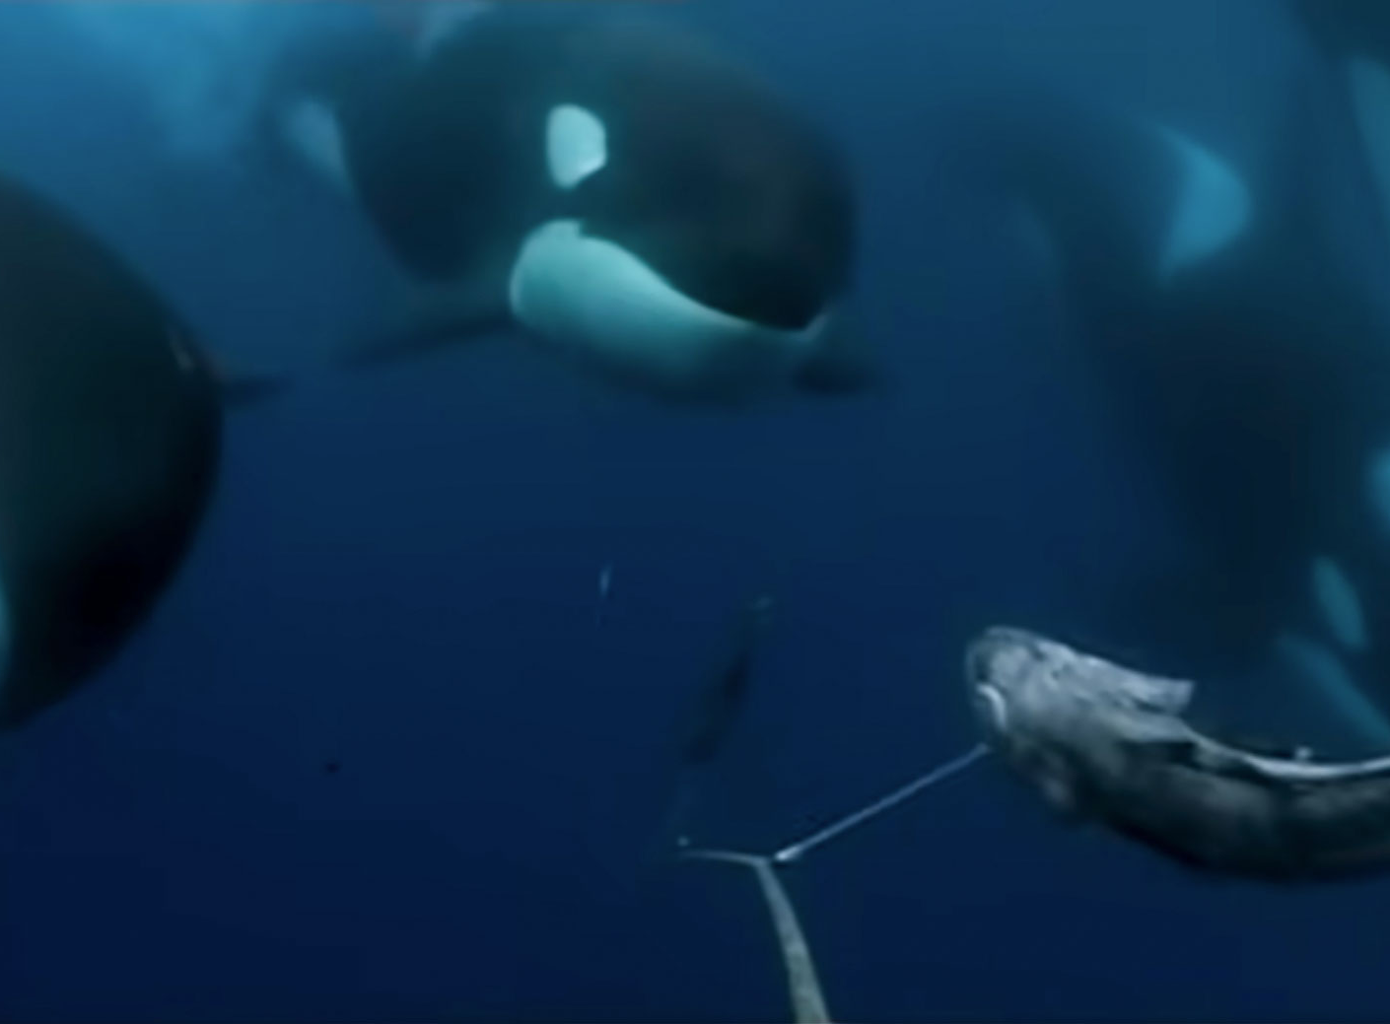
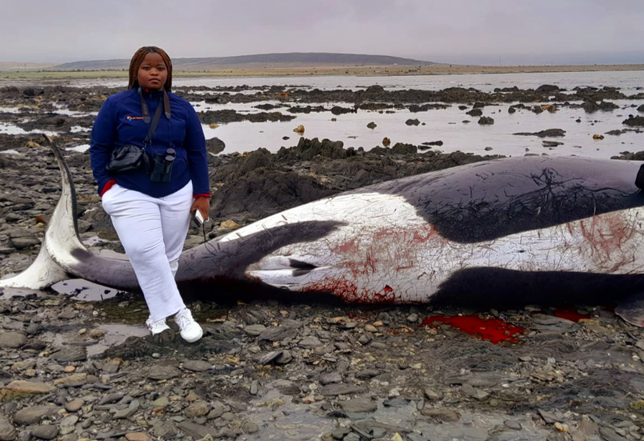
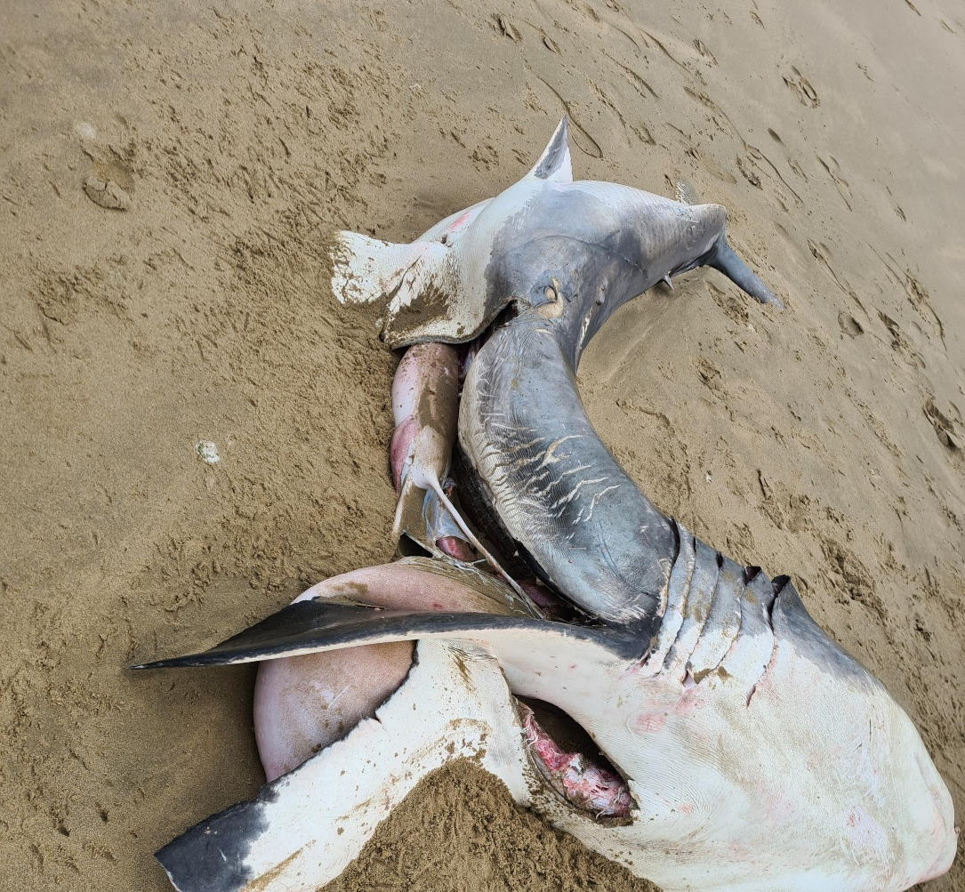
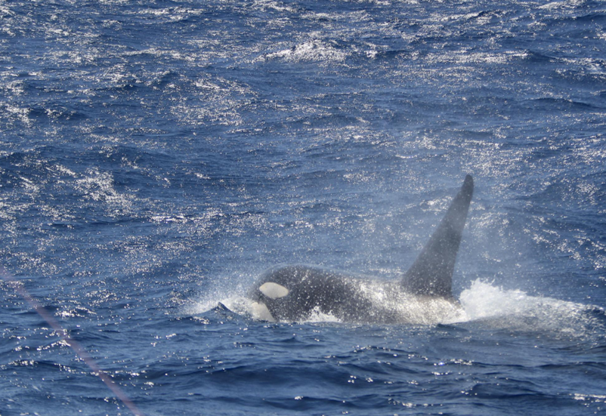
KILLER WHALES IN SOUTHERN AFRICA
Potential ecotypes
Populations = coastal and offshore
Diet – broad but specialization has been observed
Knowledge gaps
- Not much known about the ecology and behaviour of killer whales
Notes:
Regional variation in morphology, diet, acoustic behaviour and genetics
Numerous forms “ecotypes” of killer whales feed off longlines globally
In Southern Africa, some animals have shown dietary specialization :
Marine mammals (Best et al. 2010, Elwen et al.submitted).
Some shark specialization
At least some animals known to depredate from longlines

Slide 10
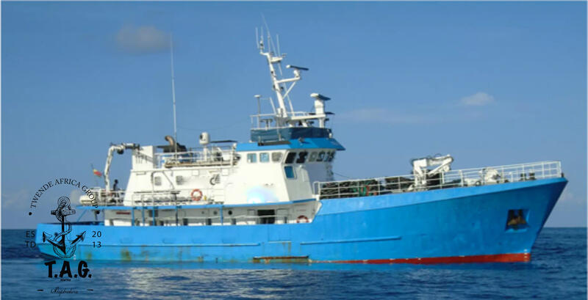
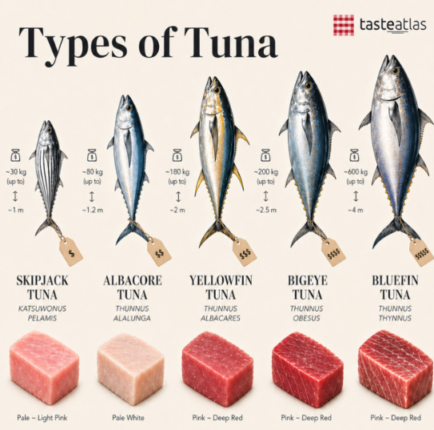
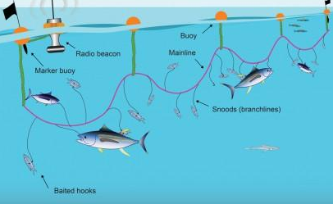
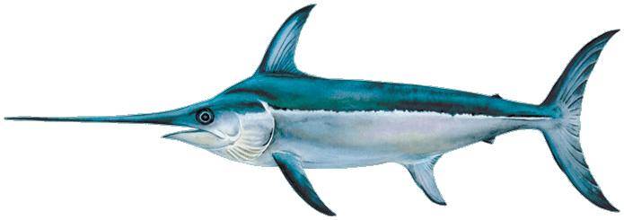
LARGE PELAGIC TUNA LONGLINE FISHERY
Started in 1960s
Initially - Yellowfin, Southern Bluefin
Then - Albacore, Big Eye and Swordfish
Historically : mako and blue shark = bycatch
Revenue = approx. R500 million / year

Slide 11
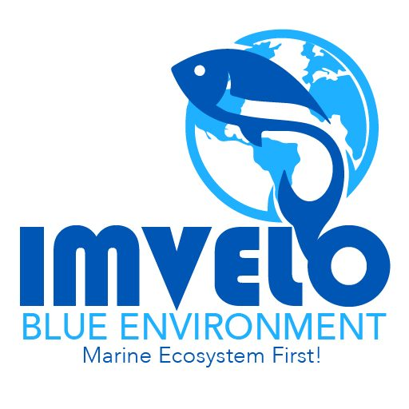
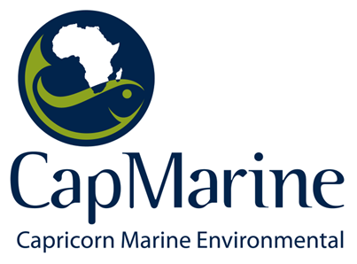
MATERIALS AND METHODS
1. Using existing fisheries data (2013-2022), I quantified killer whale depredation (interaction rates) across time, space.
2. Using a modelling approach (GAMs) I investigated a range of operational, environmental, spatial and temporal variables to understand how these may be shaping the occurrence of killer whales in space and time.
Notes:
GAM models investigated the ecological, environmental, operation variables that may be driving killer whale presence and ultimately depredation
The GAM model outputs will help us calculate the frequency of depredation in relation to the above variables

Slide 12
DATA ANALYSIS
Mapped the distribution of effort and killer whale interactions through space and time
Metrics calculated :
IR= $\frac{PROPORTION OF LONGLINE SETS WITH KILLER WHALES}{TOTAL NUMBER OF LONGLINE SETS DEPLOYED}$
Models ran:
Generalized additive models were ran to assess operational, spatial, temporal and environmental factors driving killer whale presence

Slide 13
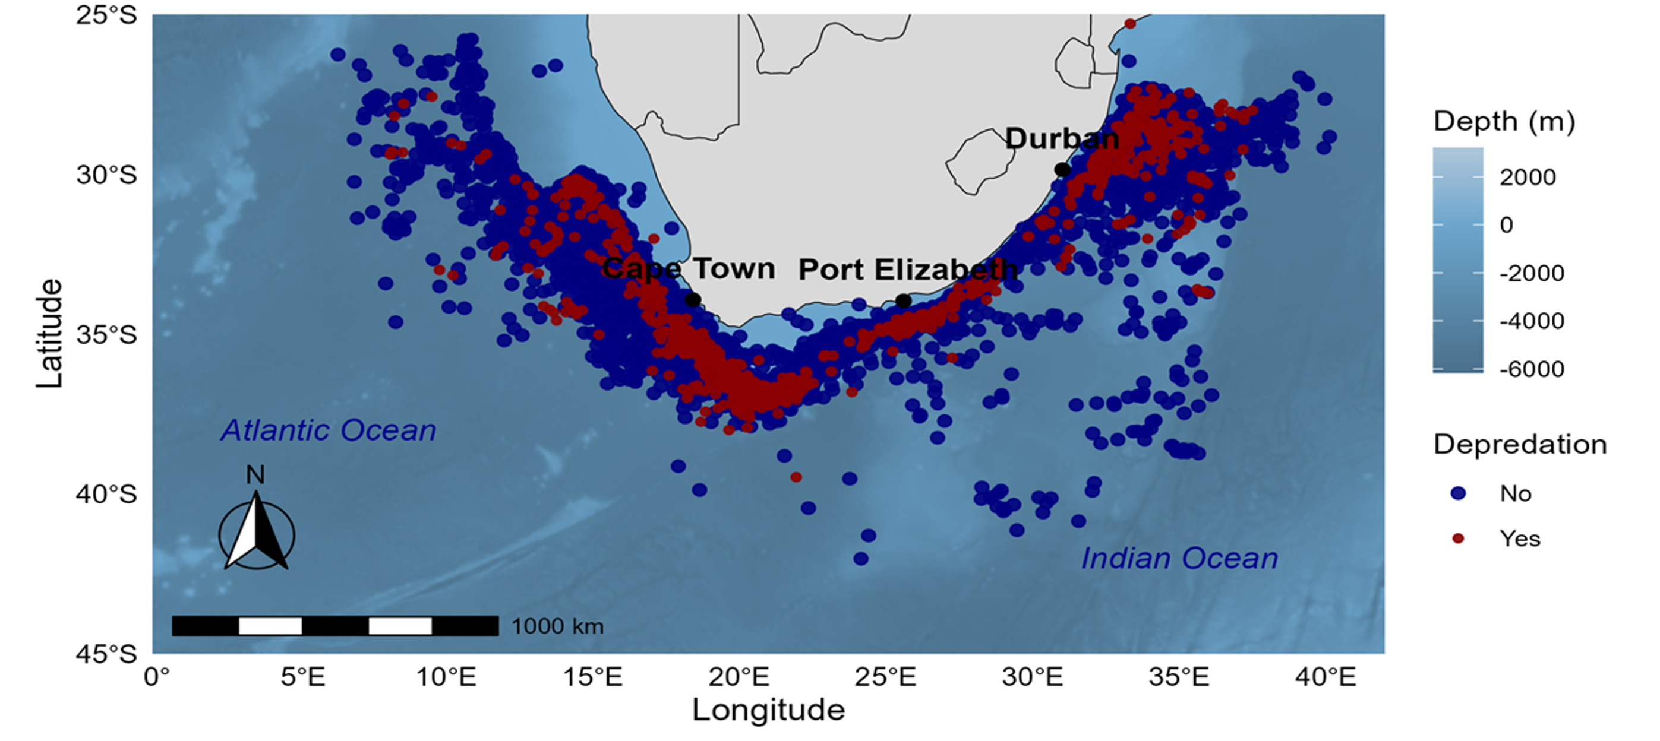
KEY FINDINGS
Study area and fishing effort (2013-2022) of the large pelagic tuna and swordfish fishery of southern Africa
Notes:
Blue dots are sets where no killer whales were observed, and red dots show areas were killer whales were observed interacting with longlines
481 236 individual fish of the target species, comprising the four tuna species and swordfish, between 2013 and 2022
Fishing effort ranged between 1000 to 3,768 hooks per set
In comparison, the bycatch species e.g. blue shark and mako shark totalled 579 763 individuals ( back then quotas for blue and make shark had not been set even though fishermen were allowed to catch them. However, quotas and limits have been put in place and these species aren’t been landed as much as before

Slide 14
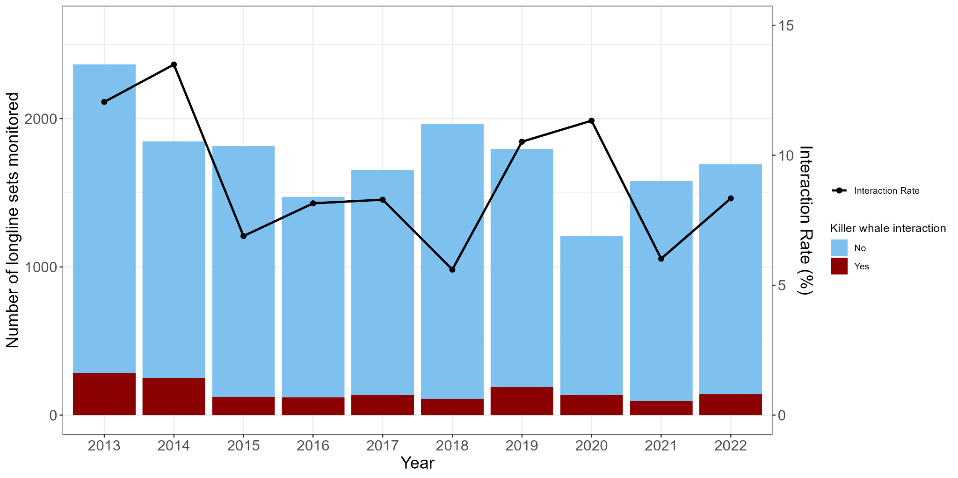
KEY FINDINGS
Notes:
IR = Proportion of longlines with kw/ total no. of longlines set
Interactions vary across time with peaks observed in some years, but are fairly low
A total of 15821 sets were deployed over the 10 year study period, with killer whales being observed on 1,582 of these
This means that killer whales were recorded interacting with ~9.2% of the longlines set over a 10 year period.
This interaction rate was comprised of both assumed and confirmed cases of depredation. The assumed cases of depredation accounted for 8.6% of interactions and the 0.6% accounted for confirmed interactions

Slide 15
MODELLING KILLER WHALE PRESENCE
GAM MODEL RAN | DEVIANCE EXPLAINED
KW_presence ~ Year + s(HOOKnr) + s( Soak.Duration) + s (lon, lat,) + s( Water.depth) + s (Sea Temperature)+ Vessel_ID+ Target | 32.5%
ENVIRONMENTAL
OPERATIONAL
TEMPORAL/SPATIAL
Sea surface temperature
Water depth
Soak duration
Hook number
Vessel_ID
Target – species specific
Year
Location
Notes:
We explored a wife range of variables to assess the possible drivers of killer whale occurrence near fishing vessels:
Sea surface temperature, soak duration, hook number, year and location had a significant influence on killer whale occurrence
Soak duration : the longer the lines were left to soak in the water column, the greater the probability of killer whale presence
Hook number : the more hooks are deployed, the more fish there is and thus the more killer whales are likely to occur near fishing vessels
Despite testing all these variables, the model performed quite poorly, which indicates that there are other factors at play which may not be recorded, however with insights from fishermen and observers, we believe that the real drivers of killer whale depredation can be assessed and this information will then inform mitigation solutions

Slide 16


CHALLENGES AND OPPORTUNITIES FOR TRANSDISCIPLINARY OCEAN SCIENCES
Challenges:
Limited collaboration between disciplines
Human dimension is often missing
Methodology mismatch
Opportunities:
1. Behavioural ecology + fisheries science integration
2. Improved monitoring systems
3. Combined knowledge across disciplines
Notes:
Limited collaboration between disciplines :
fisheries scientists focus on catch/effort
ecologists focus on behaviour/populations
little integration in interpretation
2. Human dimension is often missing :
Fishers’ behaviour and adaptation to interactions with top predators is not always captured
Economic incentives ignored in ecological models
3. Methodological mismatch
Statistical models assume independences
Ecological interactions are dependent and dynamic
Opportunities:
Behavioural ecology + fisheries integration
treating fisheries as part of ecosystem, not external pressure only
2. Improved monitoring systems
electronic monitoring – use of cameras ( to capture footage of interactions) and hydrophones to pick up whale songs
Train AI models to detect killer whales, automated detection of depredation events
better spatial resolution
3. Co-produced knowledge
involving fishermen in interpretation of interactions
integrating experiential knowledge and possibly traditional knowledge

Slide 17
CONCLUSION
In deep waters, we are not just studying the ocean, we are studying the relationship between nature, industry, and the knowledge systems we use to understand both.
Notes:
My research shows that marine mammal–fisheries interactions are not just ecological events, but socio-ecological signals of a tightly coupled systems. Understanding them requires breaking disciplinary boundaries and rebuilding them into integrated ocean science. Ultimately, the goal here is to develop mitigation solutions with contribution from different disciplines in order to help us preserve ocean life while also ensuring that fisheries are not impacted.

Slide 18
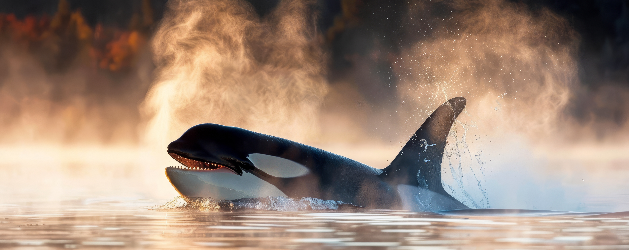


ACKNOWLEDGEMENTS
“Until we extend the circle of compassion to all living things, we ourselves will not find peace “
- Dr Albert Schweitzer

