Slide 1



Slide 2

Global Maritime Challenges
demand for autonomous and surveillance capabilities
reduce reliance on imported systems
Need for faster development‑to‑deployment cycles
importance of data‑driven maritime decision‑making

Slide 3
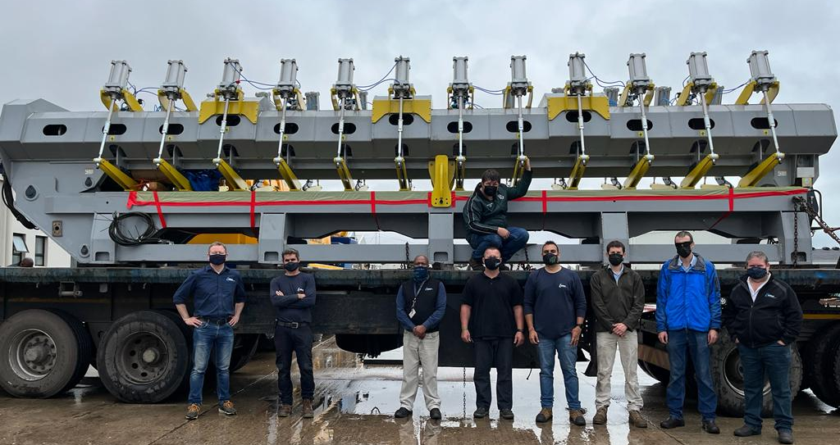
Where eNtsa Fits
“We translate ideas into deployable engineering systems.”

Slide 4
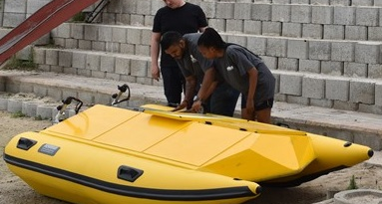
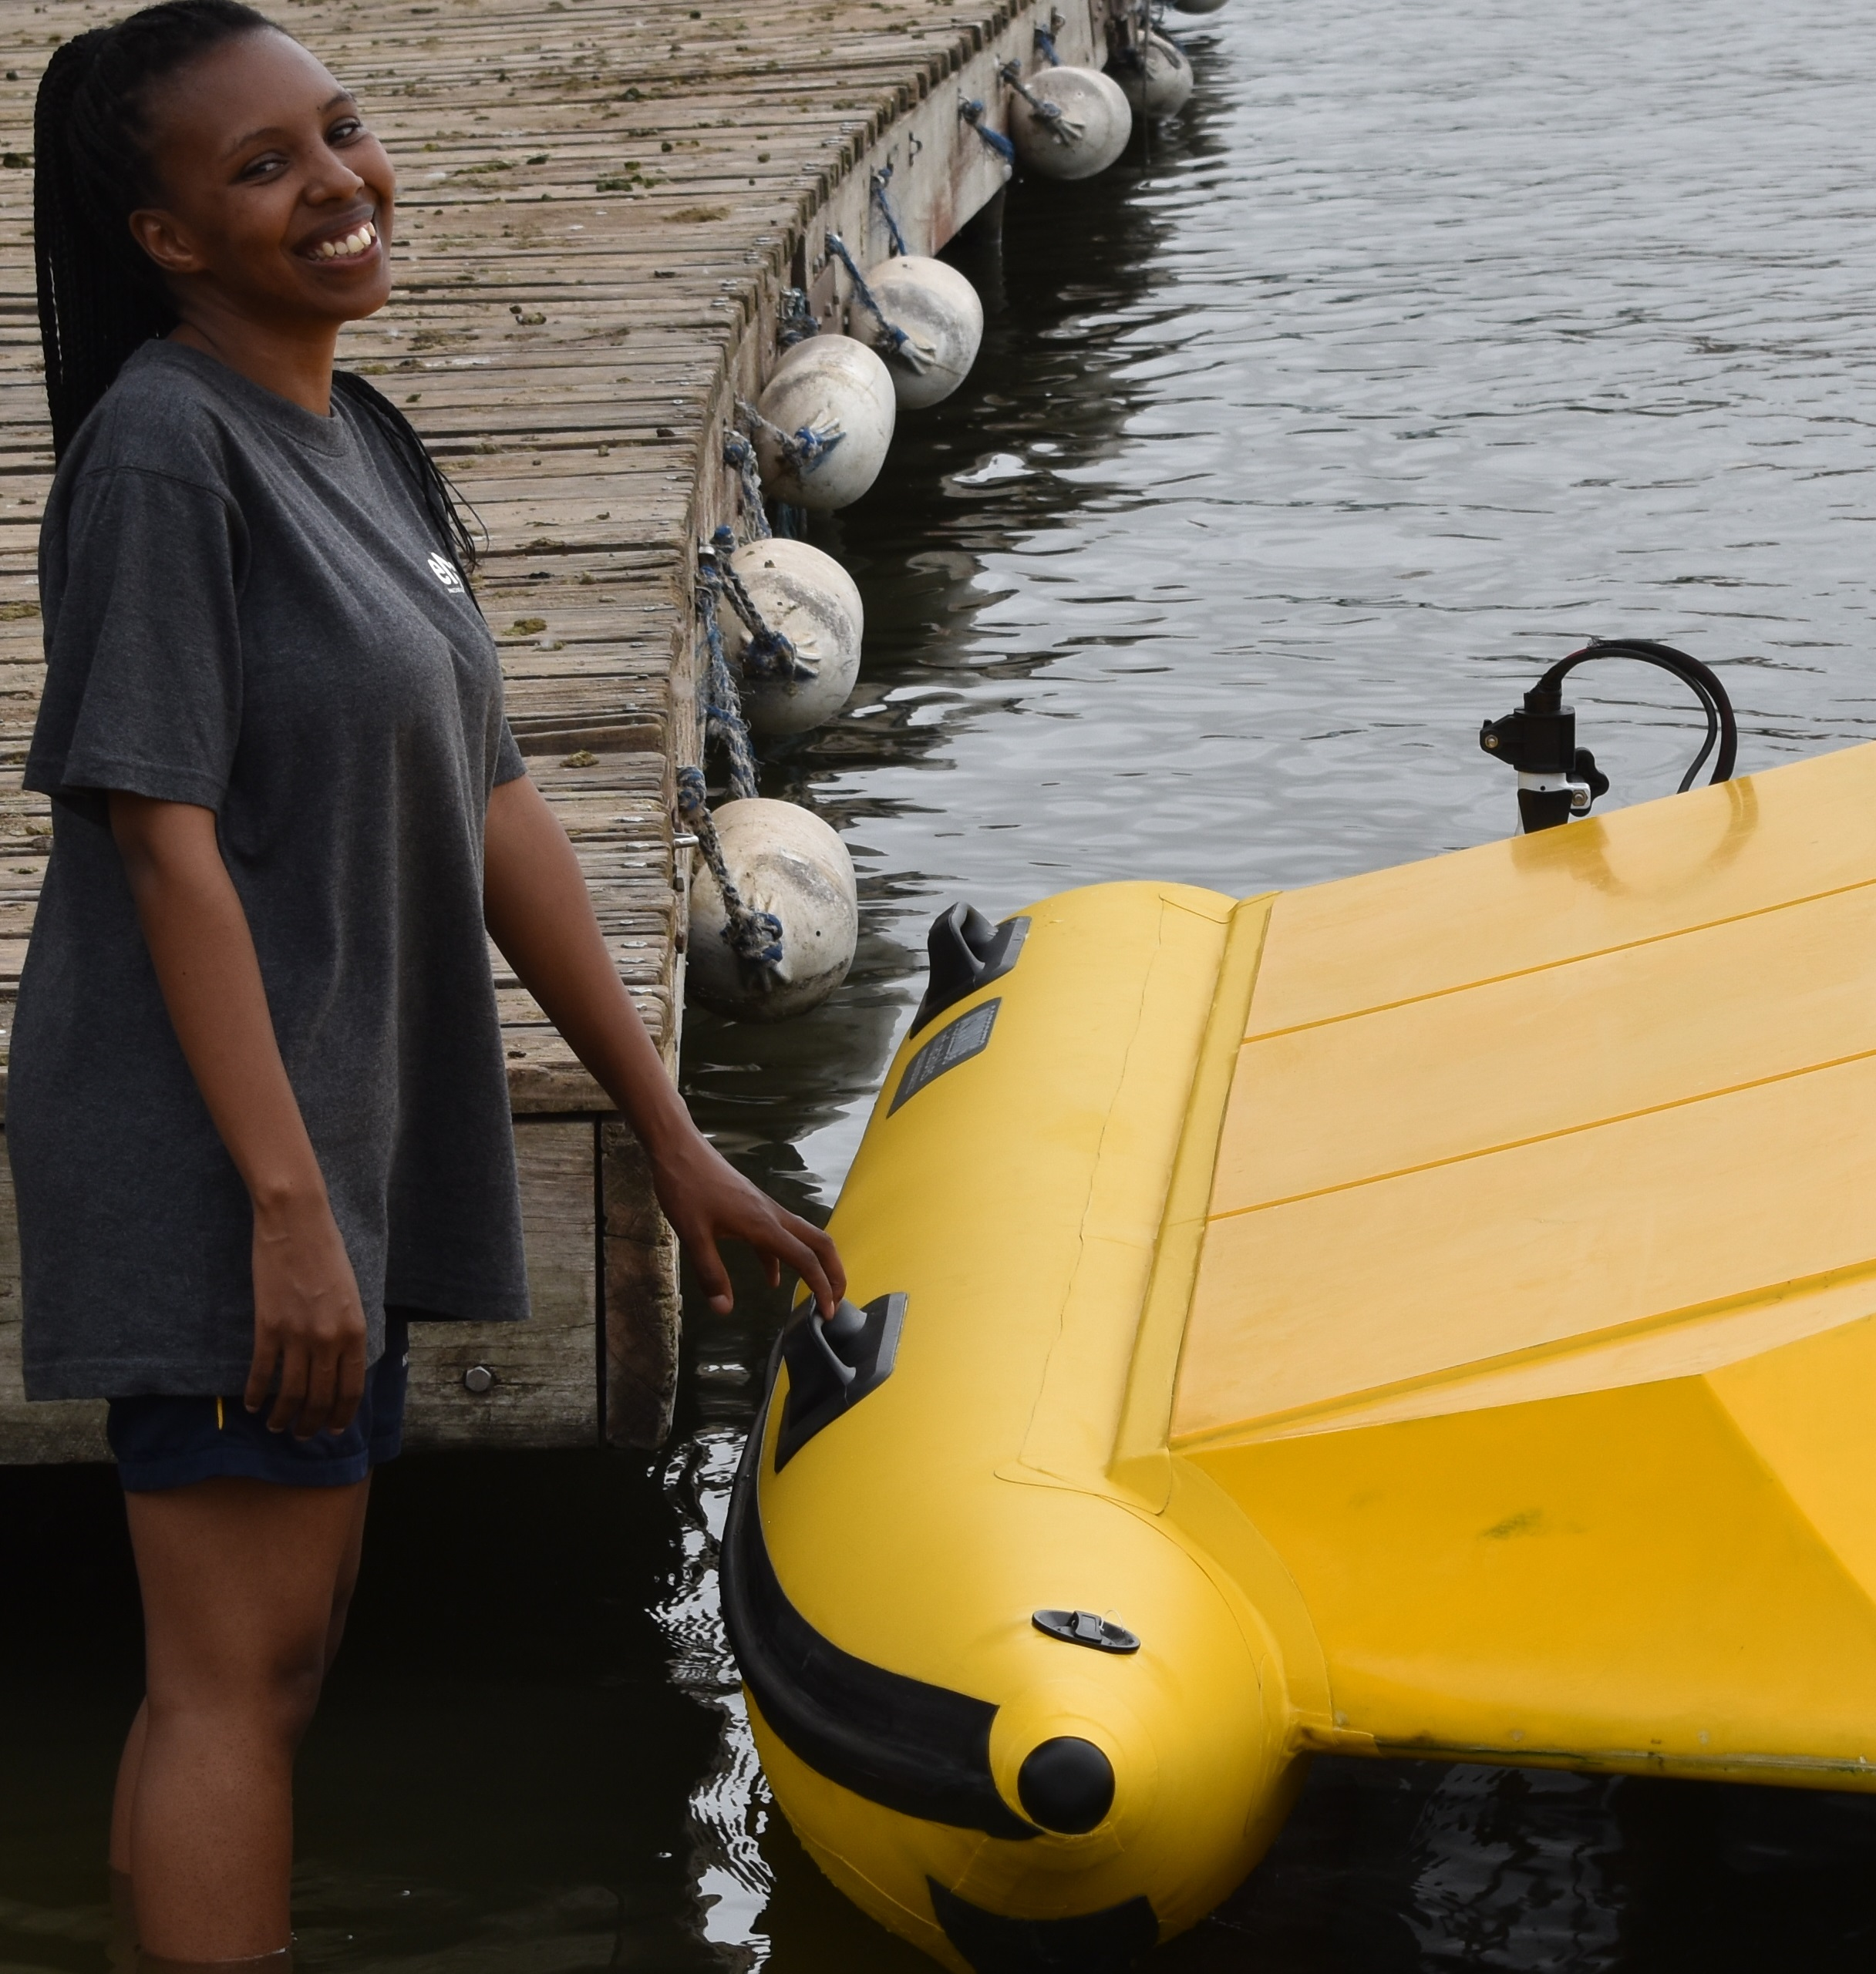
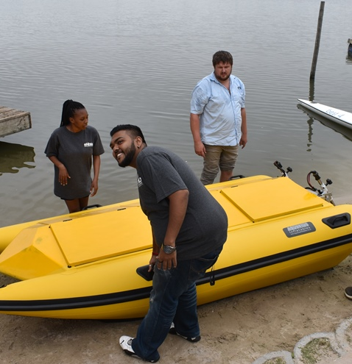
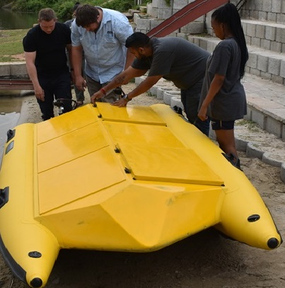

Slide 5
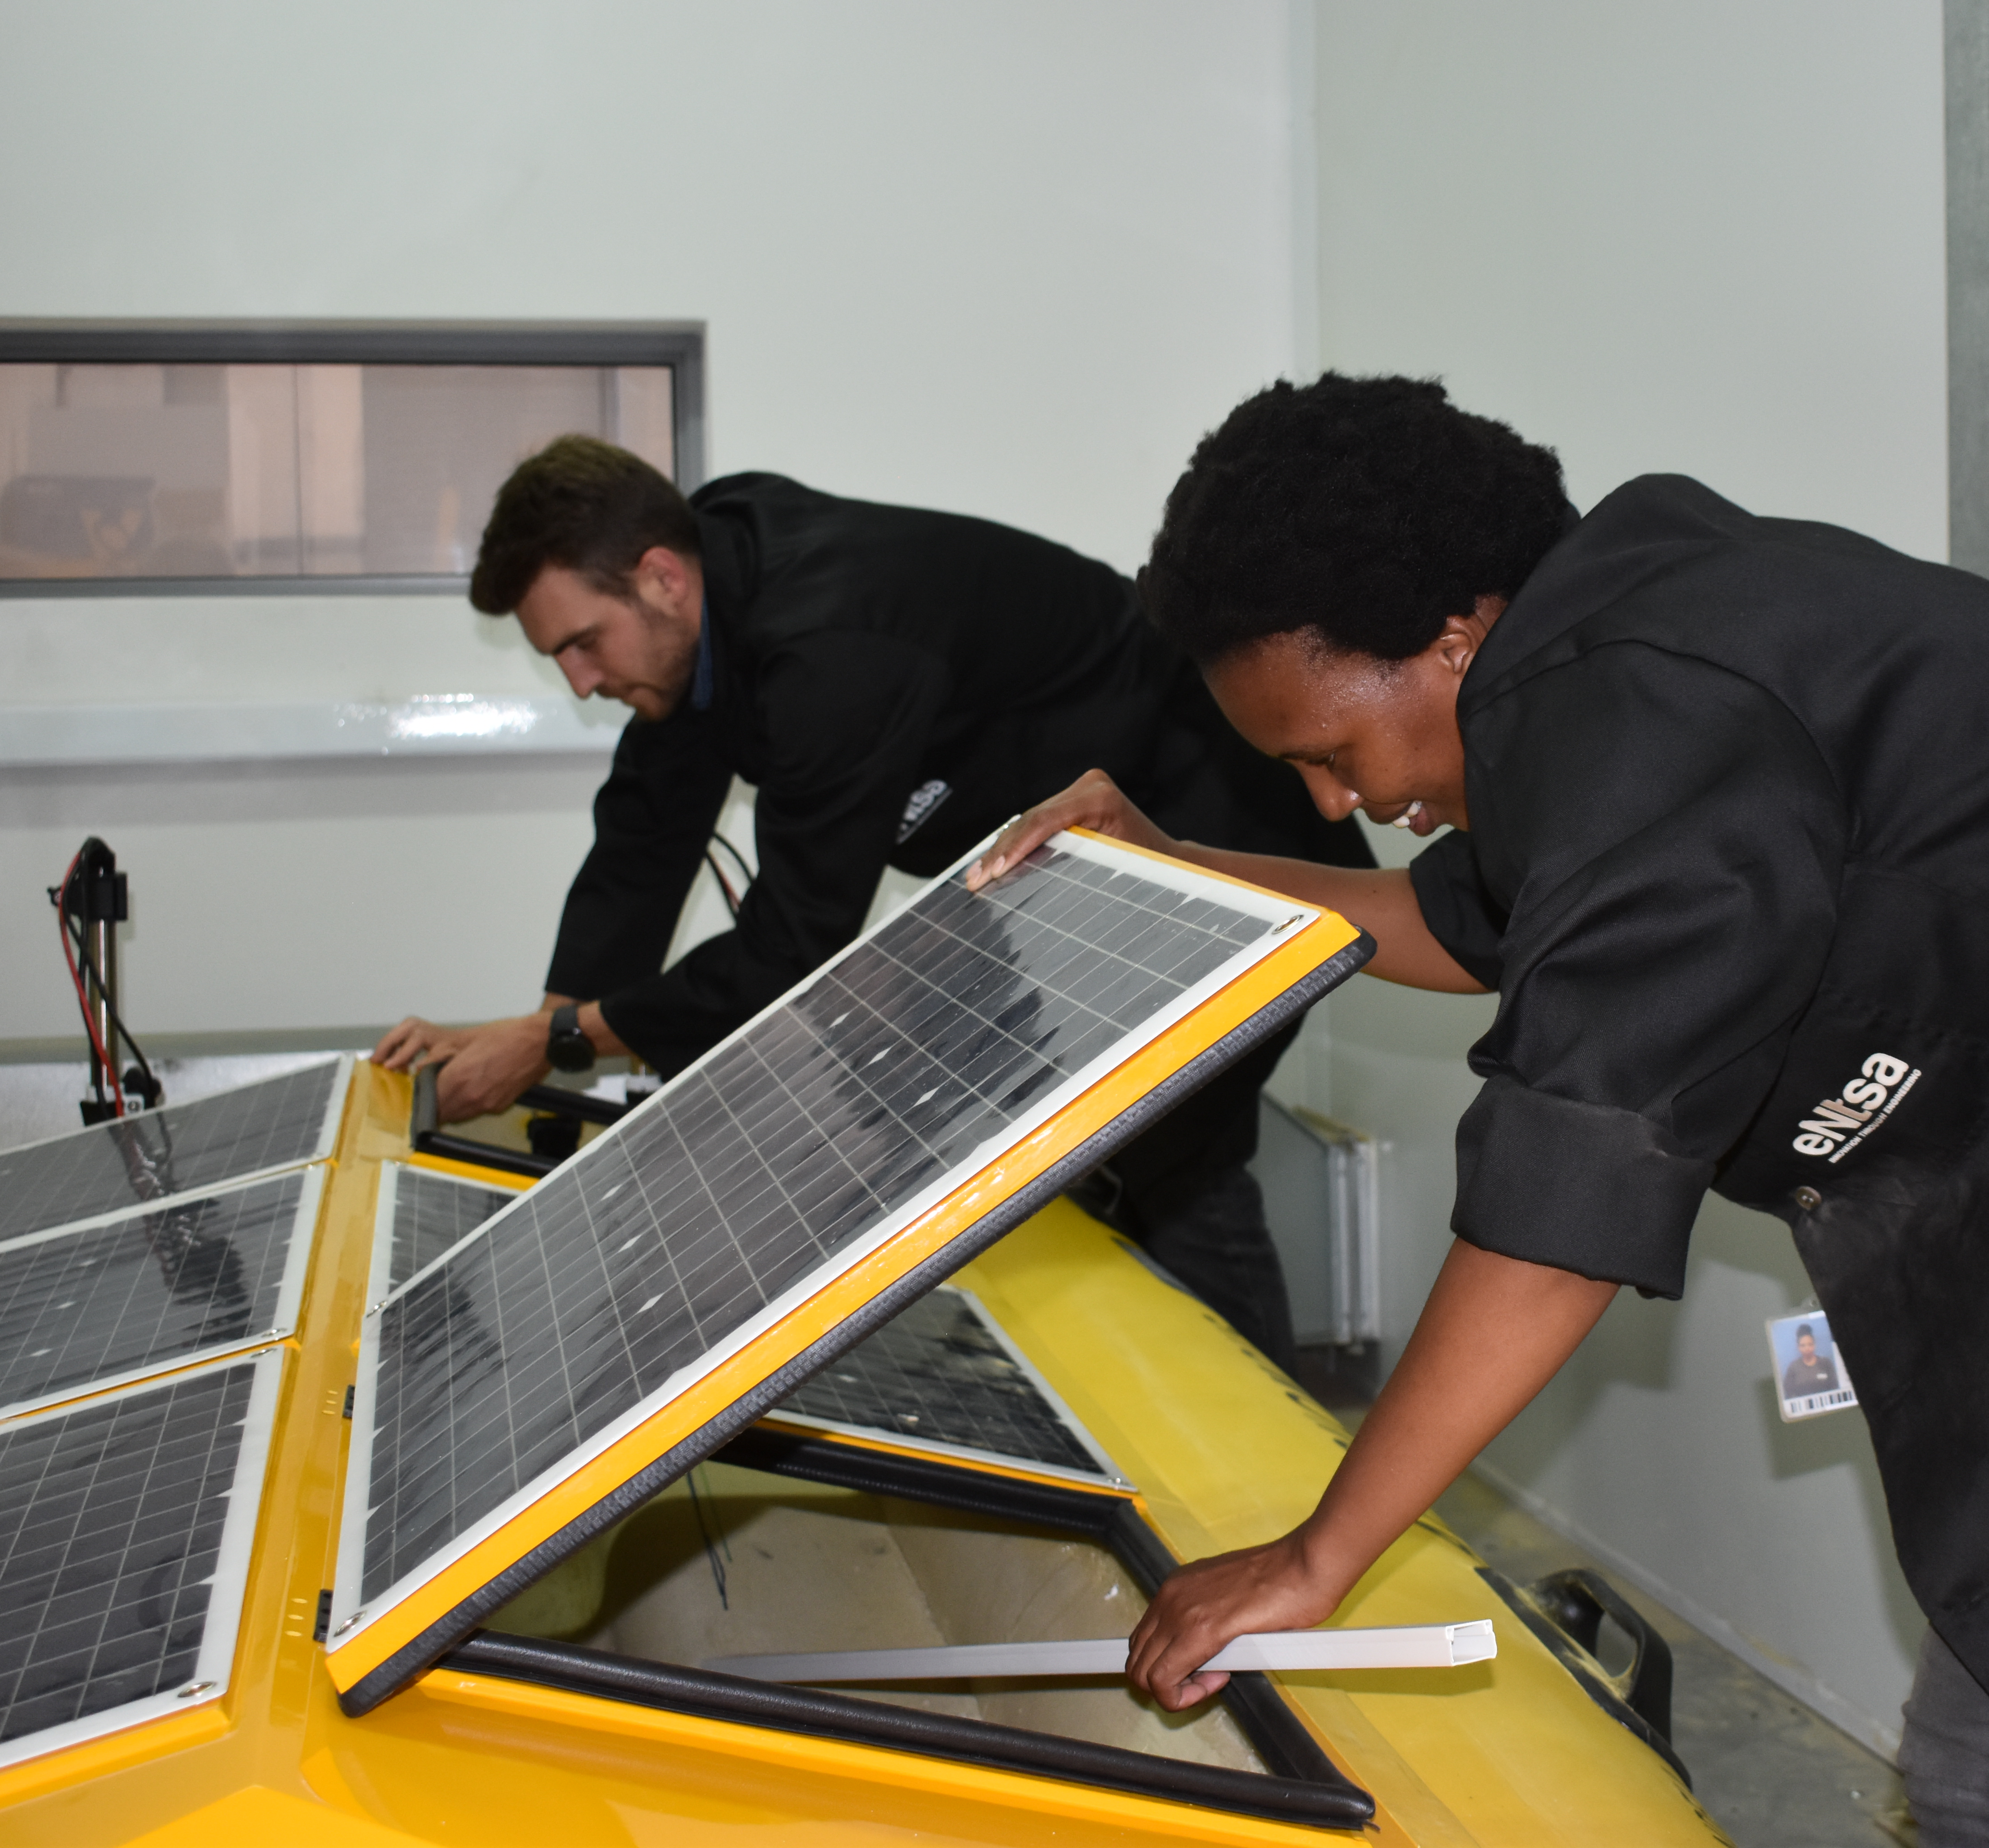
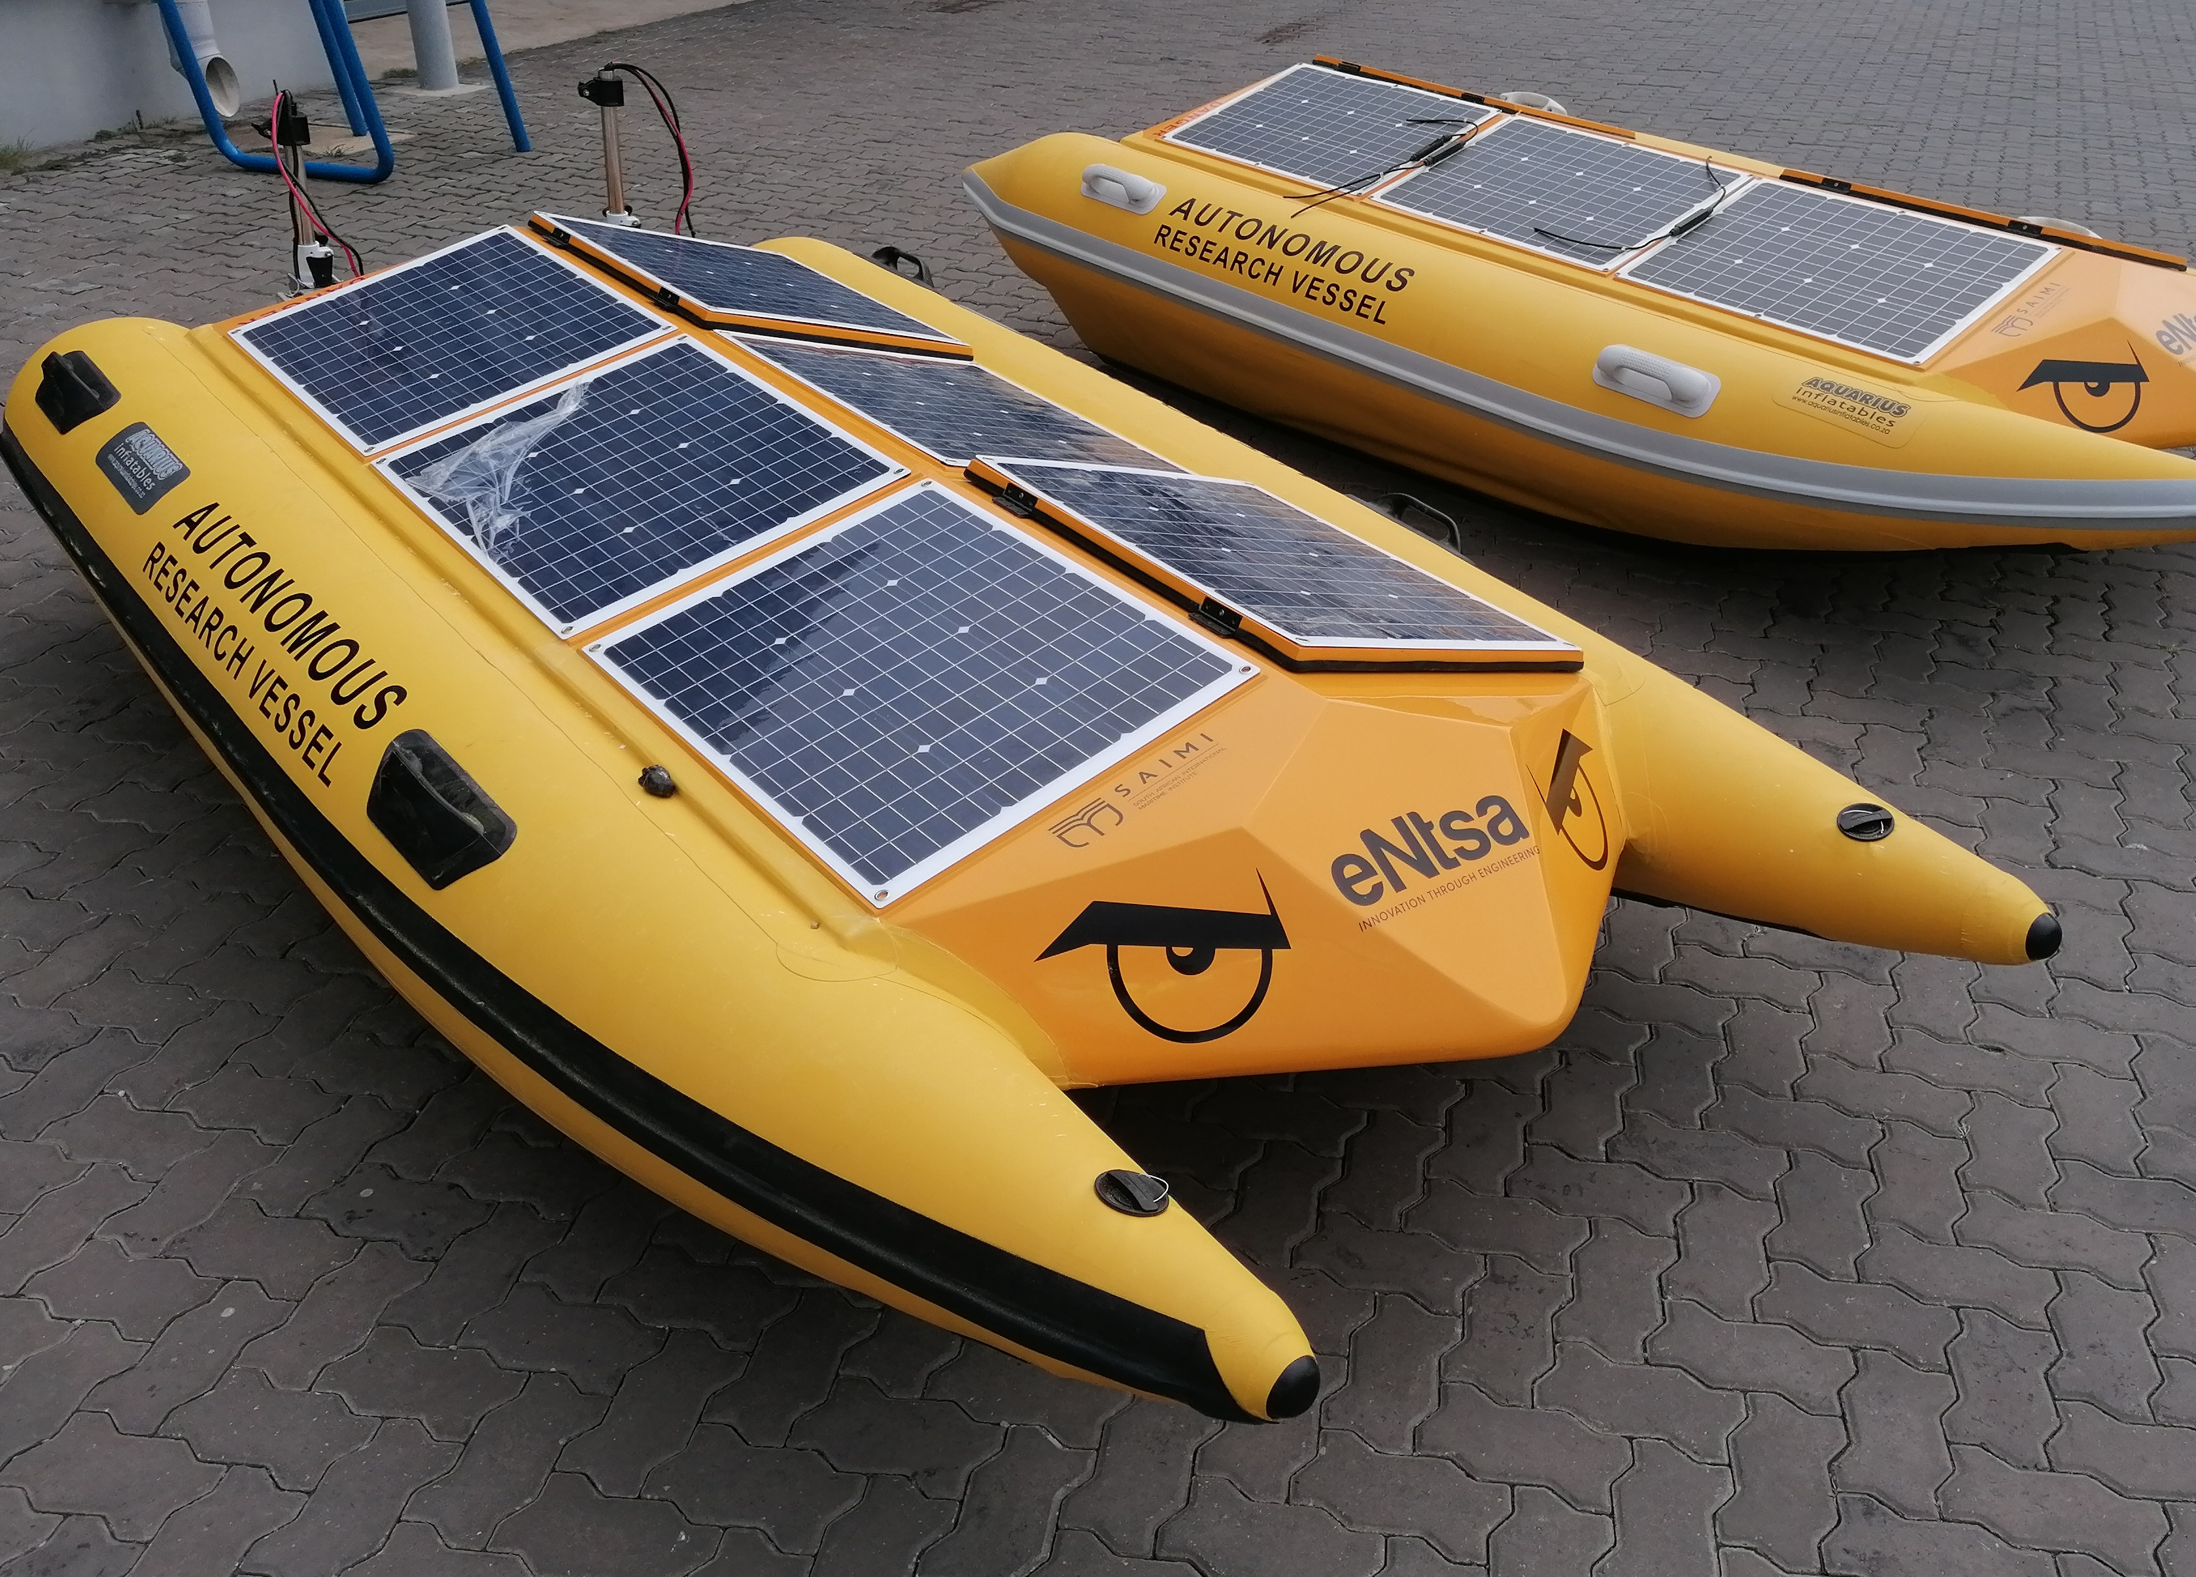
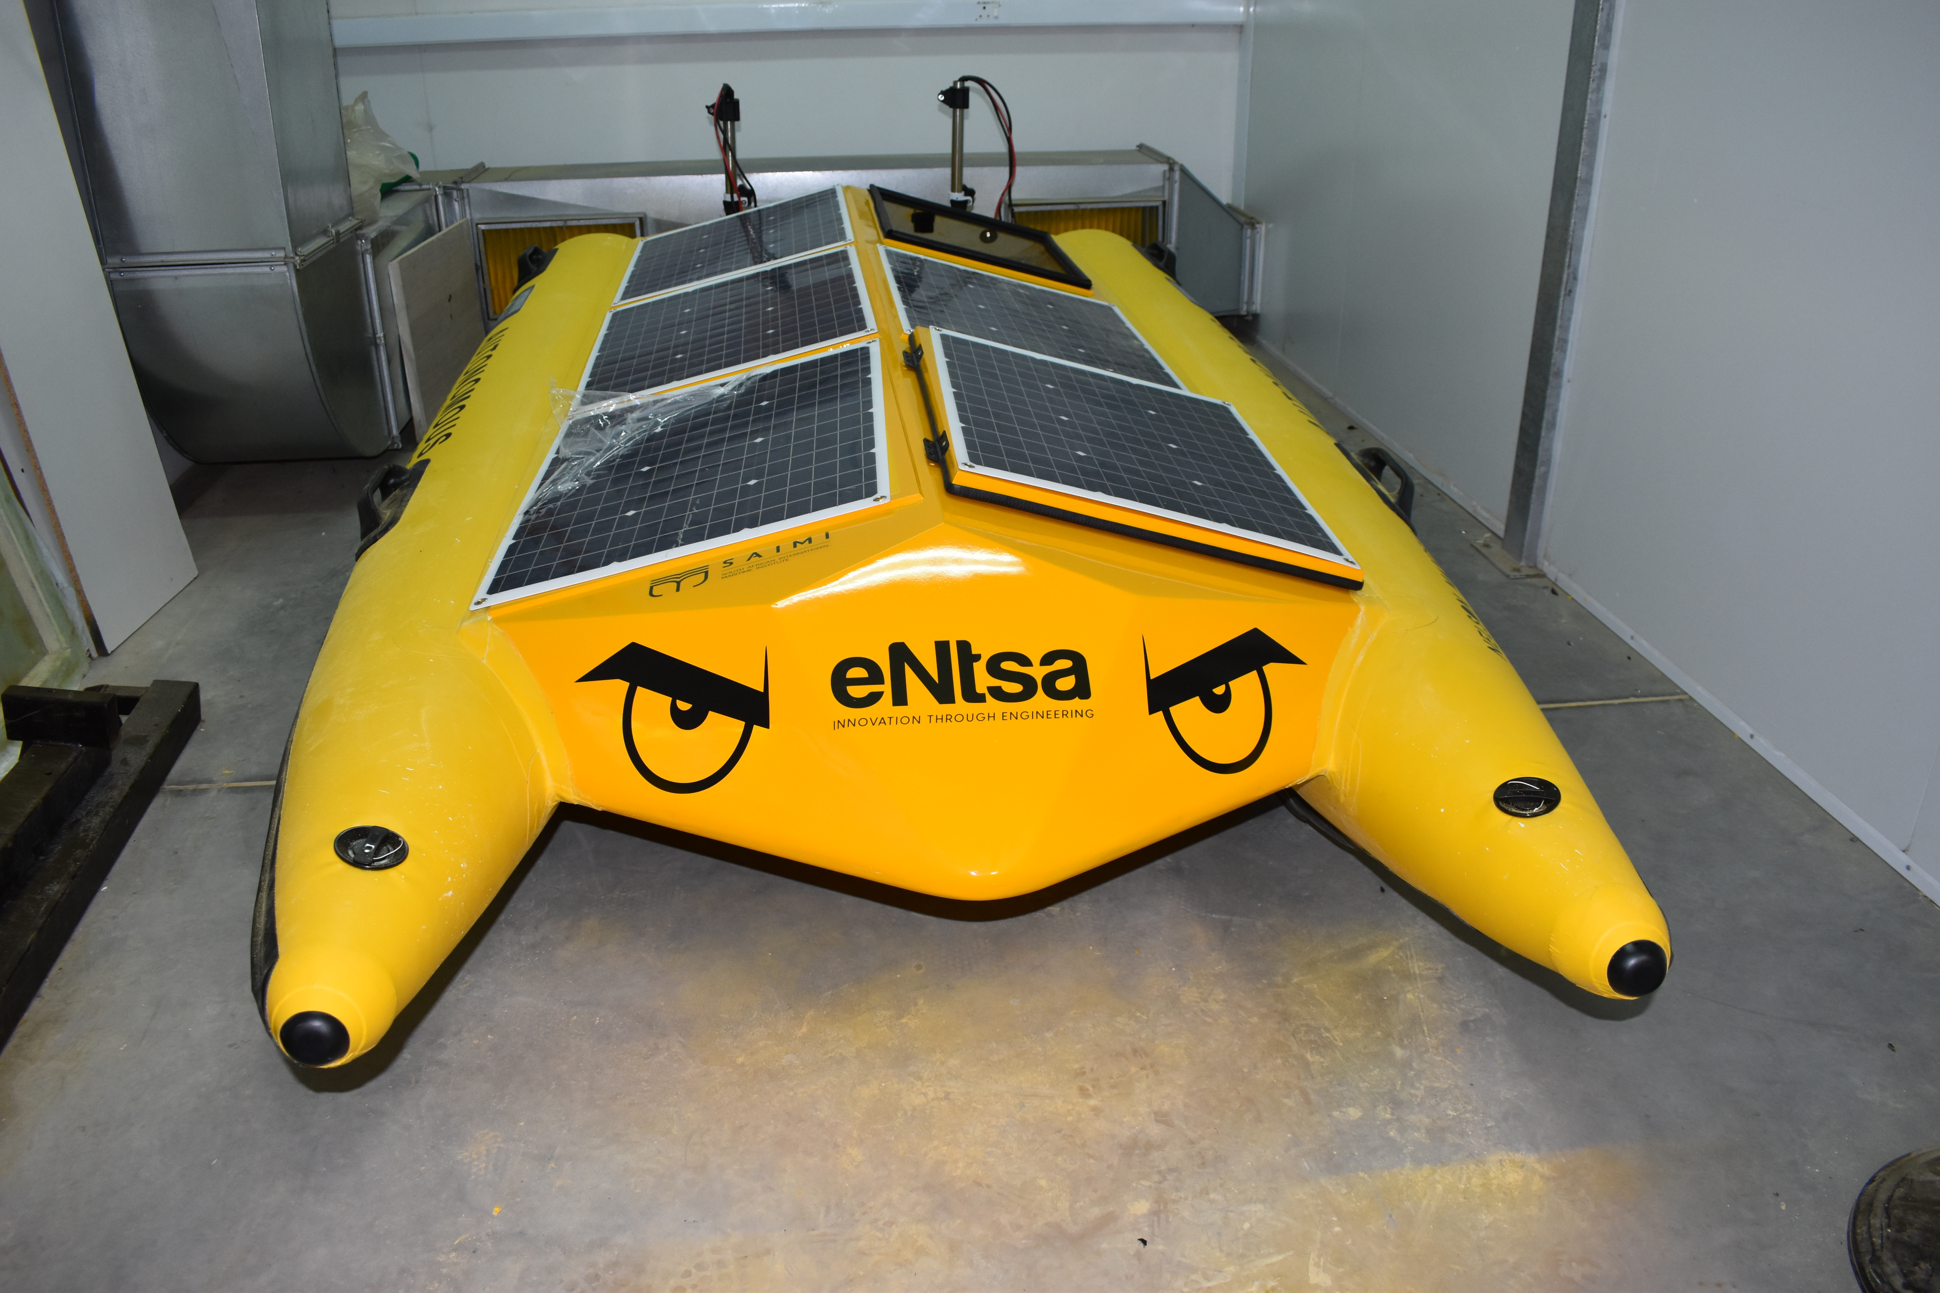

Slide 6
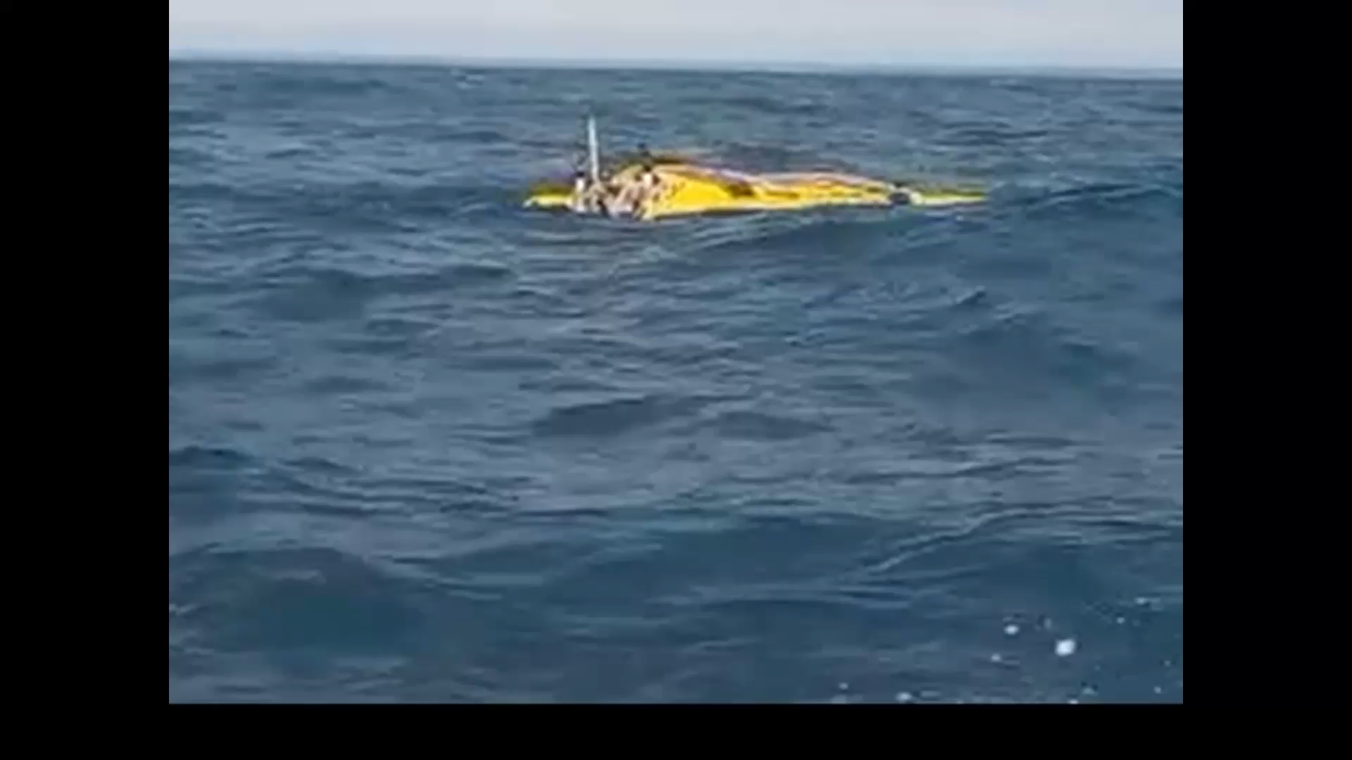

Slide 7
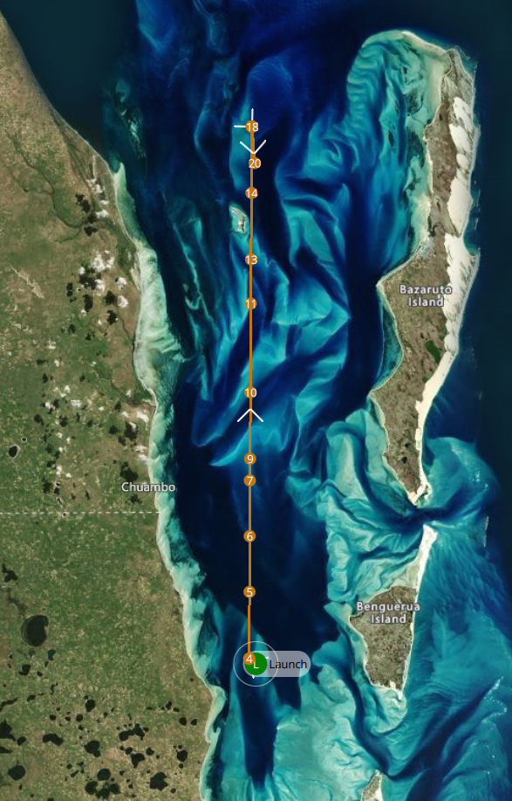
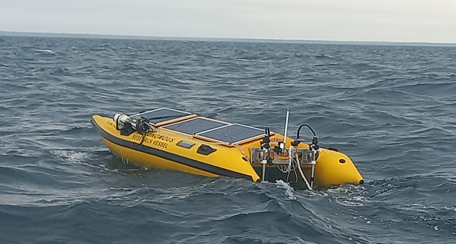
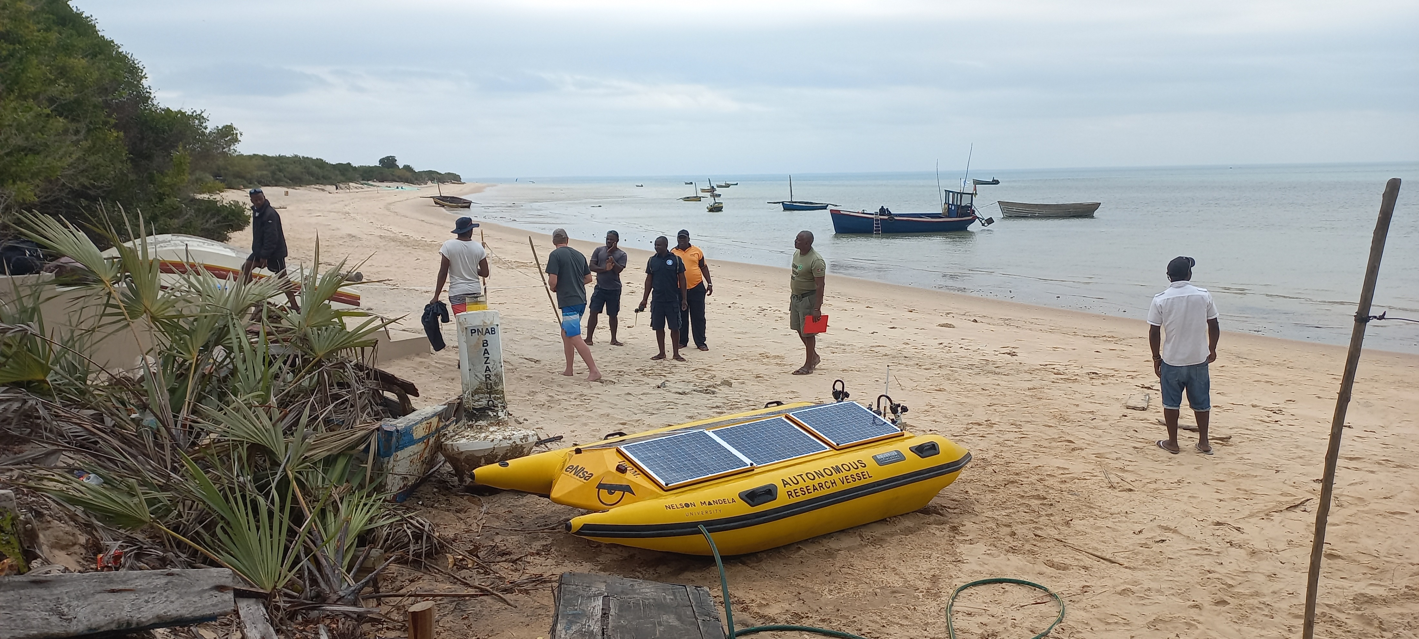
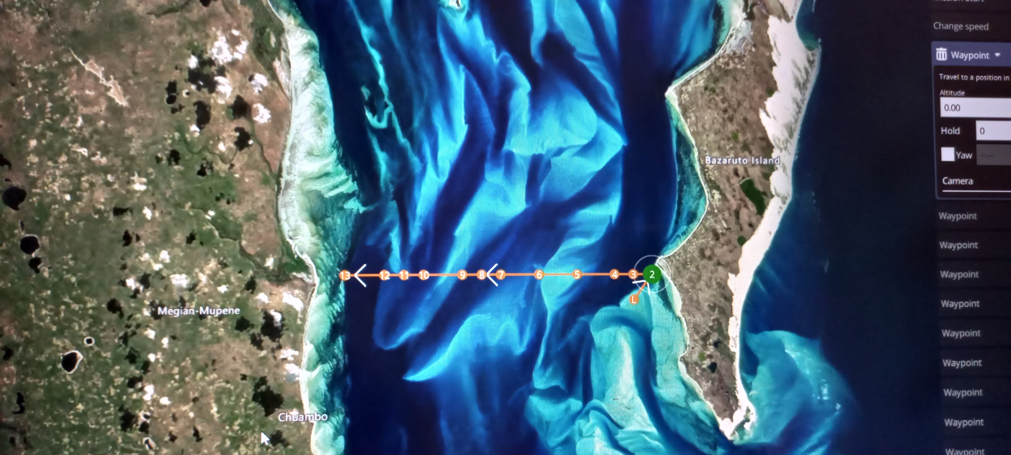
Case study: Maputo experiment
South North: 6 hours
East West: 3 hours
CTD:
    Temp
    Conductivity
Watersamples

Slide 8
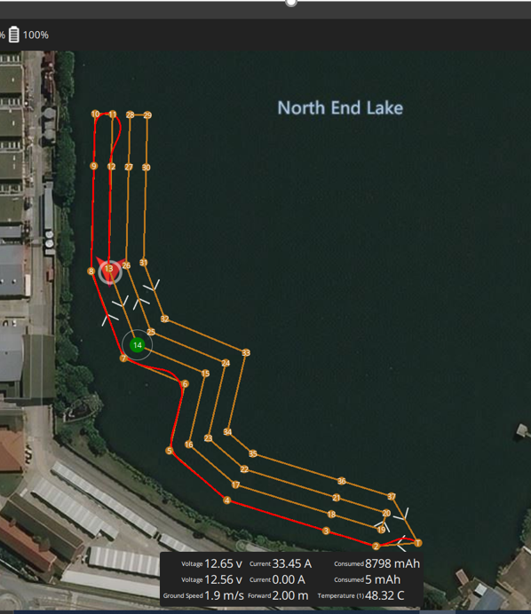
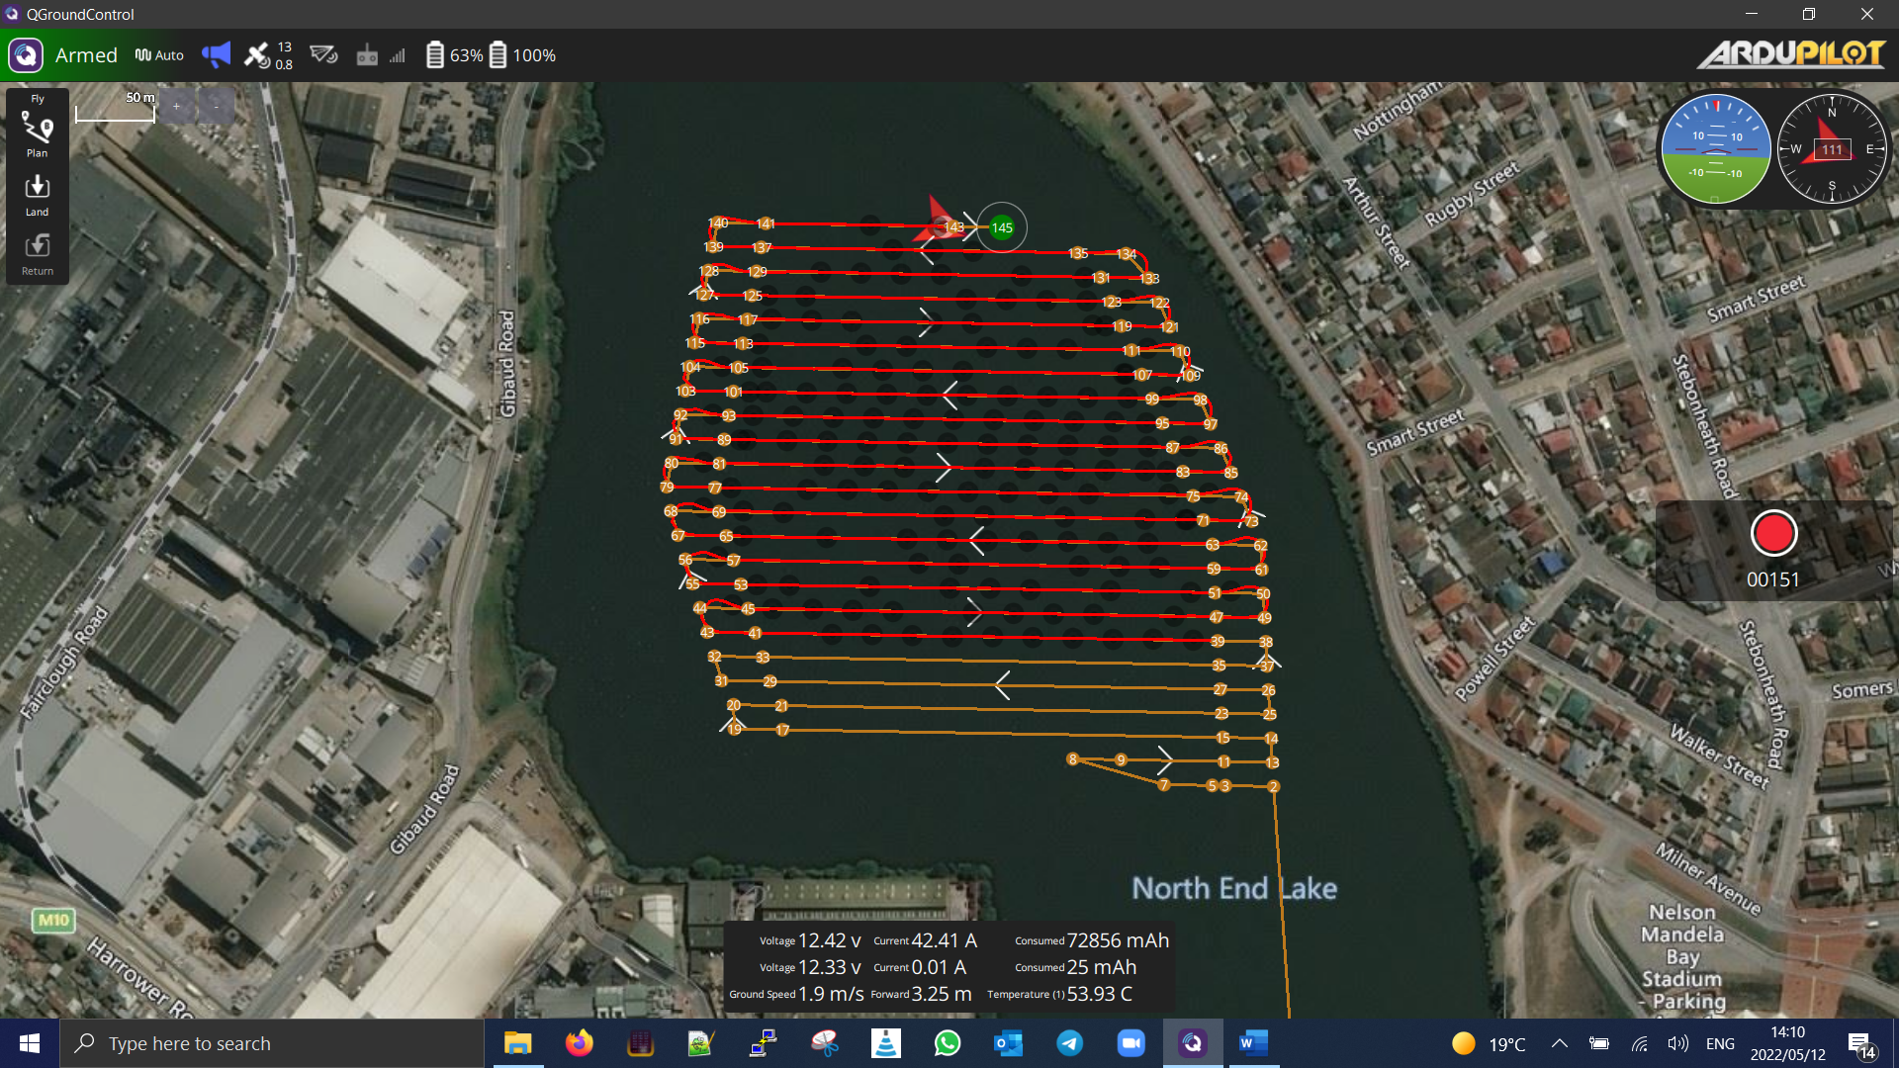
Corridor & survey scan - execution
Path following
Speed control
Loiter at waypoint
Change speed
Execute command
Smart RTL
Notes:
Consistency is key
Speed is self regulated – will maintain commanded velocity
Smart RTL when battery fall below battery crytical threshold

Slide 9
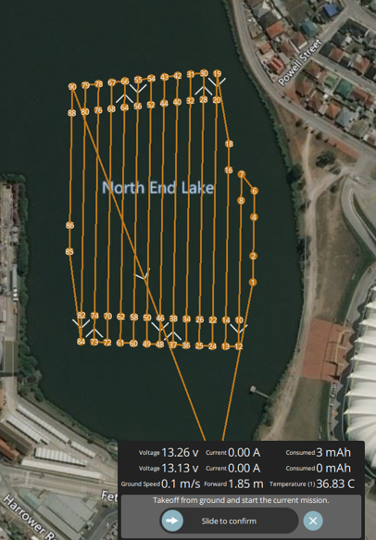
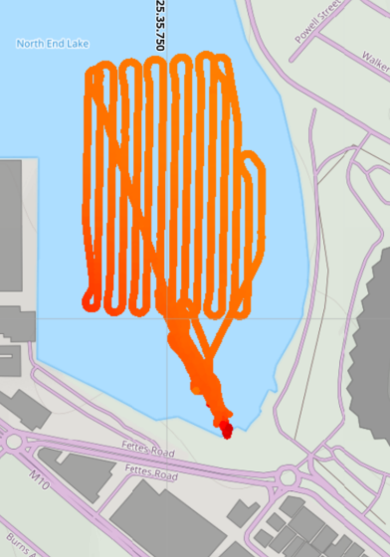
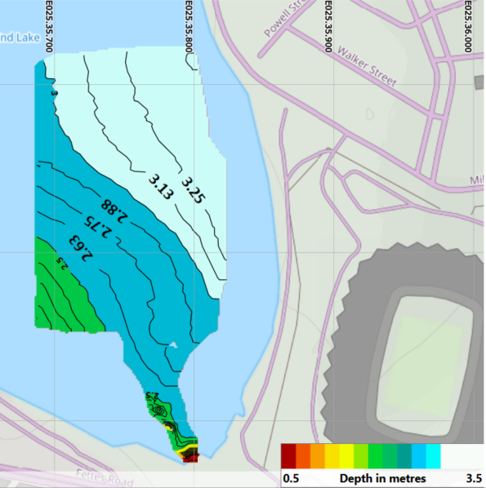
Survey scan
Planned path
Data points
Processed data

Slide 10
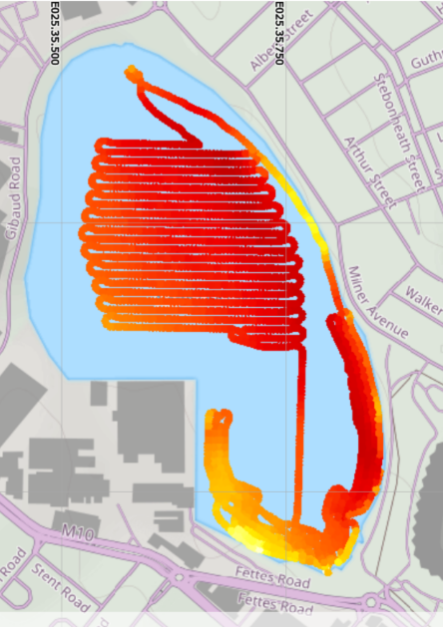
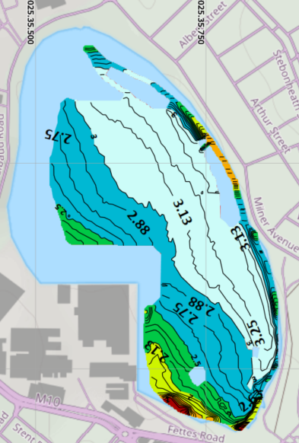

Combining scan data
Combined map
1
4
1
3
2

Slide 11
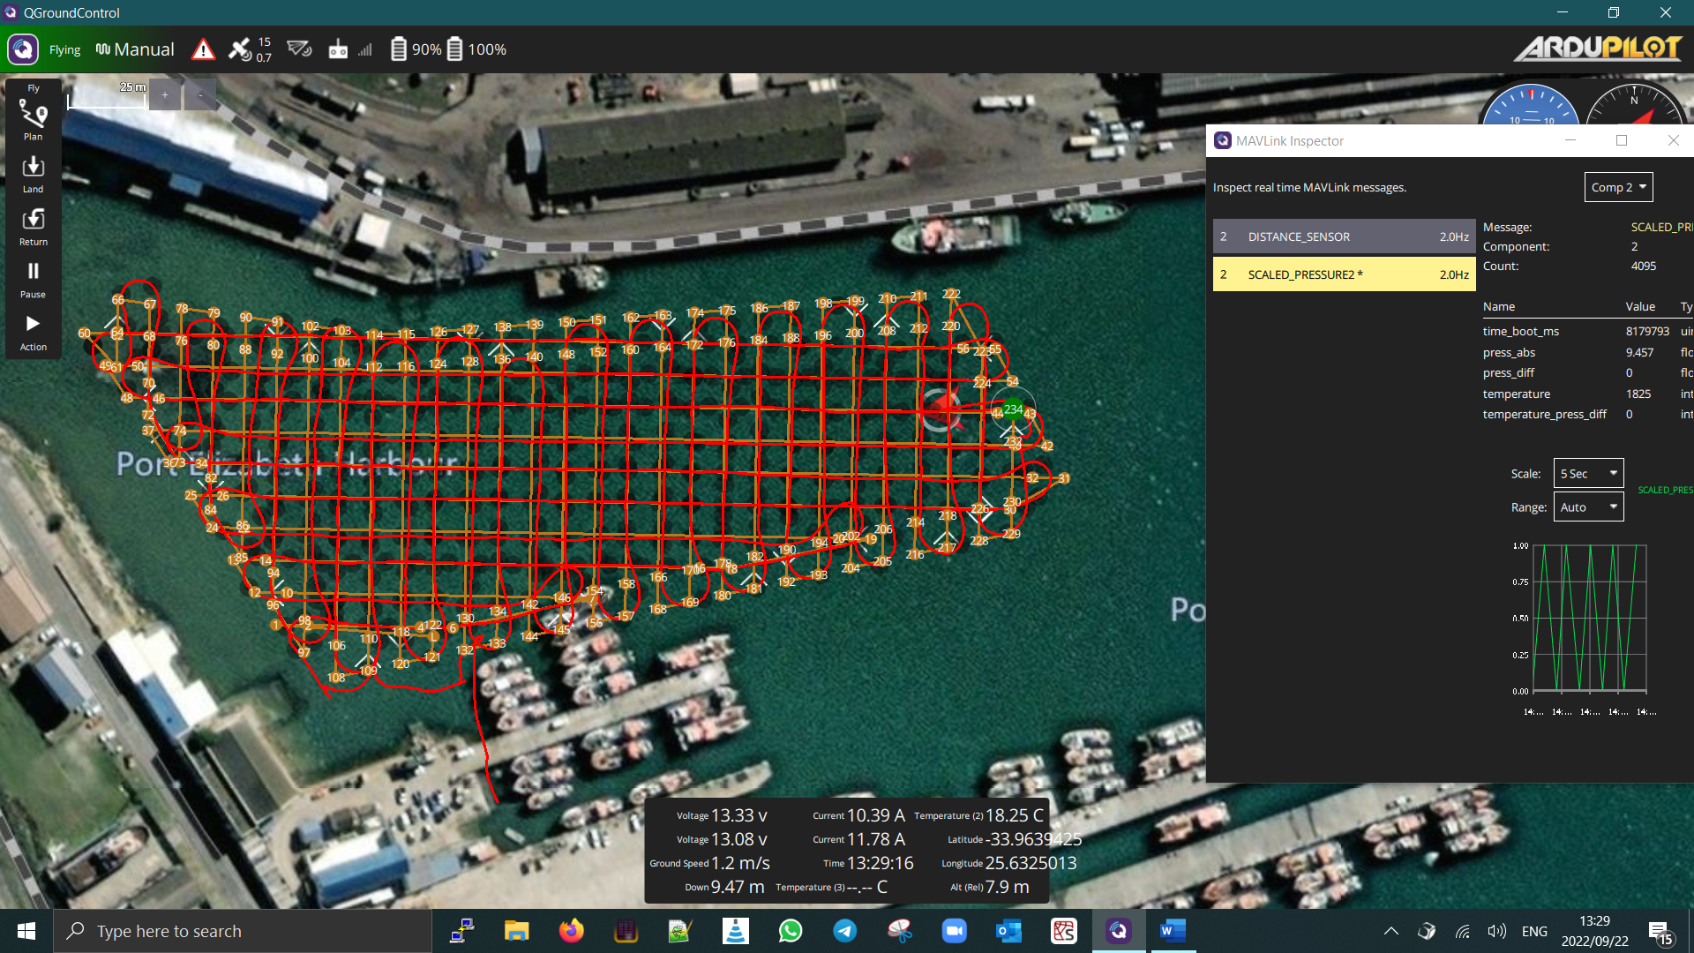
Navy key - scan
Old Navy key in Port Elizabeth harbour
Hart beat - to indicate logging status
Shortcoming of this software – map not real time

Slide 12
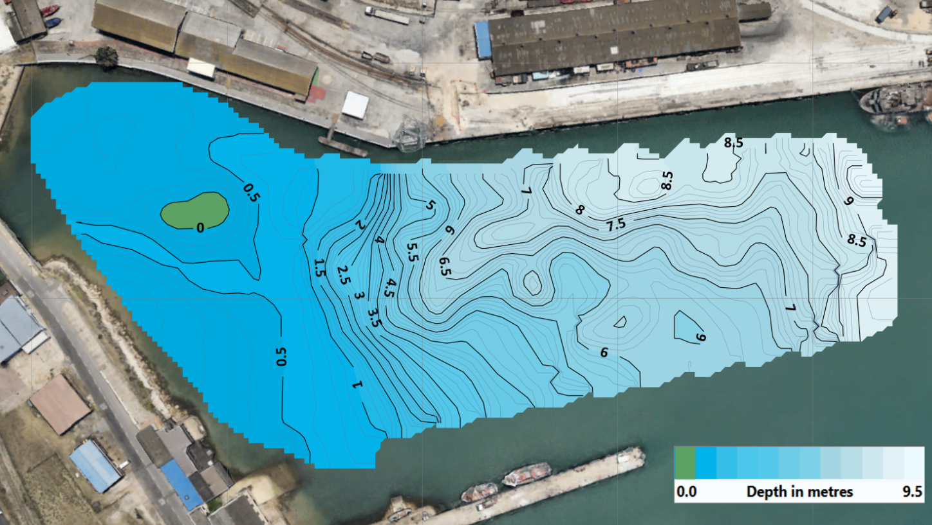
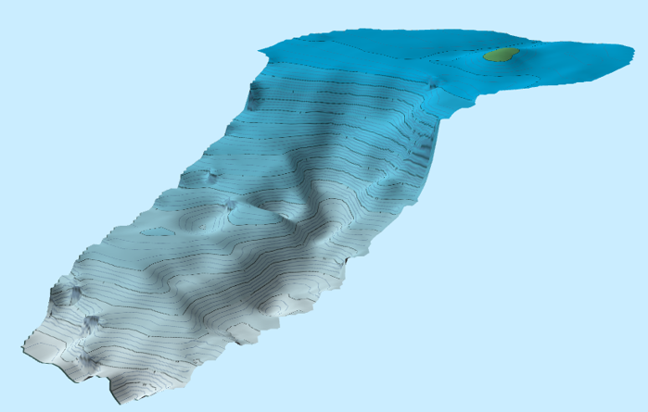
Old Navy key – results
Old Navy key in Port Elizabeth harbour

Slide 13
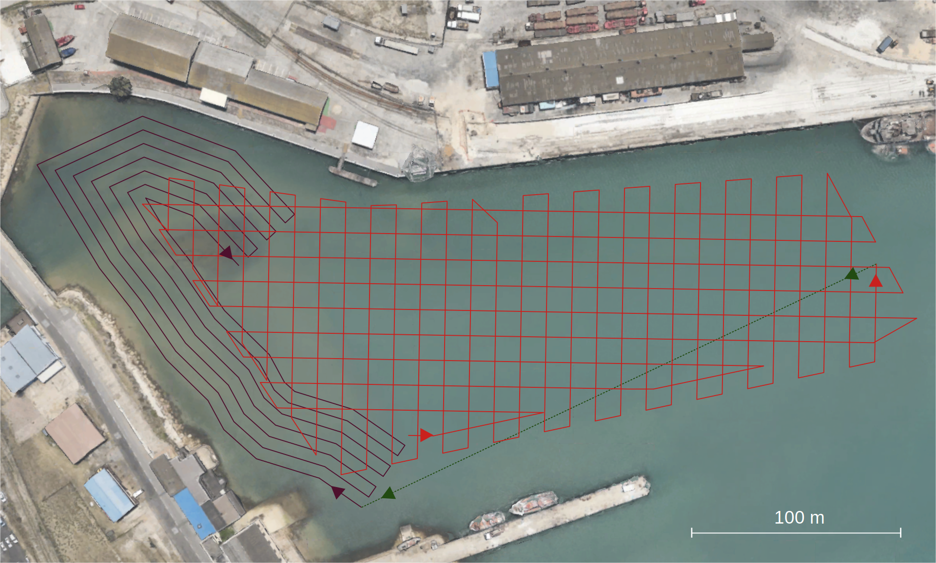
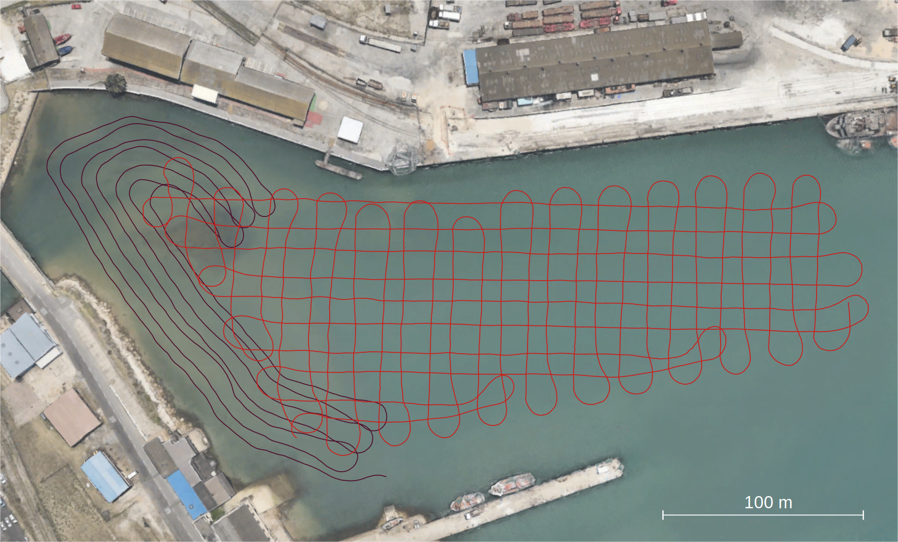
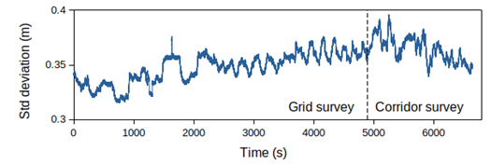
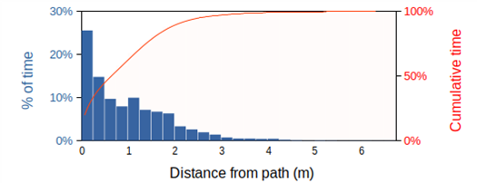
Harbor survey
Notes:
To guarantee localization accuracy is a recurring problem in mobile robotics.
Localization accuracy mainly depends on the sensor's accuracy and its refresh rate.
In the absence of additional external sensor data, the covariance matrix of location is a good precision indicator.
In this field experiment the square root of the covariance of the Kalman filter's estimate in position remains sufficiently low

Slide 14
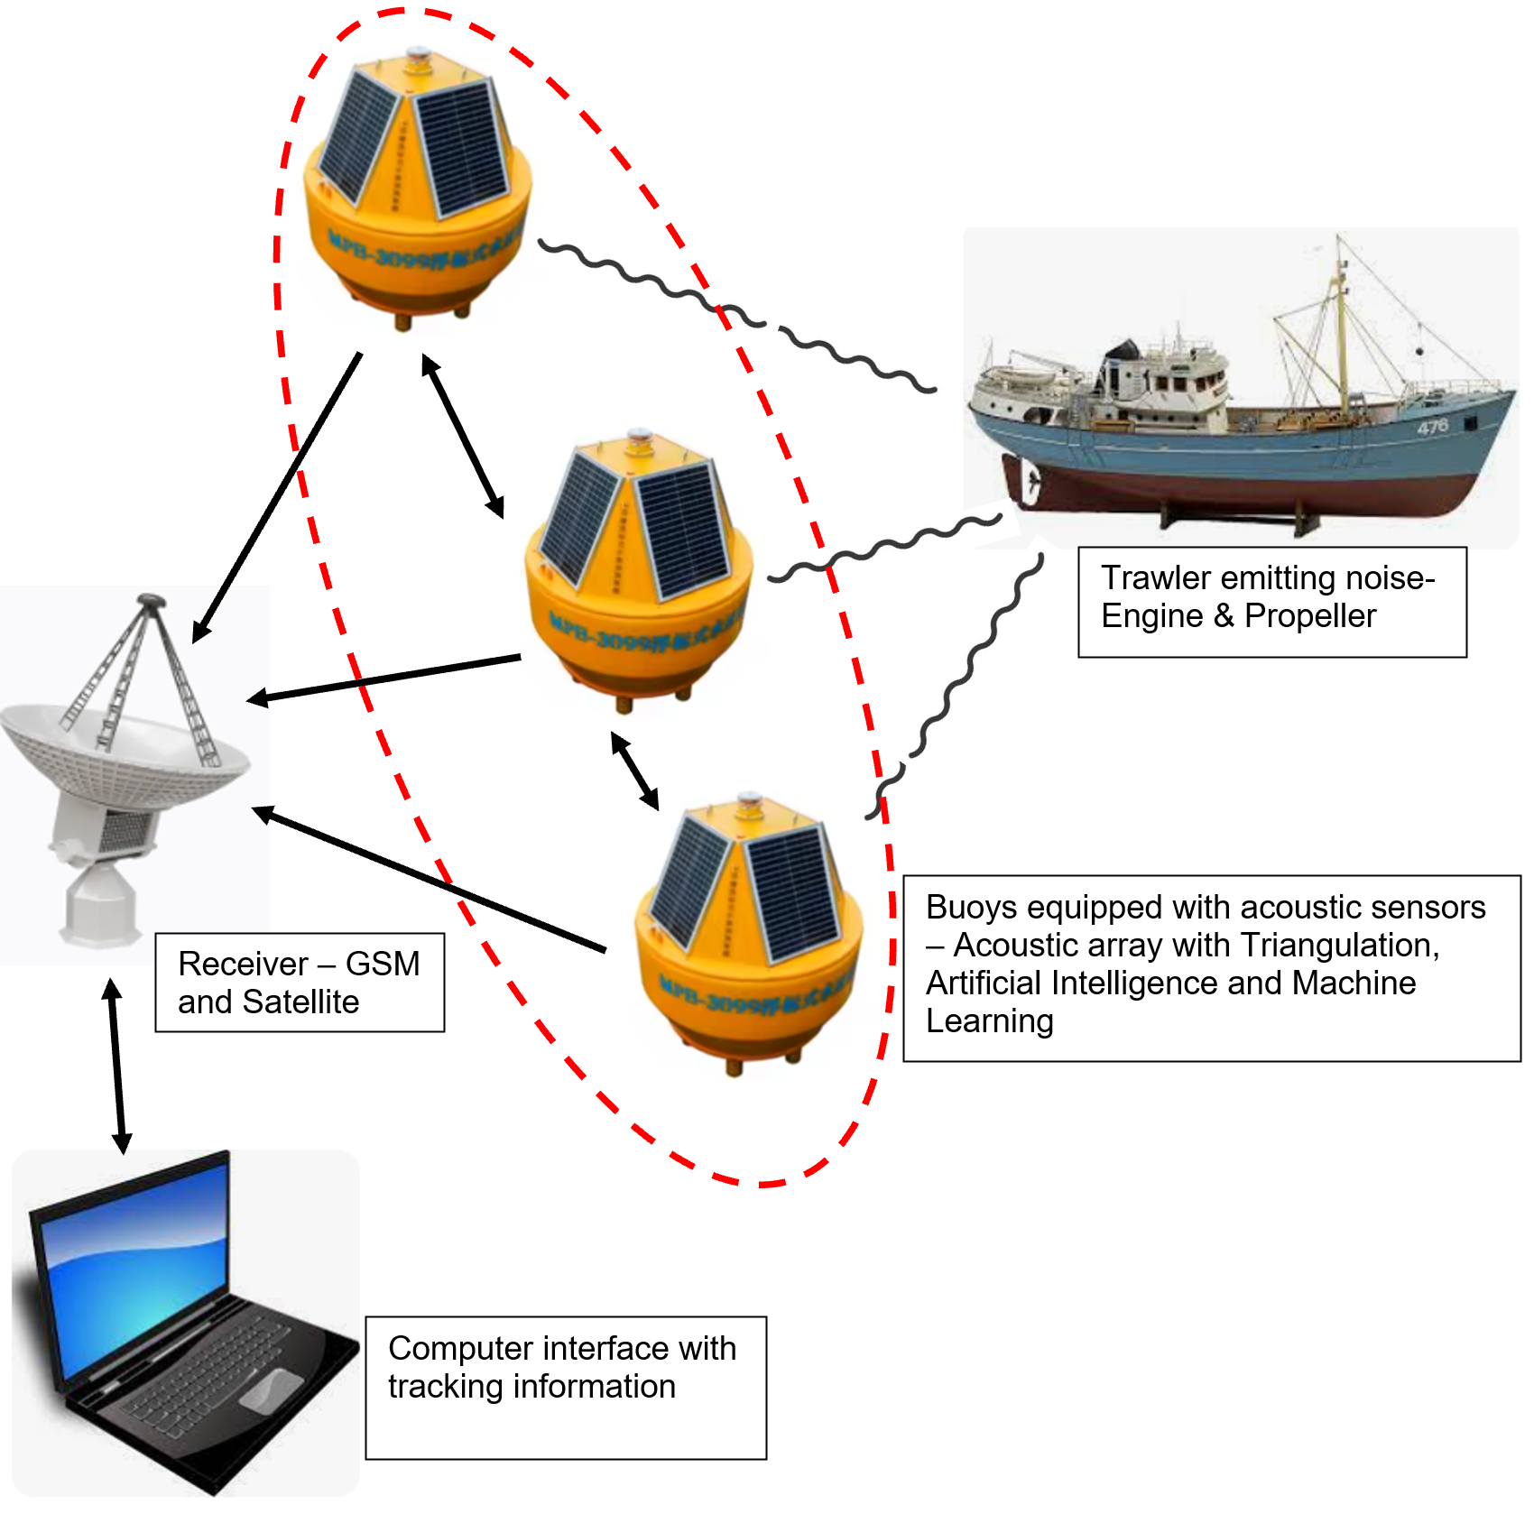

Slide 15
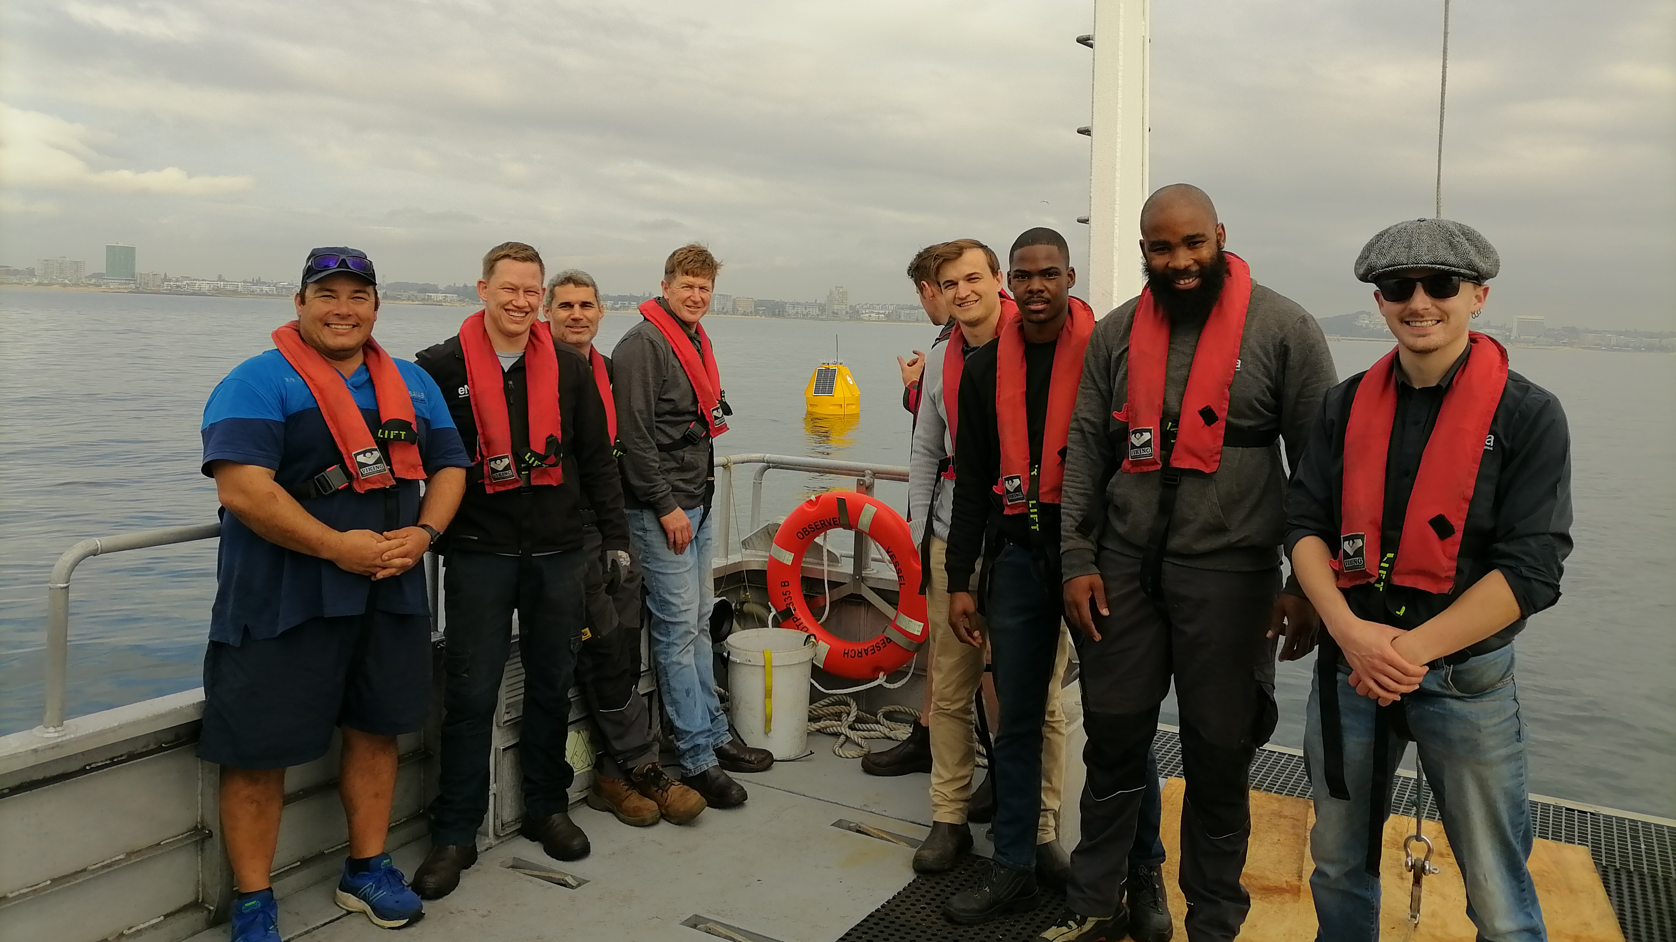

Slide 16
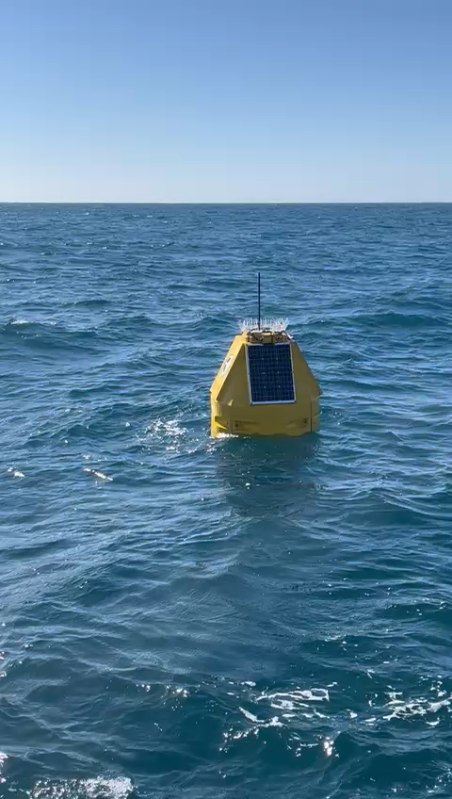

Slide 17
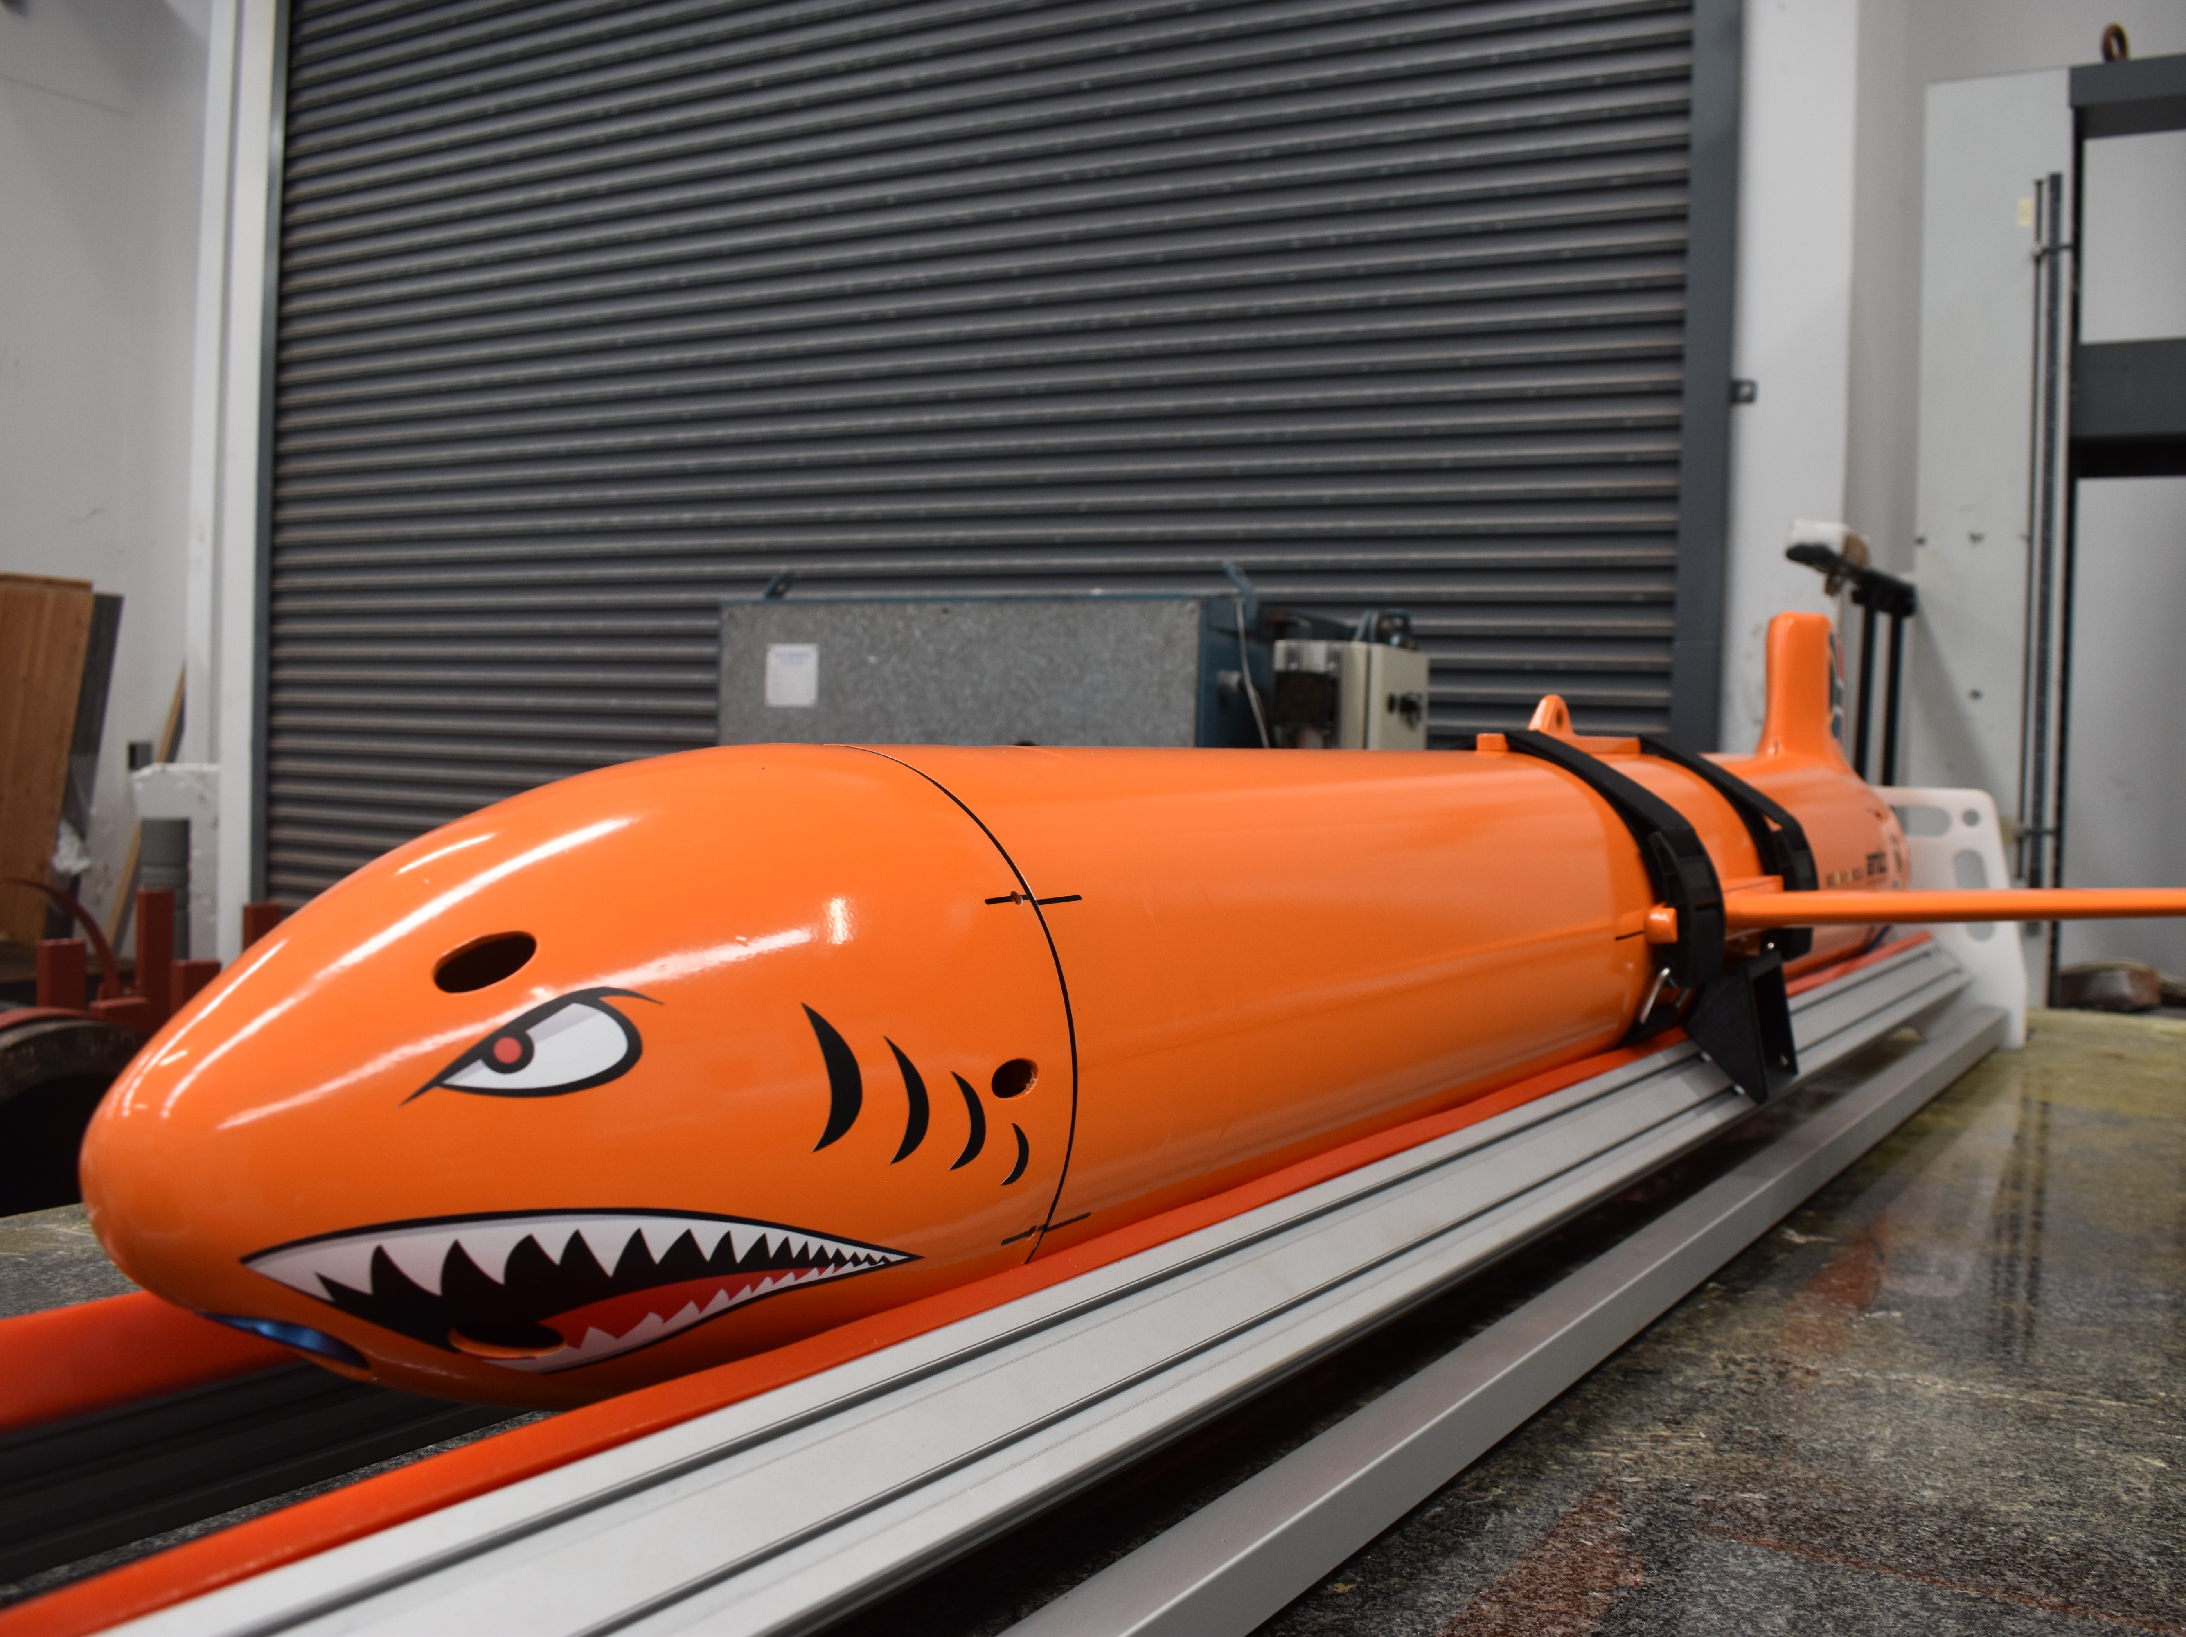
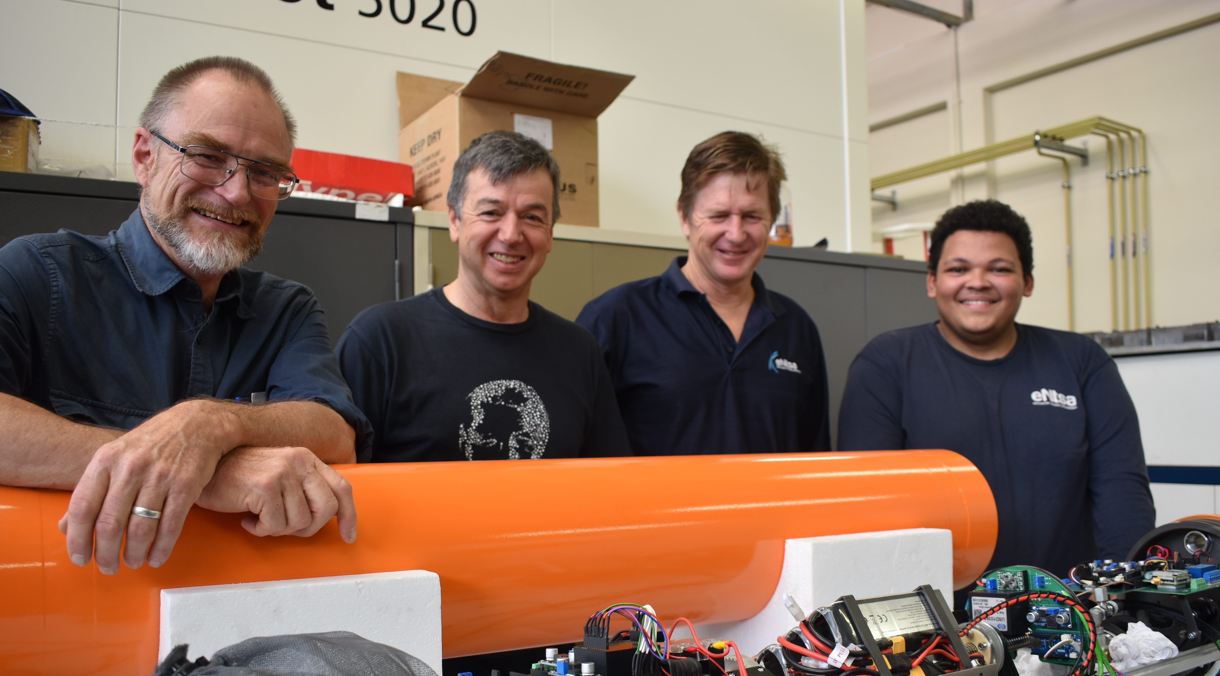
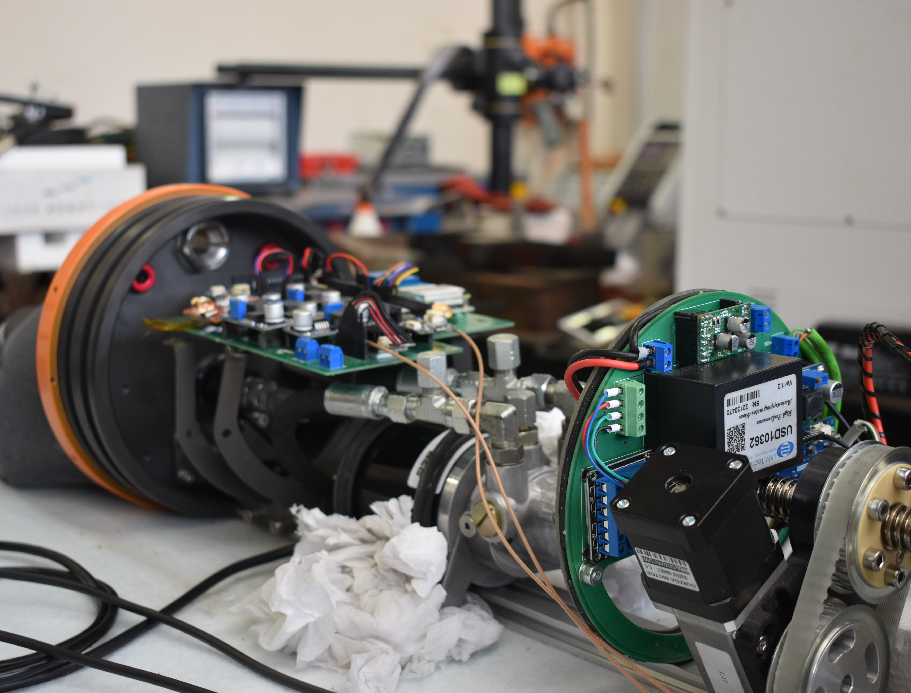

Slide 18
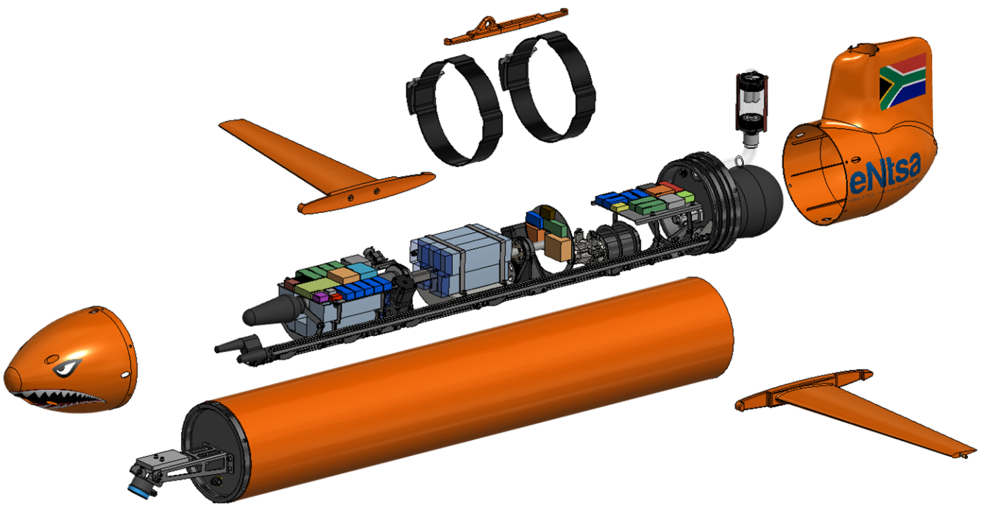
Glider components
Glider v2
Wing straps
Antennae
O-ring seals
Wings
Battery
Rear cover
Internal bladder
Nose cone
External bladder
Oil pump
Aluminium hull
Sonar

Slide 19
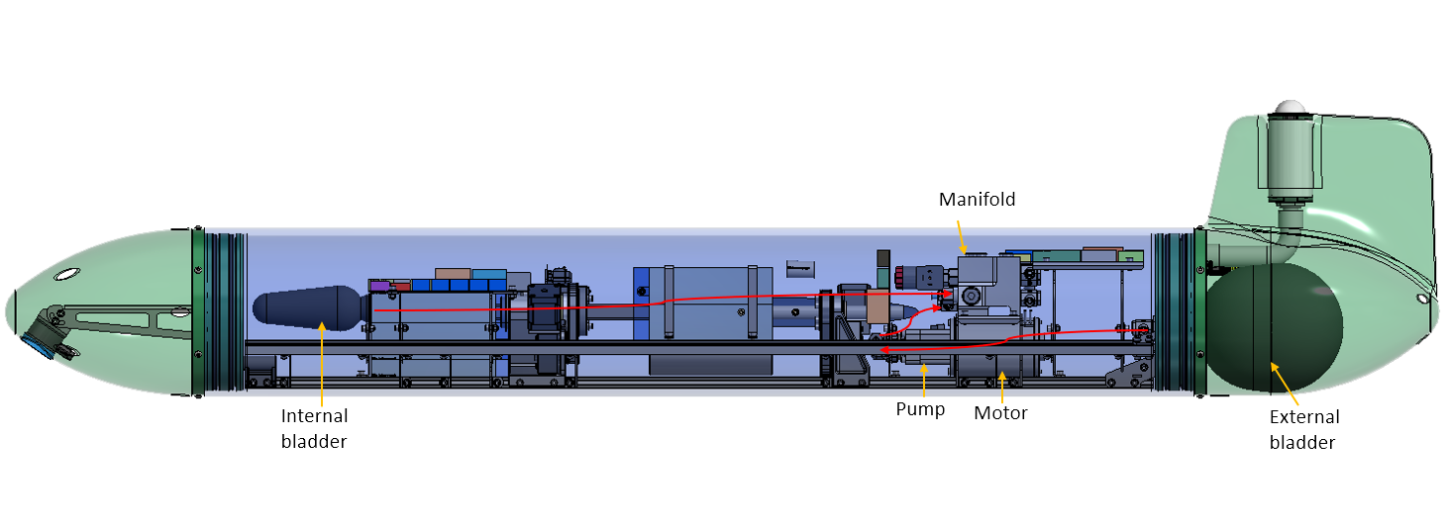
Mechanical Design – internal view
Component assembly
Green is wetted surfaces
Blue dry compartment
Bladder positions: 1 Wet & 1 Dry
Battery pack, offset weight
Pump – far from IMU
Antennae tube at stern
Sonar for object detection

Slide 20
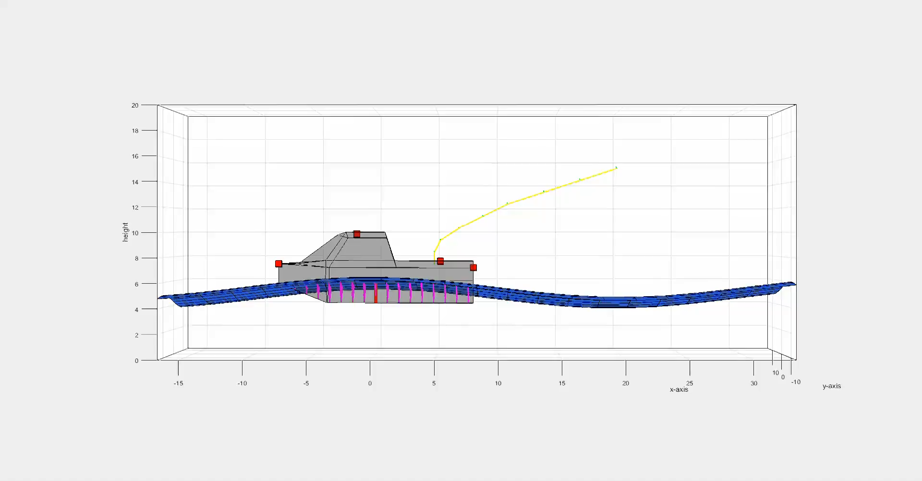
Last mile flight landing

Slide 21
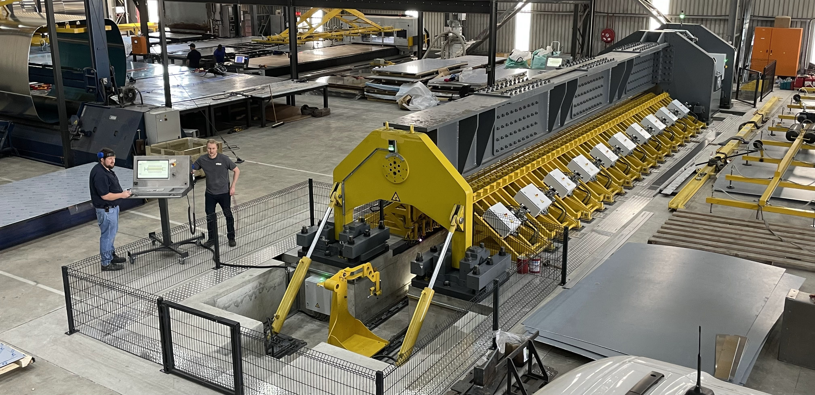
Where AI Fits
“We translate ideas into deployable engineering systems.”

Slide 22


Thank You

