Slide 1




INSTITUTE FOR SOCIAL AND HEALTH SCIENCES
PLANETARY WOMANHOOD: WOMEN, RITUAL, and WATER SPIRITS IN AFRIKAN COSMOLOGIES
Relebogile Rasodi
Black Planetary Studies
Notes:
Good afternoon/evening colleagues, my name is Relebogile Rasodi. I am a Postgraduate Assistant and doctoral student at the Institute for Social and Health Sciences and I will be presenting work from my doctoral studies titled Planetary Womanhood: Women, Ritual and water spirits in African cosmologies

Slide 2






MAIN AIM
To surface the multispecies relations by examining representations of rituals between black womanhood, water and water spirits
RESEARCH QUESTION
How do black women discursively and performatively engage in rituals involving water and water spirits?
Notes:
There is a dynamic relationship between people, nature, and the cosmos where each lives in relation and in co-constitution with the other (Ikeke, 2021). Anthropocene refers to the current planetary age where humans have placed themselves at the centre of all that exists on earth. Dealing with issues of the Anthropocene is complex, and there has been much criticism of the role of humans place regarding planetary concerns. By placing the human at the centre, there is the risk of justifying the oppression and marginalization of all other living and non-living elements in the environment. Human is not a neutral category; rather, it is a political term that signals the affordance of certain rights and privileges based on the embodiment of certain qualifying criteria (Braidotti, 2016). Therefore, despite anthropocentric perspectives being human-centric, the environmental/ecological benefits and risks/harm exposed to people across the globe are highly disproportionate, with people being afforded certain privileges and protections basded on spaces that they oocpy, while others are relegated to ruderal ecologies in zones of abandonment and suffer the consequences of climate change and environmental racism.
To disrupt anthropocentric perspectives, this work takes on a multispecies relations and Afro-ecofeminist framework. These focus on the relationships among all living and non-living beings, acknowledging that everything that makes up the planet exists in relation to everything else. In order to account for this, we acknowledge the relations between people, animals, the natural elements, and the cosmic bodies in the sky.
The multispecies relations, therefore, do not only exist in the form of physical interactions among the elements, but also represent the symbolic and spiritual connections between human and more-than-human elements. Additionally, these multispecies relations within African communities are often taught through the use of indigenous knowledge systems and are contained within African cosmologies.
My part of our story emerges along the rivers and the sea shores, beneath the reeds, and within the underwater worlds that bodies of water hold. All over the continent, river rituals are not uncommon practice, and these rituals have been subject to much public scrutiny. But bodies of water do a lot more than house the creatures of the land and the water, they also house cosmological and supernatural worlds that may not be visible to the uninitiated human eye. Much of the criticisms for water rituals lie in the belief that water bodies can pose great dangers, and there have been numerous reports of drownings related to spiritual rituals that have appeared in the news and on social media sites because many people have gone to conduct spiritual rituals with the belief that there are sacred waters that are inhabited by powerful water spirits. In turn, these waters have been sites of numerous drowning incidents, and much criticism and condemnation have been passed on those who sustain themselves by honouring the spirits that reside in the waters and engaging in seaside and riverside rituals.
These spiritual practices are ways of anchoring one's sense of self, of navigating identity, belonging, resilience, strength, and personal fortification. The use of Indigenous knowledge systems contained in African cosmologies here helps to create a space where we can engage with these concepts that have largely been informed by Eurocentric ideas about nature, identity, and ritual. The study emerges from the need to move towards de-anthropocentric and indigenous perspectives that foreground multispecies relations between nature and people.
The main aim is to surface the multispecies relations by examining representations of rituals between black womanhood, water and water spirits
Research question:
How do black women discursively and performatively engage in rituals involving water and water spirits ?

Slide 3



MULTISPECIES RELATIONS: TROUBLE IN THE ANTHROPOCENE
  Multispecies scholarship draws on work from the natural sciences and primarily explores relations between human and more-than-human species, examining how these entanglements come into being (Van Dooren, 2016). These forms of life do not emerge and survive in isolation but are intertwined in processes of co-constituting and co-creating the other. According to Van Dooren (2016), multispecies studies call us to pay more attention and attend to the attentiveness of multispecies ecologies and the interspecies relations that occur among all that exists within the cosmos.
  Planetary womanhood is an inquiry into black womanhood, multispecies relations, and African cosmologies to read the relationships of the feminine elements. This framework is grounded in feminist, decolonial, and de-anthropocentric scholarly traditions and proposes an alternative imagining of identity (re)construction with ecological perspectives. The concept of a planetary womanhood challenges Eurocentric scholarly traditions that privilege individualism, human exceptionalism, and universalized notions of womanhood.
  African diasporic and Afro-Caribbean scholars have long theorized such relationships as central to the survival of black life, cosmology, and modes of knowing, particularly in contexts shaped by enslavement, displacement, and plantation ecologies (Glissant, 1997; McKittrick, 2013).
Notes:
To hold the relationality of the human and more-than-human elements under study, the concept of a Planetary womanhood is offered as an attemot into the inquiry of black womanhood, multispecies relations, and African cosmologies to read the relationships of the feminine elements. This framework is grounded in feminist, decolonial, and de-anthropocentric scholarly traditions and proposes an alternative imagining of identity (re)construction with ecological perspectives. The concept of a planetary womanhood attemors challenges Eurocentric scholarly traditions that privilege individualism, human exceptionalism, and universalized notions of womanhood. Instead, it understands selfhood as co-constituted through relationships between humans, more-than-human beings, elements, ancestors, and place, with particular attention to the lived experiences of black women in African contexts (Collins, 2000; Fanon, 1967; Wynter, 2003; Tamale, 2020). Central to this framework are multispecies relationships between black women and the water bodieds are conceptualized as dynamic sites of entanglement and ecological meaning-making. These relationships include embodied, affective, spiritual, and material engagements with water bodies and their ecologies. Within this perspective, water is not viewed as an external environment, but rather as a living archive of memory, relation, and resistance.
The framework situates multispecies relationships within the enduring conditions of coloniality, racial capitalism, and environmental racism. Scholars of the African diaspora have demonstrated how colonial land regimes and extractive environmental practices continue to shape black relationships to land, water and ecological vulnerability (Sharpe, 2016; Tamale, 2020). Yet these same conditions also illuminate practices of ecological care, spiritual relation, and refusal that are enacted through everyday engagements with water and with nature. Multispecies relations, from this perspective, emerges through entanglement rather than residing solely within the individual. By foregrounding these histories, the framework resists ahistorical and depoliticized accounts of social and ecological life
Planetary consciousness operates within the framework as both an interpretive and ethical lens. Planetary consciousness is understood as an awareness of the interdependence across human and more-than-human life forged through histories of forced migration, oceanic crossings, and environmental loss (Canham & Seedat, 2025). the framework of planetary womanhood embraces forms of reimagining based on multispecies inquiry as a site of relational knowledge production, ecological care, and decolonial intervention.

Slide 4





METHODOLOGY
Research design: Embodied sensory ethnography
Participants: Women, Water, and Water Spirits
Data Collection: Observations of rituals involving women and water spirits
Theoretical framework:
Interspecies Relations, Afroeco-feminism
Data Analysis: Multimodal discourse analysis
Notes:
FOCUS ON CONCEPTUAL AND THEORETICAL FRAMEWORKS
An embodied sensory ethnography will be the qualitative research methodology used to conduct this research. According to Howes (2006), embodied sensory ethnography requires the researcher to immerse themselves in their environment; therefore, the researchers' observations of how women’s participation in water rituals and representations of water deities in African cosmologies will make up the data for the study.
Therefore, the data collection for this study will comprise of observations of how water rituals and water spirits are represented through visual mediums such as semi-structured interviews, photographs and videos. This will also include mythology, literary texts and artistic exhibitions.
A multi-modal discourse analysis will be used to analyse the visual data (photographs, videos and field notes) and this method of analysis will allow for the use of multiple discursive components to explore how women and water come together in rituals to co-produce an interspecies reading of black womanhood.
To hold the relationality of the human and more-than-human elements under study, I propose a conceptual framework for a multispecies reading of planetary womanhood. Planetary womanhood is an inquiry into black womanhood, multispecies relations, and African cosmologies to read the relationships of the feminine elements. This framework is grounded in feminist, decolonial, and de-anthropocentric scholarly traditions and proposes an alternative imagining of identity (re)construction with ecological perspectives. The concept of a planetary womanhood challenges Eurocentric scholarly traditions that privilege individualism, human exceptionalism, and universalized notions of womanhood. Instead, it understands selfhood as co-constituted through relationships between humans, more-than-human beings, elements, ancestors, and place, with particular attention to the lived experiences of black women in African contexts (Collins, 2000; Fanon, 1967; Wynter, 2003; Tamale, 2020). Central to this framework are multispecies relationships between black women and the broader natural world, conceptualized as dynamic sites of entanglement and ecological meaning-making. These relationships include embodied, affective, spiritual, and material engagements with land, water, plants, animals, and ancestral ecologies. African diasporic and Afro-Caribbean scholars have long theorized such relationships as central to the survival of black life, cosmology, and modes of knowing, particularly in contexts shaped by enslavement, displacement, and plantation ecologies (Glissant, 1997; McKittrick, 2013). Within this perspective, nature is not viewed as an external environment, but rather as a living archive of memory, relation, and resistance.
The framework situates multispecies relationships within the enduring conditions of coloniality, racial capitalism, and environmental racism. Scholars of the African diaspora have demonstrated how colonial land regimes and extractive environmental practices continue to shape black relationships to land and ecological vulnerability (Sharpe, 2016; Tamale, 2020). Yet these same conditions also illuminate practices of ecological care, spiritual relation, and refusal that are enacted through everyday engagements with nature. Multispecies relations, from this perspective, emerges through entanglement rather than residing solely within the individual. By foregrounding these histories, the framework resists ahistorical and depoliticized accounts of social and ecological life .
Planetary consciousness operates within the framework as both an interpretive and ethical lens. Planetary consciousness is understood as an awareness of the interdependence across human and more-than-human life forged through histories of forced migration, oceanic crossings, and environmental loss (Canham & Seedat, 2025).
Overall, this conceptual framework provides a coherent foundation for examining multispecies relations among black women in ways that are ethically grounded, theoretically rigorous, and methodologically aligned with feminist, decolonial, and de-anthropocentric academic inquiries. By centering African diasporic and Afro-Caribbean ecological thought alongside black feminist and planetary perspectives, the framework of planetary womanhood embraces forms of reimagining based on multispecies inquiry as a site of relational knowledge production, ecological care, and decolonial intervention.
Afro-ecofeminism: Intimate Relations on the Mother Land
To extend this understanding of relations between women and ecology, Sylvia Tamale (2020) has offered the theory of Afro-ecofeminism to merge these worlds/concepts and address issues of environmental degradation and climate justice that have disproportionate consequences for African women. For this reason, this study adopts an Afro-ecofeminist framework to study the multispecies relations between women as the human, and water, plant life, and the moon as the more-than-human.
Because of its location on the African continent, a significant element of Afro-ecofeminism is the call to engage with and preserve indigenous knowledge systems as part of the traditions and practices embedded in African communal ways of living in/with nature. Through this work, Bokaba and Coester (2025) explore the importance of uMakhulu in aiding strategies for climate change and justice in African (rural) communities and suggest that Afro-ecofeminism has been significant in contributing to the revival of silenced epistemes. Bokaba and Coester (2025) write about uMakhulu, grandmothers or older women in the community, as epistemic agents who drive change. As grandmothers, these women hold indigenous knowledge that they transmit to younger generations and exercise authority in community governance. These women are “institutions of knowledge and wisdom”, and Bokaba and Coester (2025, p. 499) suggest that their voices are integral in conversations about climate change. oMakhulu advocate for respectful relationships between people and nature, where animals are handled gently and tended to with kindness. They assume the roles of agriculturists who understand the seasons for crop management, planting, and harvesting. They gain the awareness to read weather patterns, make predictions, and concoct plant medicine for health and protection (Bokaba & Coester, 2025 ).
Feminist scholars have suggested that a multispecies orientation should be applied when considering intersectionality (Bull, 2016). A feminist approach allows us to apply an intersectional lens and enables us to ask questions like what the human and the more-than-human are, how they are conceptualized, and what relations they have with each other.
A focus on multispecies relations encourages the view that society should be looked at in a holistic manner that encompasses the relationship between the self, nature, and society. When we think of community, it should not only focus on the lives and experiences of people but also on how they live alongside the natural environment and the ways in which the more-than-human asserts itself as an agentic member (Le Grange, 2012). Furthermore, it is important to note that the adoption of a multispecies lens does not stop at what is tangible and lies on the earth but also extends to the cosmic bodies among the sun and the stars in the sky and beneath the flows of the rivers and the sea.
I also adopt Tamale’s (2020) Afro-ecofeminism framework for understanding multispecies relations to space. Tamale (2020) calls for embracing of “indigenous knowledge systems that see all the elements of the world as interconnected in a web-like fashion”. The Afro-ecofeminist lens allows us to see how the symbiotic, multispecies relationship between women, water and water deities demonstrates how nature informs constructions of social identity.

Slide 5






AFRO-ECOFEMINISM: INTIMATE RELATIONS ON THE MOTHER LAND
Afro-ecofeminism framework for understanding multispecies relations to space. Tamale (2020) calls for embracing of “indigenous knowledge systems that see all the elements of the world as interconnected in a web-like fashion”.The Afro-ecofeminist lens allows us to see how the symbiotic, multispecies relationship between women, water and water deities demonstrates how nature informs constructions of social identity.
Bokaba and Coester (2025) explore the importance of uMakhulu in aiding strategies for climate change and justice in African (rural) communities and suggest that Afro-ecofeminism has been significant in contributing to the revival of silenced epistemes. Bokaba and Coester (2025) write about uMakhulu, grandmothers or older women in the community, as epistemic agents who drive change. As grandmothers, these women hold indigenous knowledge that they transmit to younger generations and exercise authority in community governance. These women are “institutions of knowledge and wisdom”, and Bokaba and Coester (2025, p. 499) suggest that their voices are integral in conversations about climate change.
Feminist scholars have suggested that a multispecies orientation should be applied when considering intersectionality (Bull, 2016). A feminist approach allows us to apply an intersectional lens and enables us to ask questions like what the human and the more-than-human are, how they are conceptualized, and what relations they have with each other.
Notes:
To extend this understanding of relations between women and ecology, Sylvia Tamale (2020) has offered the theory of Afro-ecofeminism to merge these worlds/concepts and address issues of environmental degradation and climate justice that have disproportionate consequences for African women.
Because of its location on the African continent, a significant element of Afro-ecofeminism is the call to engage with and preserve indigenous knowledge systems as part of the traditions and practices embedded in African communal ways of living in/with nature.
Bokaba and Coester (2025) have done work explore the importance of uMakhulu in aiding strategies for climate change and justice in African (rural) communities and suggest that Afro-ecofeminism has been significant in contributing to the revival of silenced epistemes. Bokaba and Coester (2025) write about uMakhulu, grandmothers or older women in the community, as epistemic agents who drive change. As grandmothers, these women hold indigenous knowledge that they transmit to younger generations and exercise authority in community governance. These women are “institutions of knowledge and wisdom”, and Bokaba and Coester (2025, p. 499) suggest that their voices are integral in conversations about climate change. oMakhulu advocate for respectful relationships between people and nature. They assume the roles of agriculturists who understand the seasons for crop management, planting, and harvesting. They gain the awareness to read weather patterns, make predictions, and concoct plant medicine for health and protection (Bokaba & Coester, 2025 ).
Feminist scholars have suggested that a multispecies orientation should be applied when considering intersectionality (Bull, 2016). A feminist approach allows us to apply an intersectional lens and enables us to ask questions like what the human and the more-than-human are, how they are conceptualized, and what relations they have with each other.

Slide 6



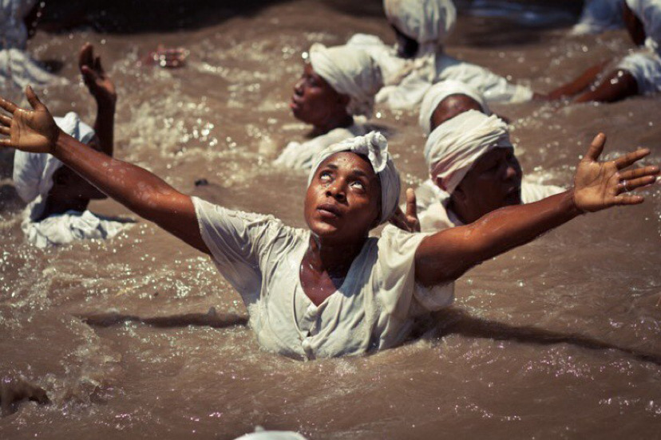
WOMEN AND WATER
  Across the African continent, it is women who assume the roles of guardians of the land since farming is often dependent on them. The destruction of land and water bodies (through deforestation and pollution) results in emotional/spiritual turmoil, and the loss of resources and status for these African women (Hunt, 2014; Njwambe et al., 2019; Raimi et al., 2019).
  Water and plant life are often used as medicine or tools for divination in rituals for women's healing and wellness, thus emphasizing the collaboration and connection between women and nature (Wepener & Müller, 2012; Mohulatsi, 2023).
  Rituals may be performed for life events such as marriage, birth, and death, and can serve as acts of ancestral and spiritual veneration, connecting the realms of the living and the dead (Naidu & Nqila, 2013).
Notes:
Across the African continent, it is women who assume the roles of guardians of the land since farming is often dependent on them. The destruction of land and water bodies (through deforestation and pollution) results in emotional/spiritual turmoil, and the loss of resources and status for these African women (Hunt, 2014; Njwambe et al., 2019; Raimi et al., 2019). Overall, the Afro-ecofeminist lens allows us to theorize how people and nature rely on each other for their co-creation.
Ecofeminist scholarship embraces the turn to studying ecological environments through the multispecies lens that reads the sentience and voice of more-than-human actors in the environment. The impacts of oppressive systems that take advantage of land and water and position these elements as subordinate to humans is confronted through acknowledging the agency of elemental bodies and their contributions to multispecies ecologies and practices in the black outdoors.
Water and plant life are often used as medicine or tools for divination in rituals for women's healing and wellness, thus emphasizing the collaboration and connection between women and nature (Wepener & Müller, 2012; Mohulatsi, 2023).
According to Kylo (2013), African cosmologies have emphasised the importance of ritual for socialization, spirituality, communication, and social cohesion. Older generations use rituals to transfer indigenous knowledge, and younger generations are able to learn about their cultural and spiritual practices and form their identities through participation in rituals (Motsei, 2023). Rituals may be performed for life events such as marriage, birth, and death, and can serve as acts of ancestral and spiritual veneration, connecting the realms of the living and the dead (Naidu & Nqila, 2013). Rituals are evident both in performative and ceremonial acts as well as in abstract and artistic representations. They occur as communal events or private, individual acts. These are done with the intention to aid and facilitate processes of transition or healing. However, rituals may also be harmful with the intention to cause suffering and destruction.

Slide 7


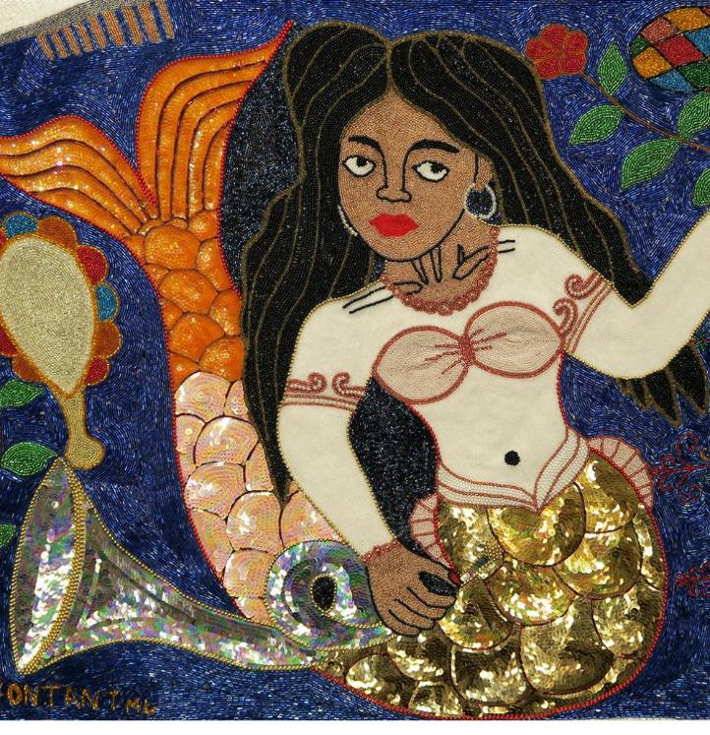
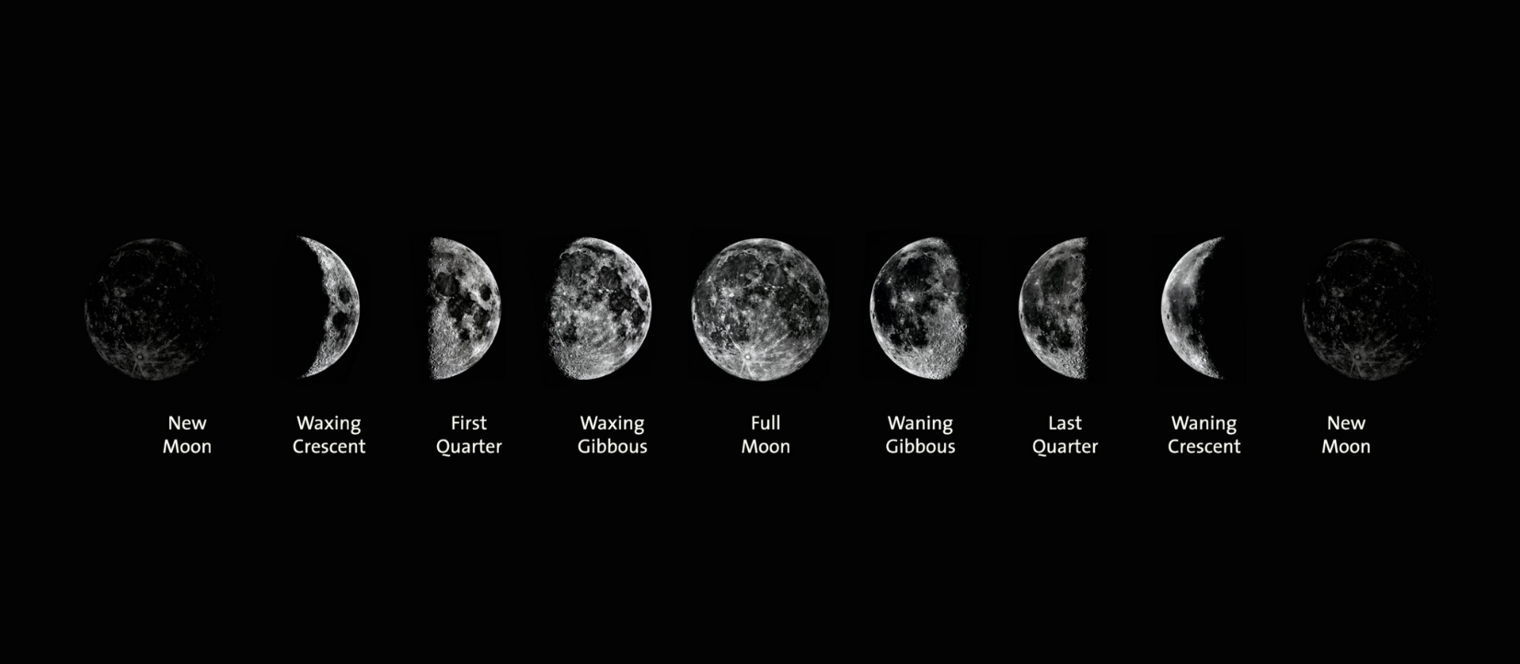

NATURES GAURDIANS: PART FLESH, PART FISH
  Across the African continent, various spiritual and cultural rituals and ceremonies are performed using water and the sea, rivers, and wetlands are considered places where spiritual entities reside (Bernard, 2003).
  Scholars have reported on spiritual deities from South Africa, Zimbabwe, Zambia, Uganda, Sudan, Nigeria (Morcom, 1966; Hagan, 1978; Oestigaard, 2015; Joseph, 2021).
  Mermaids are believed to have different abilities, some being able to sing like sirens and others being mute, and some having the power to influence nature and weather patterns. Some are constructed as man-eaters, posing a bestial, untamed and raging with powers of seduction, defying the norms of traditional femininity (Robertson, 2013)
Notes:
Venturing into the water realms opens up new possibilities of being in the world that do not ascribe to the capitalist, anthropocentric, binary perspectives on living/being. Within the context of spirituality, bodies of water are liminal spaces that present underwater worlds within which the more-than-human and even ‘supernatural’ creatures reside. It is also from these bodies of water where they emerge from the underwater worlds to exist in relation to the human and more-than-human life on land. Theorising about the water and the more-than-human life that inhabits these bodies enables us to engage with indigenous knowledges and practices that have been marginalized as non-sensical, fictional frameworks that emerged from cultures and societies that were considered barbaric and unintelligent. Thinking with underwater worlds allows us to think of and re-imagine the possibilities of alternative worlds and futures which may be found under the water and the various forms of life that emerge from its currents (Canham, 2023). The water is a place of worlds unknown to emerge and it is also seen as an archive, a space possessing its own knowledge with the phrase, ulwazi uvela olwandle, translating to knowledge comes from the sea and holds memory, history, and identity (Quigley, 2023). Bodies of water then become habitats for the more-than-human creatures, supernatural beings, a tool for healing and divination, and a space for the production and transmission of indigenous knowledge. These alternative worlds challenge anthropocentric, binary ideas of life and surface the multispecies relations that exist between the human experience, the natural world, and the supernatural realms.
People use water to pray and leave offerings to the water as a sign of respect or appreciation. Water deities are complex entities who hold the potential for exerting either benevolent action by transferring gifts, protection and power or malevolent actions like causing distress and even death to those who are impure or have disrespected the spirits. Water bodies are also considered to house spiritual and ancestral guides who call those who are gifted to be initiated to assume the roles of healers, herbalists, or diviners. On one hand, the spiritual entities living in water can cause distress and destruction to those who may be seen as impure or have disrespected the water and the spirits. On the other hand, the keepers of these waters can also provide protection and transfer power and gifts to those who have been called to the water.
Those who have been called by the water spirits to become healers are called to ‘living waters’ such as the sea, rivers, and wetlands because the more turbulent bodies of water are considered to have more power. These are considered ‘living waters’ and the strength of the current indicates the presence of spirit. The initiates are called by the spirits to become submerged in the water or live in the water for hours or even days while they receive ancestral and spiritual guidance on how to channel their divine gifts.

Slide 8
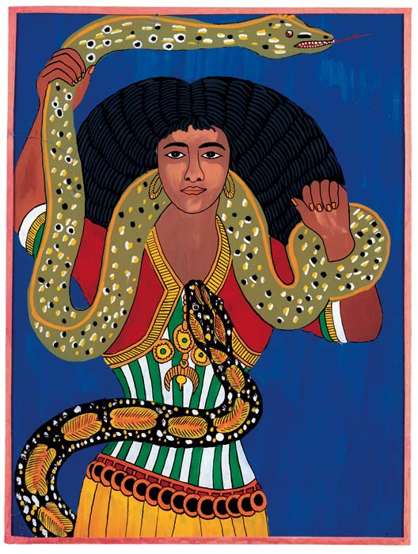
ZOUMANA SANE
Notes:
One way of illustrating how this concept of planetary womanhood comes into effect is through an exploration of how water spirits and goddesses are constructed in African cosmologies.
Water spirits may also manifest in different forms, depending on the cultural context from which they emerge
The first figure that we have here is Mami wata, which translates to Mother Water, is an example of a water spirit who represents a pantheon of water spirits in Africa and the diaspora.
She is often depicted as a mermaid, or a snake or a mermaid with a snake wrapped around her body. She stands to symbolise aspects of fertility, femininity and healing but she is also more popularly known for representing the unpredictable forces of nature, having the potential to cause death and destruction and also using her powers of seduction lure people in for her desires.

Slide 9
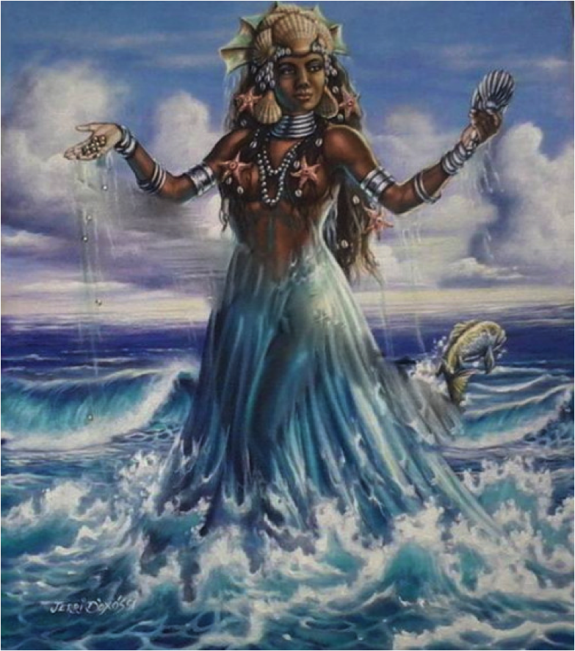
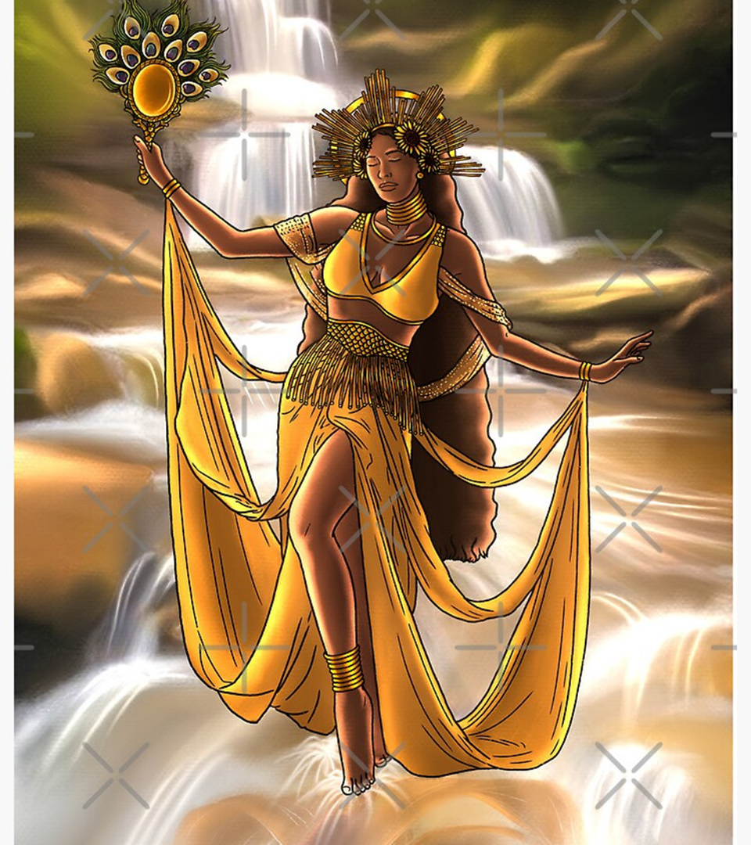
Notes:
In Yoruba spirituality, the water goddesses amongst the Orisha (deities) of the ocean and the rivers, Yemeya and Oshun, are presented as human-like figures with supernatural abilities to offer protection, blessings, and aid in fertility (Hagan,1978).
Yemaya is the guiding spirit who rules over the oceans but she is also associated with the full moon and aids with issues related to motherhood, fertility, and femininity. She is known as the quintessential mother figure, shone emerges from the waters to aid and protect women and children on earth.
Oshun, on the other had is the goddess of the Osun River in Nigeria and is often associated with freshwater and rivers and helps with issues related love, beauty, sexuality, fertility, and wealth

Slide 10
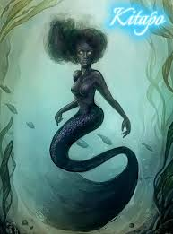
Notes:
Kitapo, the wife of the Zambezi Snake Spirit, Nyami Nyami.
Nyami Nyami is often portrayed as a dragon-like creature with the head of a fish and the body of a snake. Their primary role is to protect the zambezi river and a Nyami nyai talisman can bring one good luck, but when the creature is angered, elders and spirit mediums intervene to appeal to the spirit. Nyami Nyami controls the life in and around the Zambezi river.
Legend has it that the construction of the Kariba dam forcibly separated Nyami Nyami from his wife, Kitapo, the goddess of the underworld and deeply angered him, resulting in the floods and death before Nyami Nyami disappeared completely.
Kitapo is often represented as a mermaid who demands offerings from those who approach the riverbank. She is also known to take those who are impure as human sacrifices. A threat to some and a hero to others, she is also known to rescue children

Slide 11
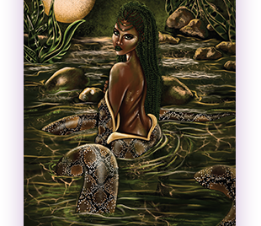
Notes:
Mamlambo
The people of Cape Nguni descent, Abantu BoMlambo are people of the river who believe in Mamlambo, a river goddess who also manifests as a snake or mermaid. She is said to reside in the Mzintlava River and even the Coffee Bay area in SA. According to Joseph (2021), Mamlambo is a shapeshifter who transforms from appearing as a small fish, a twig, a snake and then a woman. She is known to bring material wealth and abundance for those who honour her and captures those who dishonour her. She most known as a mosterous deity and is also referred to as the brain sucker as she supposedly eats the brains or heads of her victims who are also said to be primarily male.

Slide 12
I’ll tell you about the mermaid
Sheds swimmable tail Gets legs for dancing Sings like the sea with a choked throat
Knives straight up her spine
Lancing every step
There is a price
There is a price
For every gift
And all advice
—Adrienne Rich,
“Quarto”
THANK YOU!
Notes:
Each of these spirits/goddesses embodies a feminine physique and persona and are known to provide particular kinds of aid to women through ritual. Spiritual cleansings, offerings to the water, and ceremonies involving music and dance are conducted as part of these rituals.
The belief in mermaids and water spirits/deities, therefore, can inform the cultural and cosmological recognition of the sacredness of the environment and more-than-human elements that can be used to advocate for the preservation of certain bodies of water and ritual practices.
What I have presented here are snapshots of how the calling upon the use of feminine spirits and goddesses in African cosmologies can be used to imagine an interspecies womanhood, acknowledging the connections between the human worlds, natural worlds and supernatural worlds as collaborators in their joint survival.
.

